Slide 1
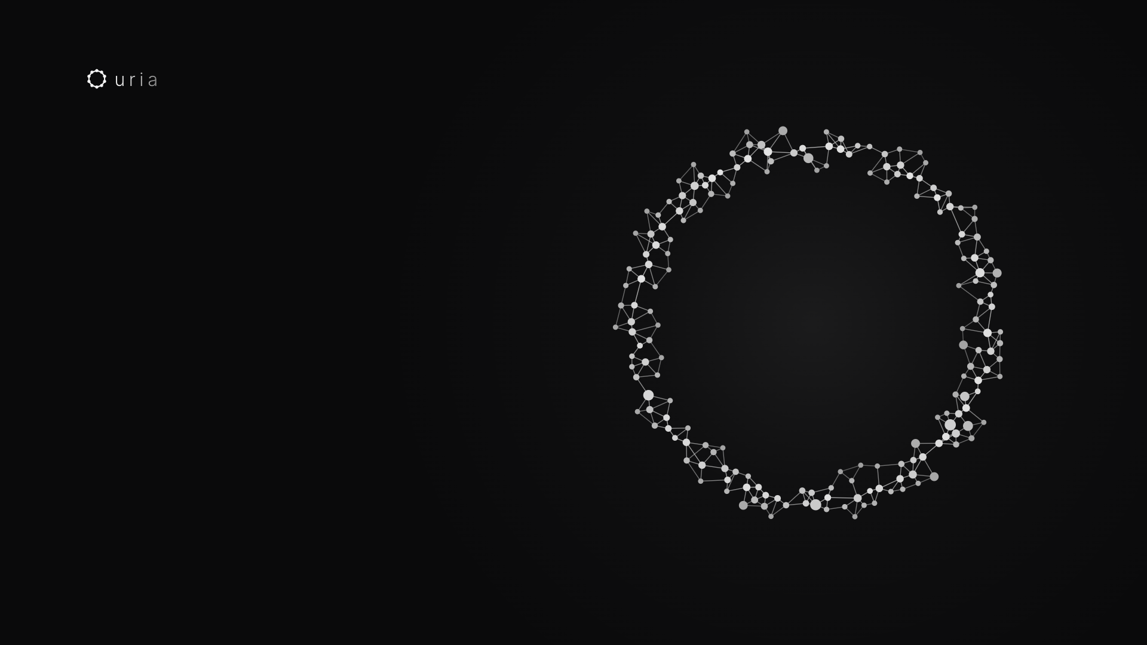
AI SUPERBRAIN INTENSIVE · DAY 1
Own the map
of your business.
GABRIEL JUDAH AND MARC CHAN · 20 OCTOBER 2026 · SINGAPORE
Notes:
Welcome everyone. Two days, one goal: you leave owning the map of your business.
I'm Gabriel, this is Marc. We teach together.

Slide 2
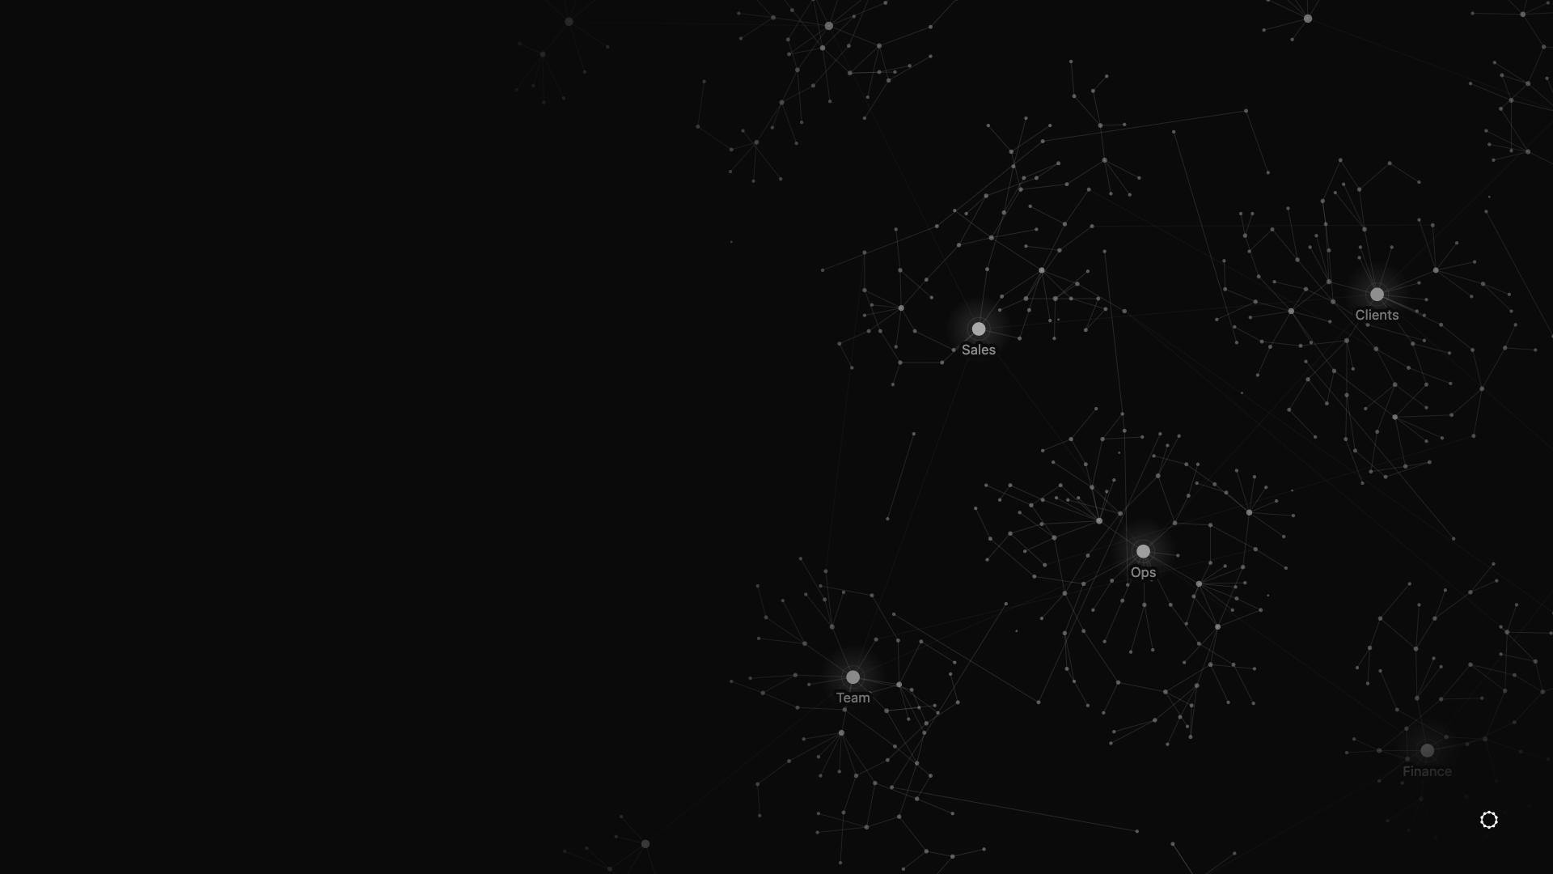
01
The map.
Why you should own your AI, not rent it.
02
Notes:
First, the why. Before any setup, I want you to see who we are up against, and what you are building today.

Slide 3
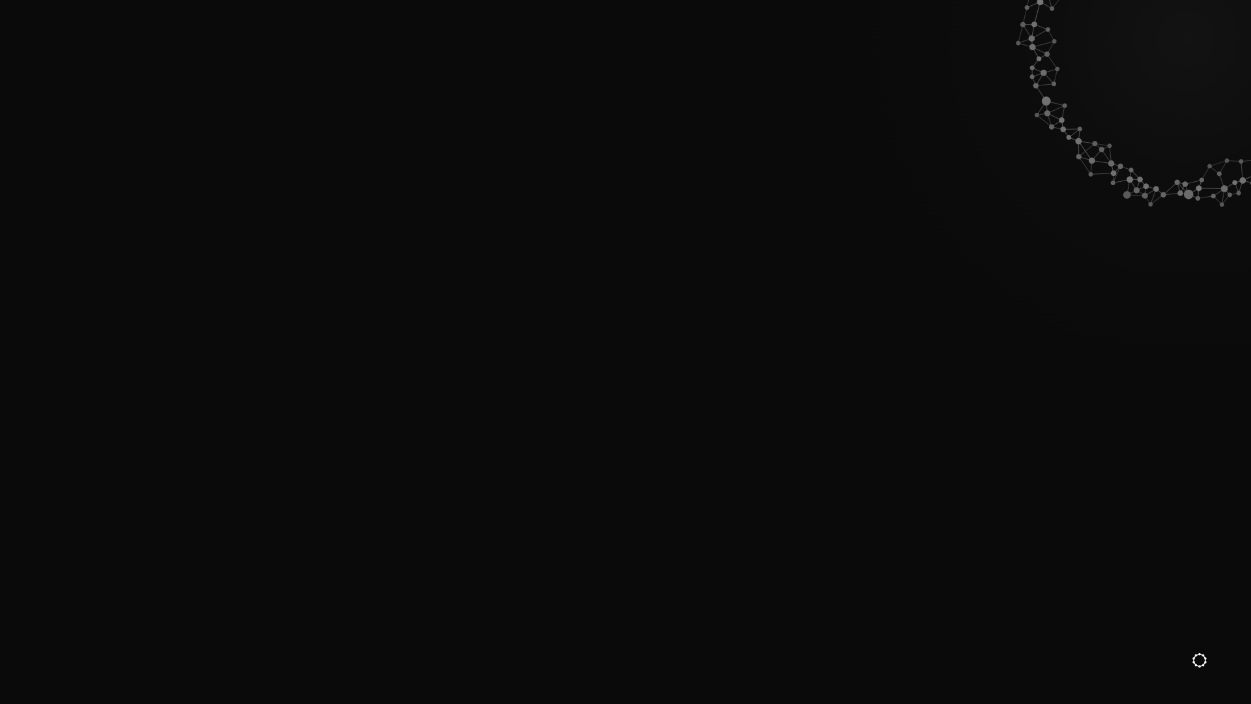
Big AI companies
rent you tools.
Nobody gives you the map.
THE ENEMY
03
Notes:
Every month there is a new AI app. You pay for it. It solves one small task.
But nobody writes down how your business really works. That map stays in your head, and in WhatsApp threads.

Slide 4

TWO KINDS OF BUSINESS OWNER
Renter or owner?
THE RENTER
THE OWNER
Pays monthly, forever
Stuck with one company's AI
Know-how lives in their app
Leaves, and starts from zero
Owns the brain folder
Swaps in any AI
Know-how in plain files you keep
Gets smarter every week
04
Notes:
Think of renting a flat versus owning a home. Renters pay forever and keep nothing.
Owners build something that grows in value. Today, you become the owner.

Slide 5

WHY TODAY
Create your map now.
Not next quarter. In this room, today.
05
Notes:
The people who build their map now will be far ahead of the ones who wait.
That is exactly what we are doing in this room today.

Slide 6
BY THE END OF TODAY
What you walk out with.
Your brain
Your chief of staff
CLOSE, run once
Two jobs done
your business, in one folder
Hermes, your first AI employee
Capture, Link, Organise, Signal, Execute
real work, off your plate
06
Notes:
By six tonight, you hold four things. One: your brain. Everything about your business, in one folder on your own computer.

Slide 7
BY THE END OF TODAY
What you walk out with.
Your brain
Your chief of staff
CLOSE, run once
Two jobs done
your business, in one folder
Hermes, your first AI employee
Capture, Link, Organise, Signal, Execute
real work, off your plate
07
Notes:
Two: your chief of staff. Hermes. An AI employee that is always on, and that you talk to on Telegram.

Slide 8
BY THE END OF TODAY
What you walk out with.
Your brain
Your chief of staff
CLOSE, run once
Two jobs done
your business, in one folder
Hermes, your first AI employee
Capture, Link, Organise, Signal, Execute
real work, off your plate
08
Notes:
Three: the CLOSE loop, run once by hand. Capture, Link, Organise, Signal, Execute. This is what makes the brain smarter every week.

Slide 9
BY THE END OF TODAY
What you walk out with.
Your brain
Your chief of staff
CLOSE, run once
Two jobs done
your business, in one folder
Hermes, your first AI employee
Capture, Link, Organise, Signal, Execute
real work, off your plate
09
Notes:
Four: two real jobs done. Not a demo. Work you would have done yourself this week.

Slide 10
MODEL-AGNOSTIC: WORKS WITH ANY AI
The engine changes.
You keep the car.
The AI model is the engine. Your brain, rules and skills are the car.
10
Notes:
Imagine a car. The engine is the AI model: Claude, GPT, Gemini. You rent the engine.
But the best engine in the world is useless without the car. The car is your brain, your AI employees, your skills. You own that.
When a new engine comes in, you swap the engine, you keep the car.

Slide 11



YOUR BRAIN STAYS YOURS
Swap in the best one each month.
Claude
OpenAI
Google Gemini
Every month we check which model is best, and swap it in.
11
Notes:
We are not married to any AI company. Each month we look at which model is best, and we swap it in.
Your brain does not move. Nothing is lost. Only the engine changes.

Slide 12
Today you build
your map.
LET'S BEGIN
12
Notes:
So that is the why. Now let's build it, starting with where your brain lives.

Slide 13
02
Two devices,
one brain.
Why your agent never sleeps.
13
Notes:
Now, where does all of this live? Two devices, sharing one brain. Let me draw it one piece at a time.

Slide 14

TWO DEVICES, ONE BRAIN
Start with your laptop.
Your laptop
Claude Code · Obsidian · Hermes app
14
Notes:
Your main device. The one with a screen, where you work.
Claude Code is your mechanic. Obsidian shows you the brain. The Hermes app is where you chat with your agent.
But when you close the lid, your agent stops.

Slide 15

TWO DEVICES, ONE BRAIN
Add a rented server.
Your laptop
Rented server
Claude Code · Obsidian · Hermes app
Always on · Hermes lives here · jobs run at night
15
Notes:
So we add a second device: a rented server, also called a VPS (a computer you rent in a data centre).
It has no screen, so we call it a headless box. It is always on. Hermes lives here, and jobs run here at night while you sleep.
We use Hostinger. Simple and affordable.

Slide 16
TWO DEVICES, ONE BRAIN
Connect them with SSH.
Your laptop
Rented server
SSH key
Claude Code · Obsidian · Hermes app
Always on · Hermes lives here · jobs run at night
16
Notes:
SSH is a private key, like a house key.
With it, Claude Code on your laptop can walk into your server, set things up, fix things, and come back.
Why it matters: you never open a black terminal screen yourself. You just tell Claude Code what you want.

Slide 17

TWO DEVICES, ONE BRAIN
Mirror the brain folder.
Your laptop
Rented server
SSH key
Claude Code · Obsidian · Hermes app
Always on · Hermes lives here · jobs run at night
The mirror
Syncthing: same brain folder on both
17
Notes:
Syncthing is free. It keeps the same brain folder on both devices, and it works both ways.
You add a note on your laptop, Hermes sees it on the server a few seconds later. Hermes writes something, it appears on your laptop.

Slide 18

TWO DEVICES, ONE BRAIN
Talk to it from your phone.
Your laptop
Rented server
Your phone
SSH key
Telegram
Claude Code · Obsidian · Hermes app
Always on · Hermes lives here · jobs run at night
Telegram talks to Hermes
The mirror
Syncthing: same brain folder on both
18
Notes:
Last piece: your phone. You text Hermes on Telegram, wherever you are.
Telegram goes to Hermes on the server. On your laptop, you use the Hermes desktop app.
Two devices, one brain.

Slide 19

GOT A MAC MINI?
Same picture. Today, use the server.
Your laptop
Mac mini at home
Your phone
SSH key
Telegram
Claude Code · Obsidian · Hermes app
A headless box: no screen, always on
Telegram talks to Hermes
The mirror
Syncthing: same brain folder on both
MOVING FROM THE SERVER TO A MAC MINI LATER IS EASY: YOUR AGENT DOES IT FOR YOU.
19
Notes:
If you own a Mac mini, it can be your box instead. Same picture, it just sits in your office.
But today, everyone follows on the rented server. Don't wait for a Mac mini and lose momentum.
Later, you just tell your agent to move everything across.

Slide 20
Your agent works while
your laptop is closed.
WHY TWO DEVICES
20
Notes:
That is the whole reason. The server never sleeps.
So your agent keeps working at night, even when your laptop is off.

Slide 21
03
Your brain folder
One folder, eight doors. Installed with one sentence.
21
Notes:
Short block. We download one file, type one sentence, and see the eight doors.
The brain folder is the map of your business. You own it, it lives on your machine, not inside a big AI company.

Slide 22
One folder.
Eight doors.
YOUR SECOND BRAIN
22
Notes:
Think of a house with eight doors. Every note you ever keep walks through one of them.
Your agent reads this folder every time it works for you.

Slide 23
DOORS 01 TO 05
Where your work goes
01. Inbox
02. Projects
03. Areas
04. Resources
New stuff lands here
Has a finish line
Never ends
Other people's material
05. Archives
06. Signals
07. World Model
08. Sources
Done, never deleted
What keeps coming up
The truth about you
Where it came from
23
Notes:
Inbox: everything you capture lands here first.
Projects have an end, like launching an event. Areas never end, like marketing or sales, family or health.
Resources are other people's material: articles, videos. Archives are retired, but never deleted.

Slide 24
DOORS 06 TO 08
Where your brain thinks
01. Inbox
02. Projects
03. Areas
04. Resources
New stuff lands here
Has a finish line
Never ends
Other people's material
05. Archives
06. Signals
07. World Model
08. Sources
Done, never deleted
What keeps coming up
The truth about you
Where it came from
24
Notes:
Signals: what keeps coming up across your notes, counted.
World Model: the lasting truth about you, your company, your people, your decisions.
Sources: where it all came from, so you can trace back.
You never file into these by hand. The bots do it later today.

Slide 25
INSTALL IT
Three moves
Drag the pack
Type one sentence
See the doors
brain-installer.md into your brain folder
New session in Hermes
Open your brain folder
25
Notes:
Download brain-installer.md. Drag it into your brain folder. You never need to read it: it is the recipe Hermes follows.

Slide 26
IN HERMES, CLICK NEW SESSION
Then type one sentence
“Read brain-installer.md in my brain folder and build my brain.”
TYPE THIS TO HERMES
26
Notes:
Click Sessions, then New session. Not Bots.
Member sentence: "Read brain-installer.md in my brain folder and build my brain."
If it stops halfway: "Finish building the eight doors from the brain installer."

Slide 27
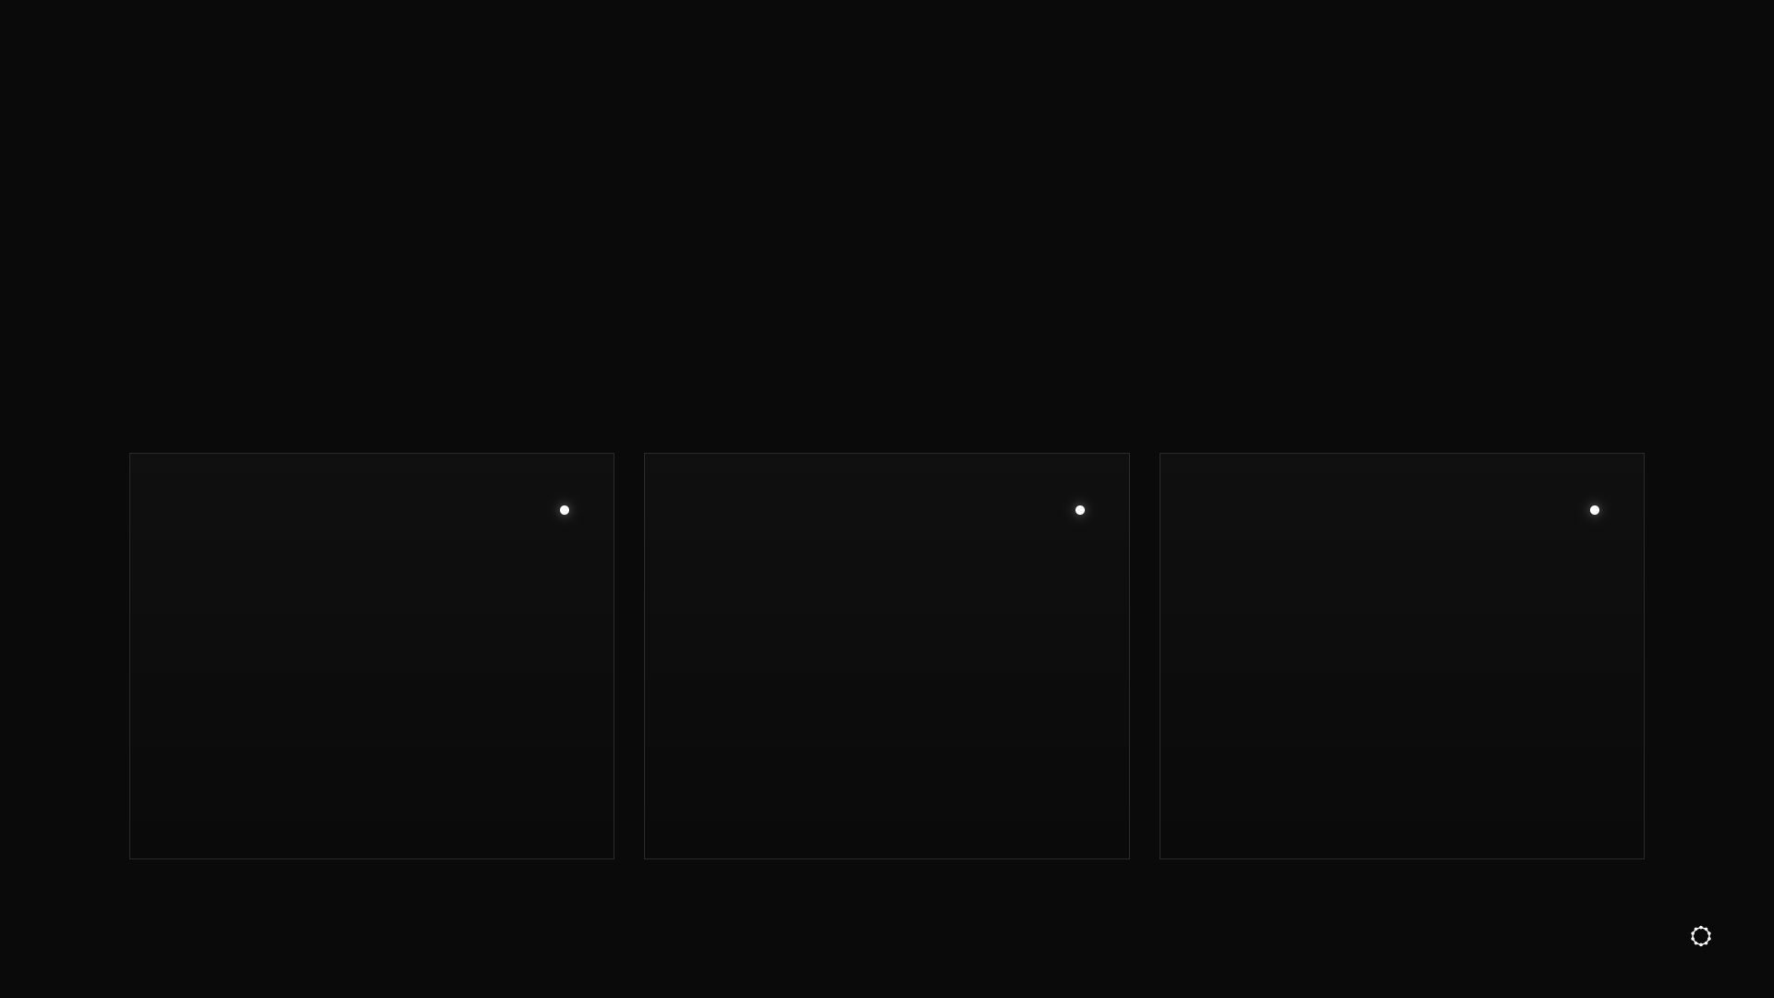
HERMES ASKS YOU FIRST
Three quick questions
1
2
3
Your name
Your business
Your goal
What should your agents call you? First name is fine.
In one sentence, what does it do, and for whom?
The one thing you most want done in the next three months.
27
Notes:
Answer each one. This is how your agent starts to know you.
Like a new hire: the model is smart from day one, but it feels personal only over time.

Slide 28
INSTALL IT
Three moves
Drag the pack
Type one sentence
See the doors
brain-installer.md into your brain folder
New session in Hermes
Open your brain folder
28
Notes:
When Hermes says your brain is built, open your brain folder on your laptop.

Slide 29
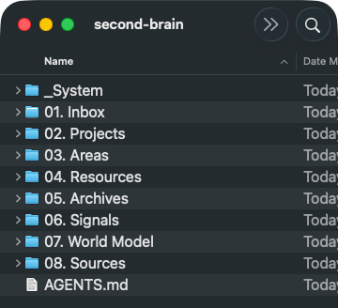
Your eight doors
EIGHT DOORS, A SYSTEM FOLDER, AND AGENTS.MD: THE RULE BOOK FOR YOUR AGENTS
29
Notes:
You should see this: the eight doors, a _System folder (the wiring, for your agent) and AGENTS.md, the rule book your agent reads every time it walks in.
If you see it on your laptop, the mirror works: your agent built it on the server and it showed up here.
Gabriel to confirm: the mirror between laptop and server is set up in block 02, so it is not repeated here.

Slide 30
04
Capture
Send one link. One note lands in your brain.
30
Notes:
Short block. Capture is the first step of the loop. We capture one article or one video, and watch it land.
The big pour of old notes and chats comes after lunch, in Fill your brain.

Slide 31
Saved. Never opened again.
THE SAVE BUTTON
31
Notes:
You see a great post, you tap save, you never go back.
Now you throw it to your agent instead, and it becomes part of your brain.

Slide 32
WHAT CAPTURE MEANS
Keep the source whole
SAVED IN AN APP
CAPTURED
Lost in a feed
Your agent cannot read it
Gone if the post goes
One note in 01. Inbox
The whole source, kept
A line saying where it came from
32
Notes:
Capture keeps it whole: one thing you send, one note in your Inbox, titled by what it is.
No summary that loses the detail. The bots link and file it later.

Slide 33
FROM YOUR PHONE
Three steps
Copy the link
Send it on Telegram
See the note land
Tap Share, then Copy link
To your Hermes
In 01. Inbox
33
Notes:
Why Telegram: you read and watch most things on your phone. So capture from your phone.
Any article, or any video: Instagram, YouTube, X.

Slide 34
ON TELEGRAM, TO YOUR HERMES
Paste the link, then type
“Capture this: [the link or the idea].”
TYPE THIS TO HERMES
34
Notes:
Member sentence: "Capture this: [the link or the idea]."
For a video: "Capture this: [the video link]."
If it says it cannot, push back: don't make a problem my problem, find a way.

Slide 35
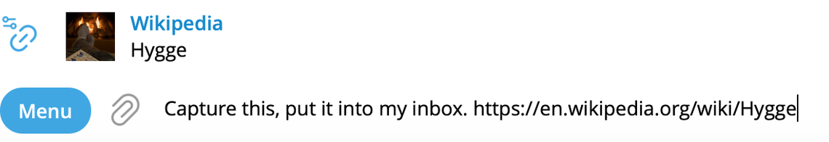
One link, two words
A REAL CAPTURE: A PUBLIC ARTICLE LINK
35
Notes:
Here is a real one: a Wikipedia article on hygge, with capture this.
Gabriel to confirm: this screenshot uses slightly longer words than the member sentence; fine as a real example.

Slide 36
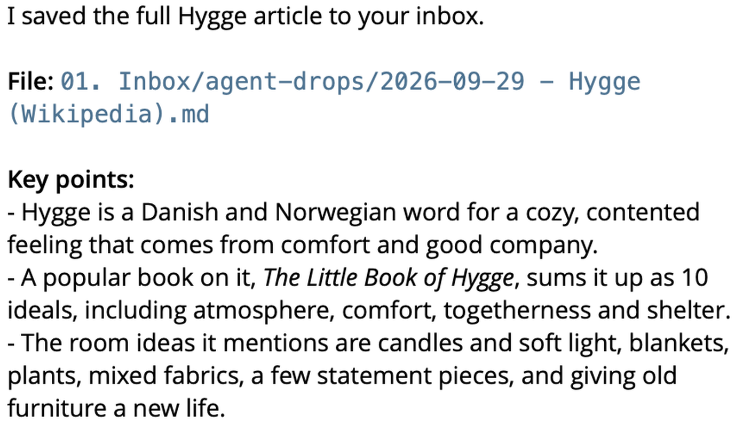
Hermes tells you where it went
THE WHOLE ARTICLE, SAVED AS ONE NOTE
36
Notes:
Hermes replies with the note's name and where it went: 01. Inbox, agent-drops.
And a few key points so you know it read it.

Slide 37
FROM YOUR PHONE
Three steps
Copy the link
Send it on Telegram
See the note land
Tap Share, then Copy link
To your Hermes
In 01. Inbox
37
Notes:
Now open your brain folder on your laptop.

Slide 38
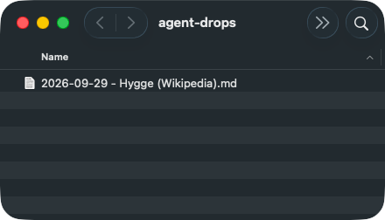
It landed in your Inbox
01. INBOX, AGENT-DROPS: ONE WHOLE NOTE PER SOURCE
38
Notes:
There it is, in your Inbox. One source, one note.
That is Capture. After lunch we pour in everything else.

Slide 39
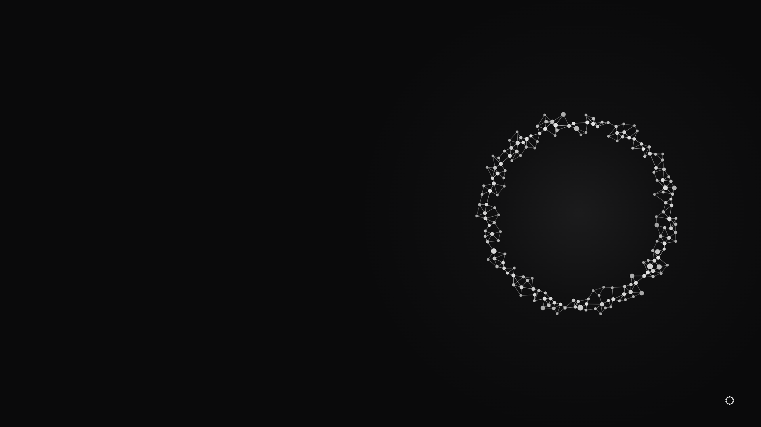
YOUR TURN
Capture one thing now
One article or one video you liked this week.
Capture this: [the link or the idea].
39
Notes:
Everyone: one article or one video, from your phone, right now. Check it landed, then we move on.
Gabriel to confirm: videos (Instagram) use the Capture bot's video skill from the course. If the room does not install capture-bot.zip, start with an article; Hermes can still try a video.

Slide 40
05
Connect your tools
Every tool your business uses, plugged into your brain.
40
Notes:
This is the long one. We list every tool, pick how the agent gets into each, connect them, link WhatsApp, and add one key.
Gabriel to confirm: the room runs this block at 45 minutes or more, with hands-on time.

Slide 41
Your brain only knows what it can reach.
GABRIEL'S RULE
41
Notes:
Gabriel's words: if you don't connect your brain to your WhatsApp or your Slack, it doesn't know what's going on. Every tool, every software, every system has data. We want to capture it.

Slide 42
THE PICTURE
A new hire with no logins
Smart and keen. But locked out of every app.
That is your agent right now.
42
Notes:
Everyday picture: you hire a great assistant, then give them no logins. They can't help. Today we hand over the logins, the safe way.
Three ways a new hire gets in: a staff pass, a spare key, or sitting at your desk. Hold that picture.

Slide 43
STEP 1: LIST EVERY TOOL
Five buckets in any business
Attract
Convert
Deliver
Money
Team
marketing
sales
operations, fulfilment
finance, admin
people, team chat
43
Notes:
Gabriel taught five pillars: marketing, sales, operations, fulfilment, finance and admin. In this room we say Attract, Convert, Deliver, Money, Team.
It doesn't matter if you are in shipping, oil trading or property. Same five.
Gabriel to confirm: the bucket names Attract / Convert / Deliver / Money / Team (Program 2.0 used the five pillars).

Slide 44






BUCKET 1 OF 5
Attract
Meta ads
Instagram
YouTube
TikTok
Google Ads
Mailchimp
Ads, content, email, DMs, your site, your numbers.
44
Notes:
Marketing. Paid ads: Meta, Google, TikTok. Content: Instagram, YouTube, TikTok. Email: ActiveCampaign, Mailchimp, maybe GoHighLevel. DMs: ManyChat. Numbers: Google Analytics, Meta Pixel.
(ActiveCampaign and GoHighLevel have no logo in the free logo set, so they are said, not shown.)

Slide 45






BUCKET 2 OF 5
Convert
HubSpot
Calendly
Zoom
Google Meet
Stripe
PayPal
Your CRM, bookings, sales calls, checkout.
45
Notes:
Sales. A CRM like GoHighLevel, HubSpot, Pipedrive. Bookings: Calendly, GHL calendars. Sales calls: Zoom, Google Meet. Checkout: Stripe, PayPal. Proposals: DocuSign, PandaDoc.

Slide 46






BUCKET 3 OF 5
Deliver
WhatsApp
Gmail
Google Calendar
Google Drive
Notion
Asana
How the work gets done and reaches the client.
46
Notes:
Operations is the day to day: projects (Asana, ClickUp, Trello, Notion), workspace (Google, Microsoft), files, automations.
Fulfilment is how the product reaches the client: client chat on WhatsApp, client calls, courses, support.

Slide 47



BUCKET 4 OF 5
Money
Xero
QuickBooks
Stripe
Google Sheets
Books, invoices, payments, expenses.
47
Notes:
Your money and paperwork. Books and invoices: Xero, QuickBooks. Payments: Stripe. Payroll, expenses, contracts. Some of you still run it in a spreadsheet. That counts too.

Slide 48




BUCKET 5 OF 5
Team
Slack
Telegram
Trello
ClickUp
Zapier
Team chat, tasks, HR, the glue between apps.
48
Notes:
Internal chat: Slack, Teams, Telegram. Tasks. HR and contracts with your staff. Automations like Zapier or Make.
These are only examples. You have your own tools for your own industry.

Slide 49
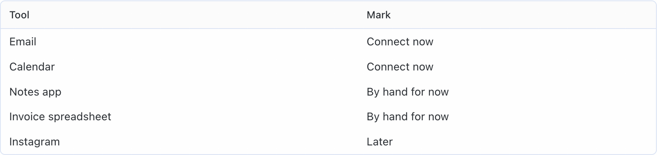
One list of every tool
MADE-UP EXAMPLE: MEI, TANGRAM TUITION HOUSE
49
Notes:
Your agent reads your brain first, then interviews you bucket by bucket. Include the tools you open only once a week.
It saves the list in your brain. Names only, never a key.

Slide 50
YOUR TURN
Drag in the file, then type:
“Read connect-your-tools.md in my brain folder and list my tools.”
TYPE THIS TO HERMES
50
Notes:
Download connect-your-tools.md, drag it onto your brain folder, start a new session on the default agent, type this.
Answer its questions bucket by bucket.
Gabriel to confirm: connect-your-tools.md is in the Ouria download set for the room.

Slide 51
Read only, for now.
IT CAN LOOK. IT CANNOT ACT AS YOU.
51
Notes:
Gabriel's rule: everything we connect today is read-only. Read means it can read your Slack. Write means it can post as you.
We keep it read-only for safety. Write access comes later, only when you trust it.

Slide 52
STEP 2: THREE WAYS IN
How an agent gets into a tool
MCP
API
Browser
a plug made for agents
a key to the back door
uses the website like you do
52
Notes:
MCP is like a staff pass made for agents. You sign in once, like any login, and it reaches what the tool maker allows.
Hermes connectors and plugins are the same idea, ready-made. Always try these first: easiest and safest.

Slide 53
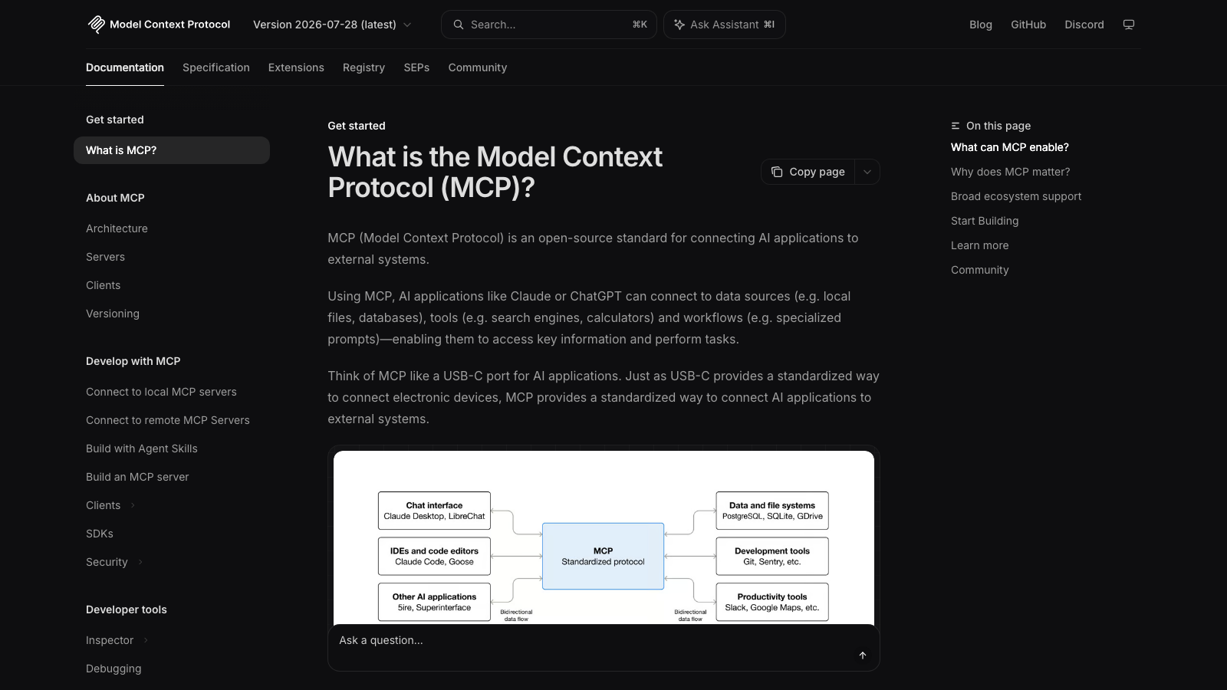
MCP: one standard plug for agents
MODELCONTEXTPROTOCOL.IO, LIVE
53
Notes:
Their own site calls it a USB-C port for AI. One plug shape, many tools: Slack, Google Drive and more.
More and more companies now ship an MCP, so this gets easier every month.

Slide 54
STEP 2: THREE WAYS IN
How an agent gets into a tool
MCP
API
Browser
a plug made for agents
a key to the back door
uses the website like you do
54
Notes:
No MCP? Then an API key. Gabriel: a window opened with a key. A string of letters and numbers that unlocks the back door. Xero is usually reached this way.
It usually reaches the most data. So whoever holds the key gets in. Treat it like a password, like money.
(CLI, the tool's own program, works much the same. Say it only if asked.)

Slide 55
STEP 2: THREE WAYS IN
How an agent gets into a tool
MCP
API
Browser
a plug made for agents
a key to the back door
uses the website like you do
55
Notes:
No MCP, no API? Old tools, a government portal, your personal WhatsApp. Then the agent opens the website in its own browser and uses it like you would.

Slide 56
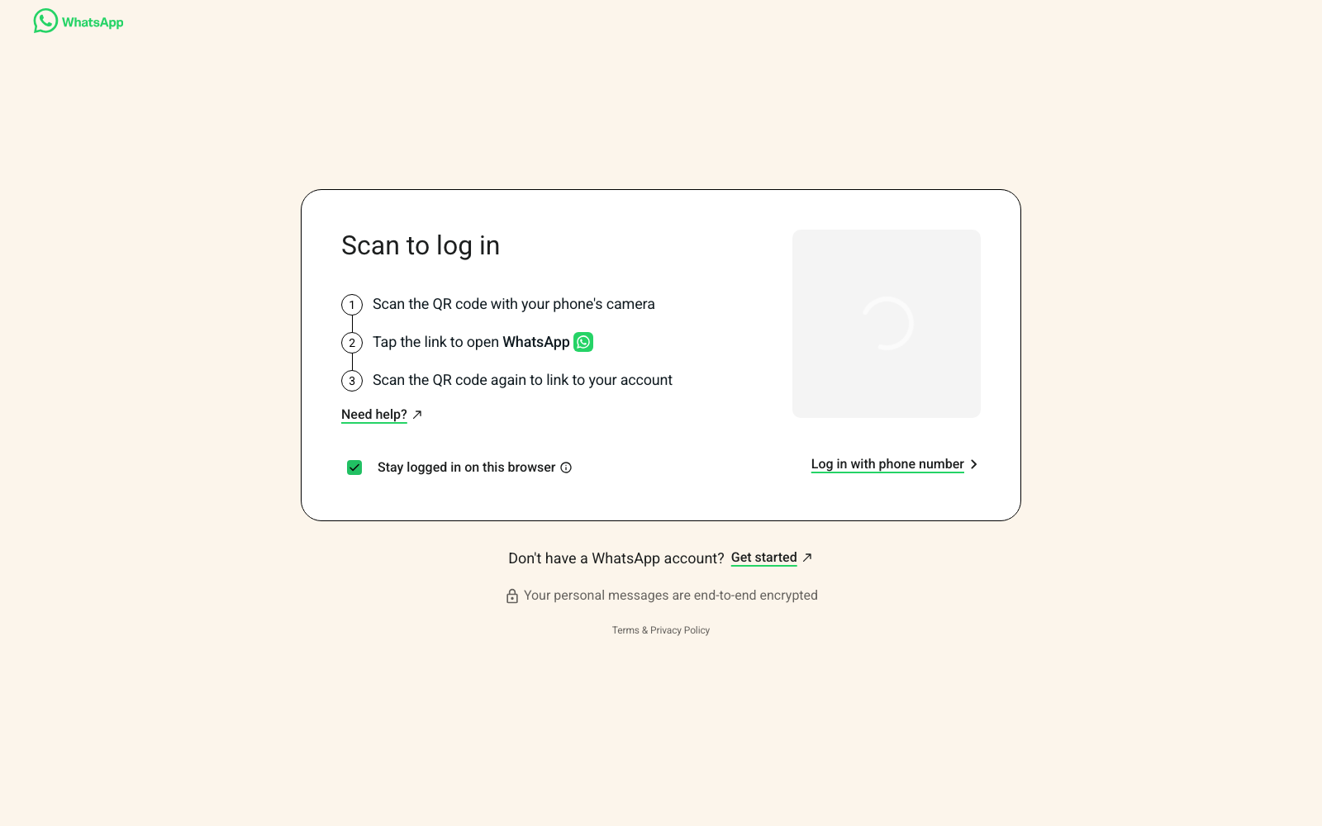
WhatsApp Web: the browser route
WHATSAPP WEB, LIVE ON SCREEN
56
Notes:
Personal WhatsApp has no plug and no key. So your agent opens WhatsApp Web on its own box, the same page you'd open on a laptop. You scan the code once.

Slide 57
YOU DON'T CHOOSE
Hermes picks the route
It checks each tool today: plug, key or website.
For a plug, you sign in once on the tool's own page.
57
Notes:
Gabriel's order: a Hermes connector? A plugin? An MCP? An API key? Last, the browser. Hermes researches each tool and walks you through it step by step.
In the Hermes app: Capabilities, then Connectors. A sign-in page opens. You type your password there, never in the chat.

Slide 58
YOUR TURN
Then type:
“Pick the route for each of my tools and connect the MCPs.”
TYPE THIS TO HERMES
58
Notes:
Exact sentence. Hermes marks each tool connected, needs a key, or needs your sign-in. If it stalls, push it: help me do some research and guide me step by step.

Slide 59
LINKING WHATSAPP
Scan, like WhatsApp Web
01
02
03
Open WhatsApp
Linked devices
Scan the code
On your phone, go to Settings.
Tap Link a device.
Hermes shows the QR code. Scan it.
59
Notes:
If the phone says it can't connect, ask Hermes for a new code and scan again. Last resort: Link with phone number instead, and Hermes gives you an eight-character code.

Slide 60
YOUR TURN
Drag in the file, then type:
“Read connect-to-capture.md in my brain folder and connect my WhatsApp.”
TYPE THIS TO HERMES
60
Notes:
This is optional. It is your private chat. Tell your agent it may read but never send.
Gabriel: I captured the last 30 days to start. You choose how far back.
Gabriel to confirm: connect-to-capture.md is in the Ouria download set, and whether the room links WhatsApp live or at home.

Slide 61
A key is like money.
STEP 3: ADD YOUR FIRST KEY
61
Notes:
Gabriel's story: someone steals your OpenAI key with your card on it, and they spend your tokens on your card. Treat every key like cash.

Slide 62
WHERE KEYS LIVE
Never paste a key in the chat
NEVER
ALWAYS
The chat with your agent
A screenshot or a note
Telegram or WhatsApp
Your password manager
The locked drawer on your box
Moved for you by Claude Code
62
Notes:
Every chat is saved in a session log. If that log ever leaks, the key leaks with it.
If you ever pasted a key in a chat: make a new key on that site and delete the old one.

Slide 63
HOW A KEY TRAVELS
Copy it. Never show it.
Copy the key
Claude Code carries it
Locked drawer
on the tool's own site
from your clipboard, unseen
on your box, by name only
63
Notes:
On the tool's site: API keys, create new key, give it a name you'll remember. Most sites show it only once. Save it in your password manager, then click copy.

Slide 64
HOW A KEY TRAVELS
Copy it. Never show it.
Copy the key
Claude Code carries it
Locked drawer
on the tool's own site
from your clipboard, unseen
on your box, by name only
64
Notes:
Why Claude Code on your laptop, not Hermes? Hermes lives on the box. It cannot see your laptop's clipboard. Claude Code can, and it pipes the key across without ever printing it.

Slide 65
HOW A KEY TRAVELS
Copy it. Never show it.
Copy the key
Claude Code carries it
Locked drawer
on the tool's own site
from your clipboard, unseen
on your box, by name only
65
Notes:
The locked drawer is a private settings file on your box. Hermes reads the key from there by name. You only ever see the name, never the key.

Slide 66
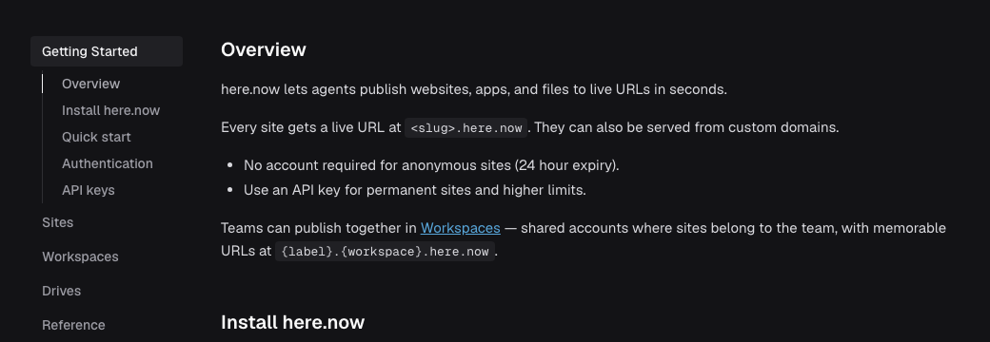
Your first key: here.now
HERE.NOW DOCS, LIVE. IT PUBLISHES YOUR AGENT'S PAGES TO A LINK.
66
Notes:
Log in at here.now, make an API key, copy it. We use here.now later today when your agent talks to you in pages.
Gabriel to confirm: members make their own here.now account and key in the room, and the add-a-key skill is already saved in Claude Code.

Slide 67
YOUR TURN
With the key copied, type:
“Add a key for here.now.”
TYPE THIS TO CLAUDE CODE ON YOUR LAPTOP
67
Notes:
Exact sentence. Not Hermes: Claude Code on your laptop. Don't copy anything else until it's done. It reports the key is in place, by name only.

Slide 68
CHECK IT WORKED
Back in Hermes, type:
“Show my tools table.”
TYPE THIS TO HERMES
68
Notes:
Hermes shows one row per tool: connected, needs a key, or needs your sign-in. Anything stuck, raise your hand and Marc or Gabriel comes over.

Slide 69
DONE WHEN
Tools connected
Every tool listed. Plugs signed in.
WhatsApp linked, if you want it.
here.now key in the locked drawer.
Your brain can now reach your business.
69
Notes:
Recap: list, route, connect, one key. Next, Marc runs Attract, Convert, Deliver.

Slide 70
06
Attract, Convert, Deliver.
Every business, in three steps.
70
Notes:
Marc leads. Quick run-through before the interview, so everyone has the three words in their head when their chief of staff starts asking.

Slide 71
EVERY BUSINESS
First, people find you.
Attract
Convert
Deliver
How people first hear of you
How they become customers
How you do the work
71
Notes:
Marc: Every business, no matter how big or small, runs on three steps. Step one, Attract: how people first hear of you. Ads, posts, word of mouth, walking past your shop.

Slide 72
EVERY BUSINESS
Then they decide to buy.
Attract
Convert
Deliver
How people first hear of you
How they become customers
How you do the work
72
Notes:
Marc: Step two, Convert: how they become customers. You capture their name and number, then you nurture them: DMs, calls, messages, a trial. Then they say yes.

Slide 73
EVERY BUSINESS
Then you do the work.
Attract
Convert
Deliver
How people first hear of you
How they become customers
How you do the work
73
Notes:
Marc: Step three, Deliver: you onboard them and do the work you promised. Marketing, sales, operations. In plain words: Attract, Convert, Deliver.

Slide 74
MADE-UP EXAMPLE: TANGRAM TUITION HOUSE
Attract: a parent sees a post.
Sees a post
WhatsApp enquiry
Trial lesson
Enrol?
First term
Facebook
Asks about Sec 1 maths
Booked by the front desk
Yes or no
Classes, homework, reports
74
Notes:
Marc: A made-up tuition centre. A parent scrolls Facebook, sees a post, and sends a WhatsApp enquiry about Sec 1 maths. That is Attract.

Slide 75
MADE-UP EXAMPLE: TANGRAM TUITION HOUSE
Convert: a trial, then a yes.
Sees a post
WhatsApp enquiry
Trial lesson
Enrol?
First term
Facebook
Asks about Sec 1 maths
Booked by the front desk
Yes or no
Classes, homework, reports
75
Notes:
Marc: The front desk books a trial lesson. Then the decision: enrol or not. Decisions are where work gets stuck. That is Convert.

Slide 76
MADE-UP EXAMPLE: TANGRAM TUITION HOUSE
Deliver: the first term.
Sees a post
WhatsApp enquiry
Trial lesson
Enrol?
First term
Facebook
Asks about Sec 1 maths
Booked by the front desk
Yes or no
Classes, homework, reports
76
Notes:
Marc: They enrol, and the first term starts: classes, homework, reports to the parent. That is Deliver. Every step uses a tool or a person. We map every step on post-its in MapOS on day two.

Slide 77
Your interview asks about all three.
ATTRACT · CONVERT · DELIVER
77
Notes:
Marc hands back to Gabriel: Why this matters right now. Your chief of staff is about to interview you, and it will ask how you Attract, how you Convert and how you Deliver. Have your answers ready in your head.

Slide 78
07
The interview.
Your chief of staff learns you and your business.
78
Notes:
Now your agent gets to know you. This is one of the most important things you do today. It starts now and runs through lunch.

Slide 79
LIKE A NEW COACH
It reads first, then asks.
It reads your brain folder.
It only asks what it does not know yet.
79
Notes:
It is like a new coach. It reads your notes first, so you never repeat yourself. Anything it already knows, it skips. It asks only for the gaps.

Slide 80
WHAT IT ASKS
Who you are.
You
Your goals
Your business
Your rules
Who you are, how you talk
What success looks like
Attract, Convert, Deliver
Alone, ask first, contact
80
Notes:
First, you. Who you are beyond your job title, in your own words, so it learns how you sound.

Slide 81
WHAT IT ASKS
What you want.
You
Your goals
Your business
Your rules
Who you are, how you talk
What success looks like
Attract, Convert, Deliver
Alone, ask first, contact
81
Notes:
Then your goals. What would make the next twelve months a success, and how we will know it is moving.

Slide 82
WHAT IT ASKS
How your business runs.
You
Your goals
Your business
Your rules
Who you are, how you talk
What success looks like
Attract, Convert, Deliver
Alone, ask first, contact
82
Notes:
Then your business, through the three words Marc just taught: how people find you, how they become customers, how you do the work. Real examples help it find jobs to take off your plate.

Slide 83
WHAT IT ASKS
What it may do.
You
Your goals
Your business
Your rules
Who you are, how you talk
What success looks like
Attract, Convert, Deliver
Alone, ask first, contact
83
Notes:
Last, your rules. What it may do alone. What it must ask you first. It always asks before spending money or deleting things. And how and when to contact you.

Slide 84
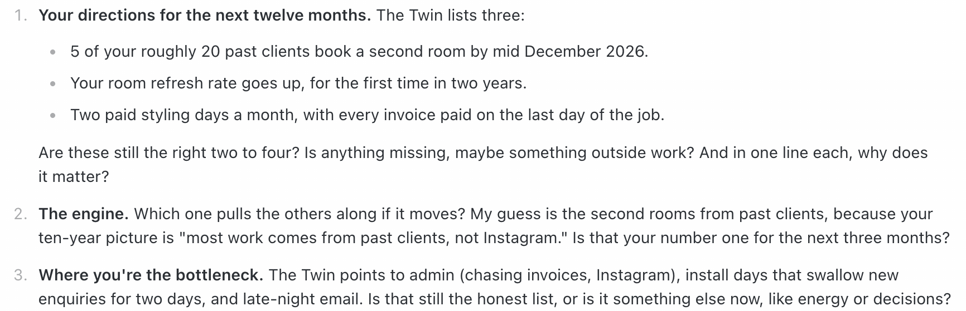
It asks one question at a time.
A REAL INTERVIEW, MADE-UP MEMBER
84
Notes:
Here is what it looks like. Notice it already has a guess from your notes, and asks you to confirm or fix it. Give real answers, real numbers, real examples. The more detail, the better it works for you.

Slide 85
It writes your Brain Map.
THE LIST OF FOLDERS YOUR NOTES GO INTO
85
Notes:
Why it matters: at the end it writes your Brain Map. That is the list of folders your notes get filed into: your projects, your areas, the topics you read about. Your bots use it after lunch to know where every note goes.

Slide 86
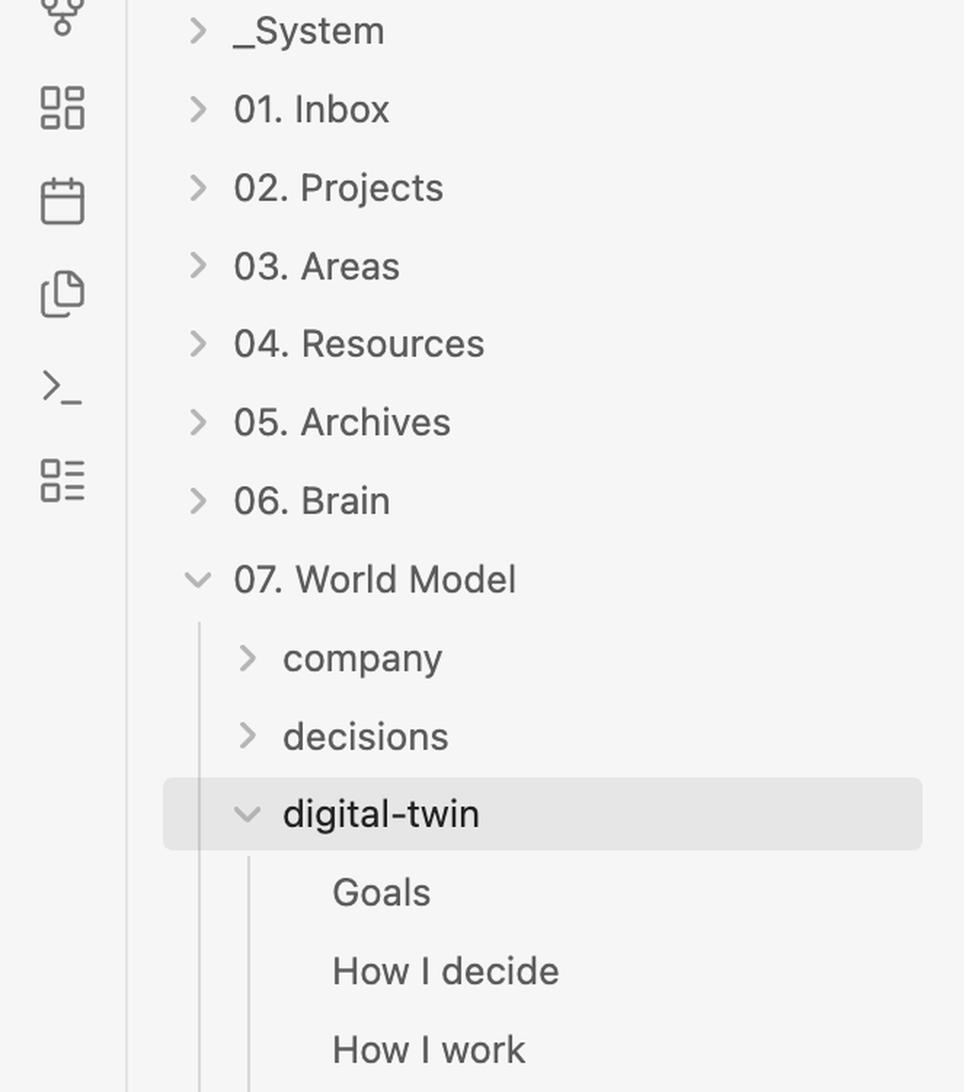
YOUR BRAIN FOLDER
Your notes land in your brain.
Who you are, your goals, how you work.
YOUR TWIN NOTES, IN YOUR BRAIN FOLDER
86
Notes:
Your answers become notes about you, in your own words: your Twin. Your agent reads them before it acts. You own them. They are on your map, not in a big AI company's account.

Slide 87
START
Say this to Hermes.
“Read ouria-interview.md in my brain folder and interview me.”
TYPE OR SAY THIS TO HERMES
87
Notes:
Drag the interview file onto your brain folder first, then say exactly this.
Read ouria-interview.md in my brain folder and interview me.

Slide 88
STOPPED? PICK IT UP
Say this to carry on.
“Continue my interview.”
WORKS IN A NEW CHAT, ON ANY DEVICE
88
Notes:
Stop any time. It saves as you go. When you come back, even in a new chat, say exactly this.
Continue my interview.

Slide 89
TIP 1
Answer by voice on Telegram.
Telegram
Talking is faster than typing. Talk like you would to a new hire.
89
Notes:
Tip one. Use a voice note on Telegram. Talking is faster than typing, and you give more detail when you talk.

Slide 90
TIP 2
Skip what it already knows.
If its guess is right, say yes.
If it is wrong, fix it.
90
Notes:
Tip two. When it already has a guess, just confirm it or fix it. You can also skip a question. But do not skip everything. The more you give, the better it works.

Slide 91
TIP 3
Fix anything, any time.
Everything is in pencil, not pen.
91
Notes:
Tip three. Nothing is permanent. If it reads back a line that is wrong, tell it: That line is wrong. The right version is, and then the right version. Do it early so it does not drift.

Slide 92
WHAT YOU GET AT THE END
Three things, written for you.
01
02
03
Brain Map
Your goals
Your rules
Where every note goes.
Your result, and the weekly action you control.
Alone. Ask first. How to reach you.
92
Notes:
At the end you get three things. Your Brain Map. Your goals: the result you want, which shows up later, and the weekly action you control. And your rules: what it does alone, what it asks first, how it reaches you.

Slide 93
Lunch. Keep answering on your phone.
YOUR INTERVIEW KEEPS GOING WHILE YOU EAT
93
Notes:
Lunch. Keep the interview going on your phone while you eat. Voice notes on Telegram work well. After lunch, your Brain Map must be ready, because the bots need it. Not finished? Say: Continue my interview.

Slide 94
08
Fill your brain
Pour in what you already have. Sort it once. See your map.
94
Notes:
Welcome back. This block finishes Capture: we pour in everything you already have, make three helper bots, run them once, and you end with a graph of your brain.
Plan this as a long working block, not a talk. Leave room for the first run.

Slide 95
Nothing in, nothing out.
CAPTURE IS THE HEAVIEST PART
95
Notes:
Everything starts from capture. If it is not captured, your brain cannot link it, cannot organise it, and nothing comes up from it.
That is why we spend so long on this layer.

Slide 96
POUR IN WHAT YOU ALREADY HAVE
Three piles
Old projects
Old notes
Old chats
Files and folders that still matter
Apps, notebooks, bookmarks
Your ChatGPT or Claude export
96
Notes:
Pile one: old projects. Proposals, plans, price lists, client files that still matter. Not everything on your laptop, just what you would want an assistant to know.

Slide 97
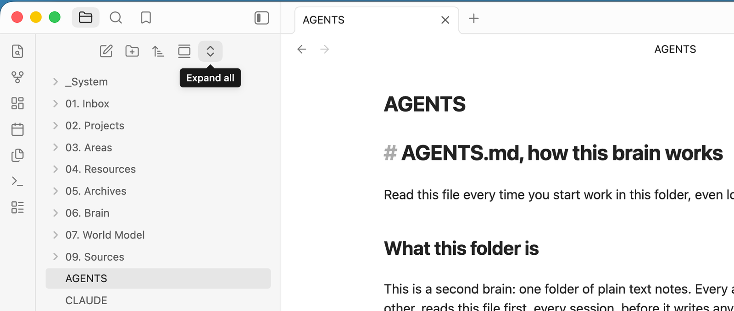
WHERE IT GOES
Drag it into 01. Inbox
One door for everything new. The bots sort it later.
YOUR BRAIN FOLDER IN OBSIDIAN
97
Notes:
Open your brain folder. Drag the files straight into 01. Inbox. Don't sort them yourself: that is the bots' job.
It mirrors to your box in a moment. Tip from the course: messy is fine.

Slide 98
POUR IN WHAT YOU ALREADY HAVE
Three piles
Old projects
Old notes
Old chats
Files and folders that still matter
Apps, notebooks, bookmarks
Your ChatGPT or Claude export
98
Notes:
Pile two: old notes. Most people forget this one. Notes are everywhere.

Slide 99



OLD NOTES LIVE EVERYWHERE
Find every note you kept
Apple Notes
Evernote
Google Keep
Bookmarks
A paper notebook? Take a photo of each page.
99
Notes:
Export what you can: Apple Notes, Evernote, Keep, your Chrome bookmarks.
Paper notebook: take a picture of every page. AI reads pictures now, even hard handwriting, and turns them into text notes.
Claude Code on your laptop can help gather old files or export bookmarks for you.

Slide 100
SEND THE PHOTOS AND FILES TO HERMES
Then say two words
“Capture this.”
TYPE THIS TO HERMES
100
Notes:
Gabriel's words: compile it, pass it to Hermes, and literally say capture this.
Member sentence: "Capture this."

Slide 101
POUR IN WHAT YOU ALREADY HAVE
Three piles
Old projects
Old notes
Old chats
Files and folders that still matter
Apps, notebooks, bookmarks
Your ChatGPT or Claude export
101
Notes:
Pile three, the biggest: your old AI chats. Months or years of conversations. That is a lot of you: how you think, what you decided.

Slide 102
YOUR OLD CHATS
Years of you, in one zip
ChatGPT
Claude
ChatGPT: Settings, Data controls, Export. Claude: Settings, Privacy, Export data.
102
Notes:
The export comes by email, usually within a day, and the link dies about a day later. Set an alarm.
No export yet? Request it now, and drop it in when it arrives. Your bots pick it up on the next run.
Gabriel to confirm: were members told to request their export before the room? If not, most will not have it today.

Slide 103
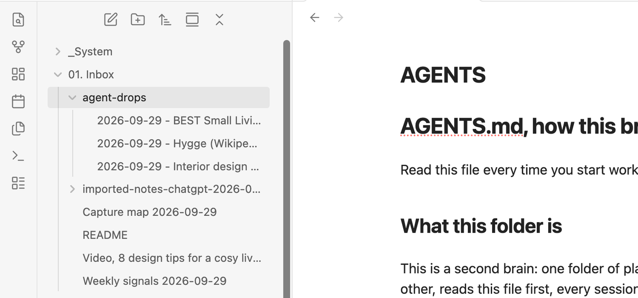
DRAG THE ZIP IN WHOLE
Don't open it. Drop it in.
Drag the export zip onto 01. Inbox. Your bots read every chat.
EVERYTHING NEW LANDS IN 01. INBOX
103
Notes:
Drag the whole zip onto 01. Inbox. A big export takes a minute or two to arrive on the box.
Check: ask Hermes "Can you see my ChatGPT export in my brain inbox?" If it says it is still arriving, that is fine.
The Link bot keeps the whole export safe in 08. Sources and works through every chat.
Gabriel to confirm: the room skips the separate drop-your-chats pack and lets the Link bot place the export.

Slide 104
Missed something? Drop it in later.
YOU CAN ALWAYS RUN IT AGAIN
104
Notes:
Don't worry about getting everything now. Put in what you can. Anything you find later goes into the Inbox and gets picked up on the next run.

Slide 105
A full Inbox is a messy drawer.
NOW WE SORT IT
105
Notes:
Now your Inbox is full. On its own it's just a pile. The next part turns the pile into a brain. The loop is called CLOSE.

Slide 106
PICTURE THIS
A lemonade stand
Every time a customer says something, it goes in a notebook.
106
Notes:
Picture you run a lemonade stand. Every time someone buys and says something, you write it in a notebook.
Watch what happens to that notebook, step by step.

Slide 107
THE CLOSE LOOP
One loop, five steps
Capture
Link
Organise
Signal
Execute
Keep it whole. Every comment in the notebook.
Small notes, one idea each, linked
File by the Brain Map
Count what keeps coming up
You act
107
Notes:
C is Capture. Keep everything whole, exactly as it came in. That is what we just did with your old notes and chats.

Slide 108
THE CLOSE LOOP
One loop, five steps
Capture
Link
Organise
Signal
Execute
Keep it whole. Every comment in the notebook.
One idea per note: "too sour". Linked to who said it.
File by the Brain Map
Count what keeps coming up
You act
108
Notes:
L is Link. A long thing, like a meeting transcript, gets broken into small notes, one idea each. Each note quotes its line and links back.
One rule: no proof, no link.

Slide 109
THE CLOSE LOOP
One loop, five steps
Capture
Link
Organise
Signal
Execute
Keep it whole. Every comment in the notebook.
One idea per note: "too sour". Linked to who said it.
Recipe notes in Recipe. Customer notes in Customers.
Count what keeps coming up
You act
109
Notes:
O is Organise. Each small note gets filed into a folder on your Brain Map, the map you built in the interview. A note that fits nowhere waits in the Inbox and you get asked.

Slide 110
THE CLOSE LOOP
One loop, five steps
Capture
Link
Organise
Signal
Execute
Keep it whole. Every comment in the notebook.
One idea per note: "too sour". Linked to who said it.
Recipe notes in Recipe. Customer notes in Customers.
3+ this week, and more than last week
You act
110
Notes:
S is Signal. The brain tallies. Last week one person said too sour. This week four. That is a Signal.
The rule: 3 or more notes this week, and more than last week.

Slide 111
THE CLOSE LOOP
One loop, five steps
Capture
Link
Organise
Signal
Execute
Keep it whole. Every comment in the notebook.
One idea per note: "too sour". Linked to who said it.
Recipe notes in Recipe. Customer notes in Customers.
3+ this week, and more than last week
You act. Fix the recipe.
111
Notes:
E is Execute. That's you, with your main Hermes. Maybe something went wrong with the recipe this week. You decide what to do with it.

Slide 112
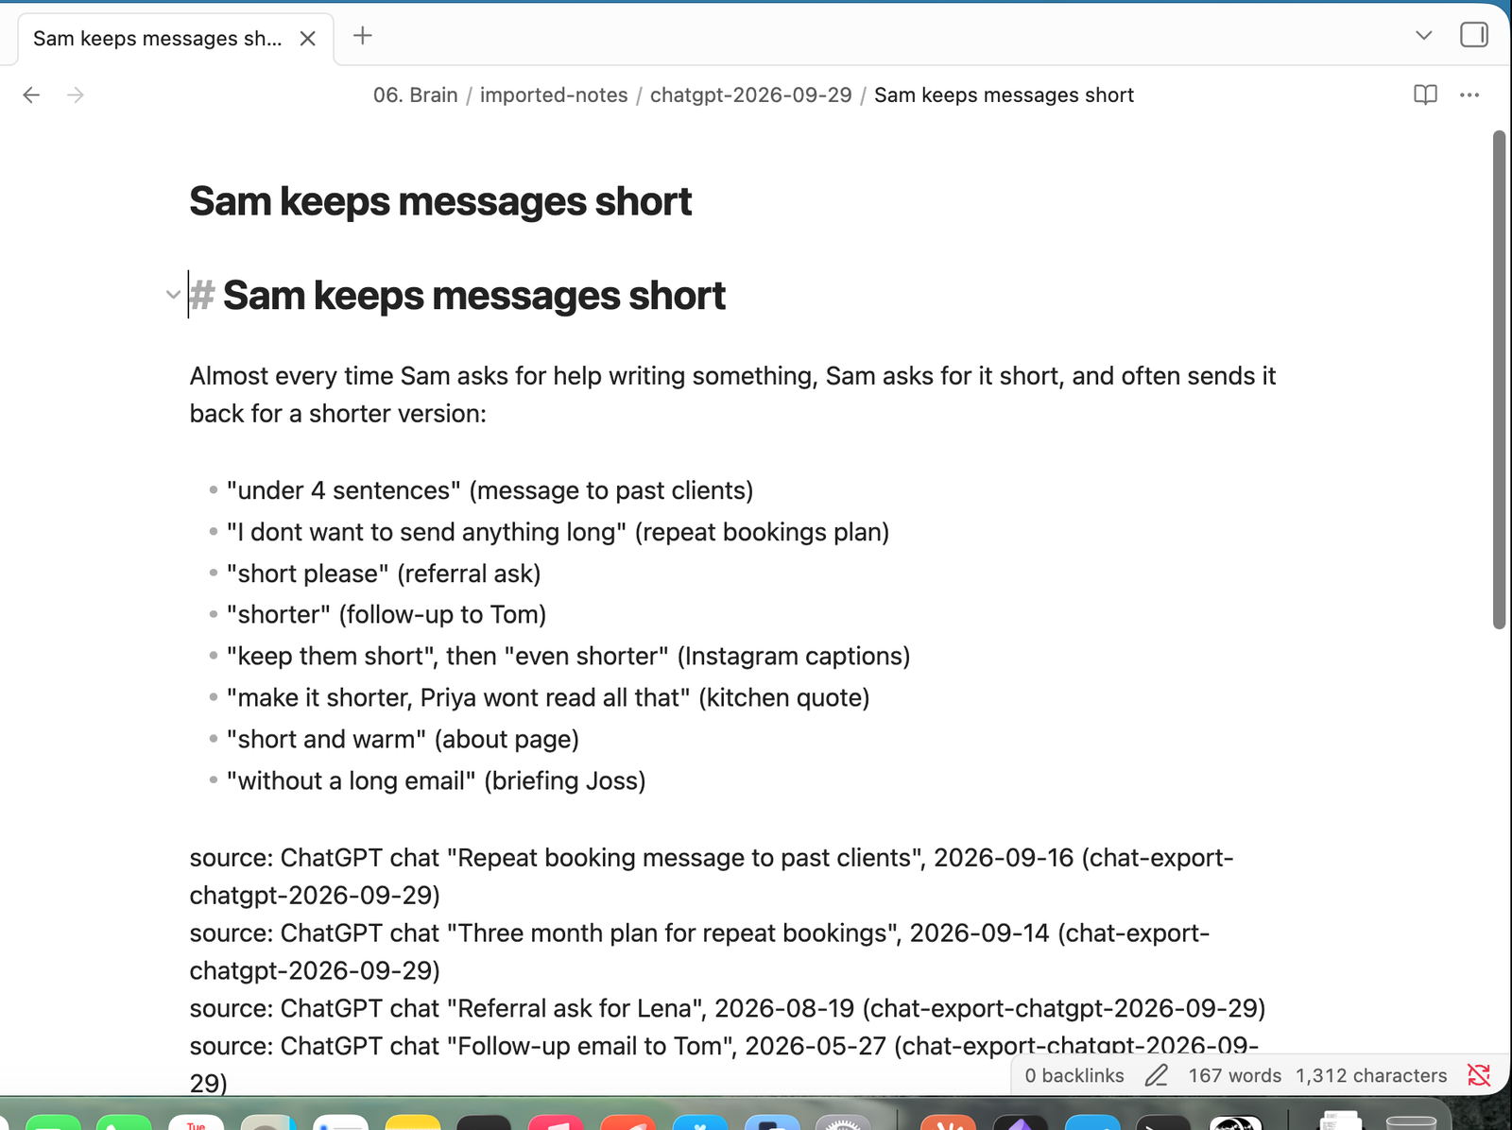
A small note: one idea, linked back
ONE IDEA, THE WORDS IT CAME FROM, AND WHERE IT CAME FROM
112
Notes:
This is what a small note looks like. One idea, the exact words it came from, and where it came from. The original is never changed, so nothing is lost.

Slide 113
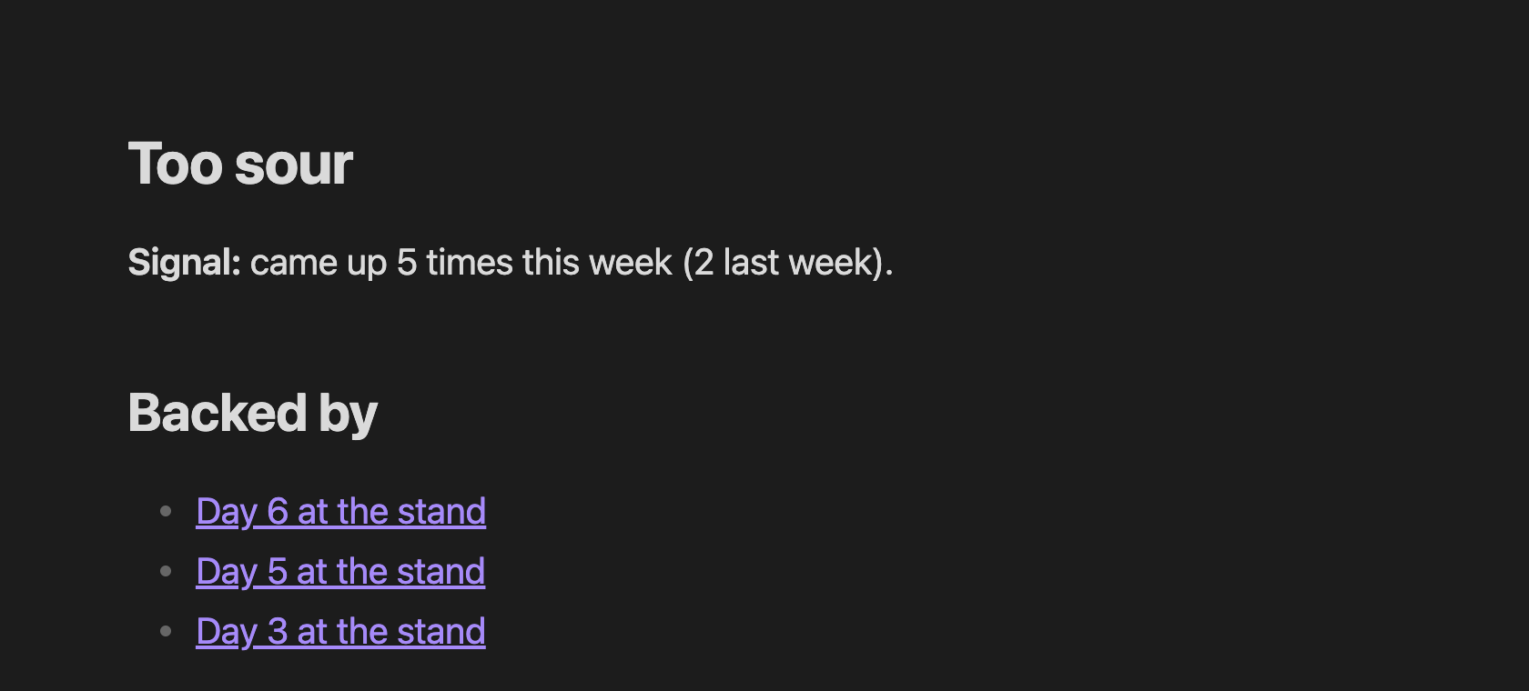
SIGNAL
A Signal is a count that grew
"Too sour": 5 times this week, 2 the week before.
EACH SIGNAL SHOWS THE NOTES BEHIND IT
113
Notes:
A Signal is not an idea. It is a count. Small note equals one idea; Signal is a count that grew.
Each Signal lists the notes behind it, so you can check the number yourself.

Slide 114
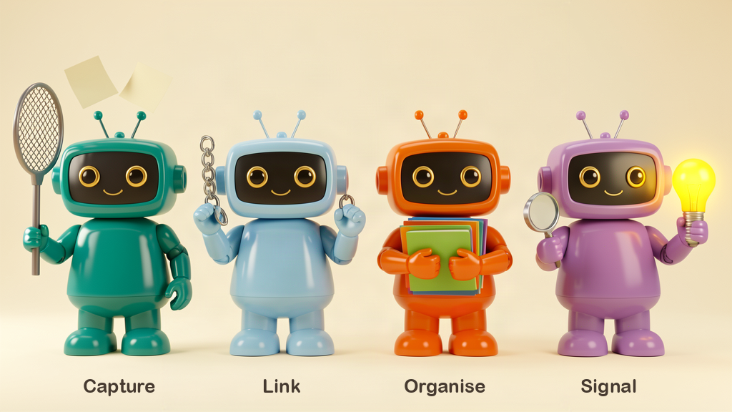
WHO DOES THE WORK
Capture is done. Three more helpers.
One bot for L, one for O, one for S. Execute is your main Hermes.
114
Notes:
You already have Capture. Now we make one bot for each of the next letters: Link, Organise, Signal. Execute is your main Hermes agent.

Slide 115
YOUR THREE BOTS
One job each
L
O
S
Link bot
Organise bot
Signal bot
Breaks each new thing into small notes and links them, with proof.
Files each small note into a folder on your Brain Map.
Counts what keeps coming up and tells you on Telegram.
115
Notes:
Three helpers, each its own bot in the Hermes app. When you ask, they run as one chain: Link, then Organise, then Signal. If a step fails, the chain stops and you get one Telegram line.

Slide 116
FIRST, THE RECIPE FILE
Drag one file into your brain
Download link-organise-signal-bots.md.
Drag it onto your brain folder.
116
Notes:
You never need to read this file. It is the recipe Hermes follows.
If Hermes says approval pop-ups are on, it gives you one sentence to paste into Claude Code on your laptop first. Do that, then come back.

Slide 117
MAKE YOUR BOTS
Then type one sentence
“Read link-organise-signal-bots.md in my brain folder and make my Link, Organise and Signal bots.”
TYPE THIS TO HERMES
117
Notes:
Hermes makes the three bots, picks the right model for each on your own login, and tells you which one each got.
Member sentence, exact: "Read link-organise-signal-bots.md in my brain folder and make my Link, Organise and Signal bots."

Slide 118
"Your Link, Organise and Signal bots are ready."
WAIT FOR THIS LINE
118
Notes:
This is what Hermes says when set-up is done. You'll see the three new bots in the Hermes app.
Nothing runs on a timer yet. Later they run every night on their own.

Slide 119
RUN THEM ONCE, BY HAND
Now the first run
“Run my Link, Organise and Signal now.”
TYPE THIS TO HERMES
119
Notes:
This first run sorts out everything you already have: the interview, your old notes, your chats.
Member sentence, exact: "Run my Link, Organise and Signal now."

Slide 120
Big Inbox? Let it run.
IT TELLS YOU HERE AND ON TELEGRAM WHEN IT'S DONE
120
Notes:
The first run can take a while if you poured in a lot. Keep going with the room; it works in the background.
If you hit your plan's usage limit on the first run, that's the one time a bigger plan for a month may help. Don't upgrade first; only if you hit the limit.

Slide 121
READ THE REPORT
Not every Signal is true
A young brain finds few. You are the judge.
121
Notes:
The report says how many small notes, links, and notes filed, plus any new Signals.
No Signals yet is normal. Some Signals you won't agree with. Only you decide what's true. Never ask it to invent one.

Slide 122
NOW SEE IT
Open Obsidian
Obsidian
Open folder as vault. Pick your brain folder.
122
Notes:
Open Obsidian. If it's the first time: don't pick Create or Quick start. Pick Open folder as vault, then your brain folder.
Then click the graph icon on the left.

Slide 123
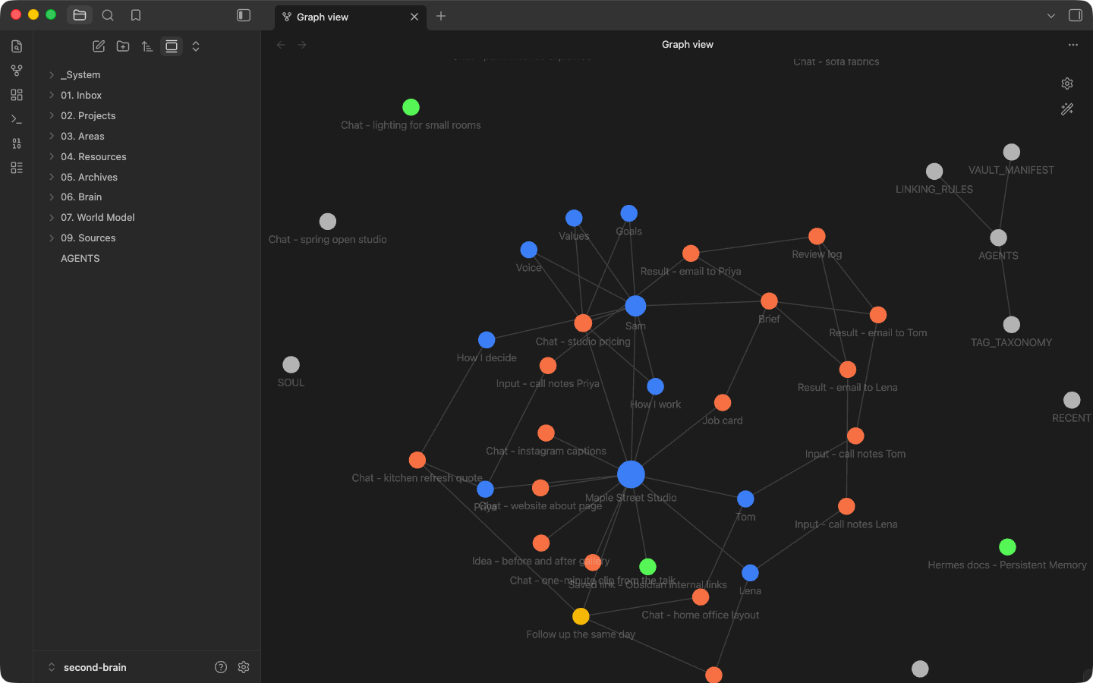
This is your brain.
CLICK THE GRAPH ICON. EVERY DOT IS A NOTE, EVERY LINE A LINK.
123
Notes:
This is the graph. This is the first version of your brain. It's small right now, but it keeps growing.
Take a screenshot of it. Give yourself a pat on the back.

Slide 124
Your first map. It only grows.
YOU OWN IT
124
Notes:
This map is yours, in plain files on your own box. No big AI company rents it to you. Every capture from now on adds to it.

Slide 125
DREAMING: THE SAME BOTS, EVERY NIGHT
Your brain works at night
Capture
Link, Organise, Signal
GBrain
Your morning
Reads your day into the Inbox
The bots you just ran, now every night
Re-reads every note so search stays fresh
Top signals on your phone
125
Notes:
What you just ran by hand, Link, Organise and Signal, is Dreaming. We just put it on a timer so it runs every night while you sleep. First your day gets captured.

Slide 126
DREAMING: THE SAME BOTS, EVERY NIGHT
Your brain works at night
Capture
Link, Organise, Signal
GBrain
Your morning
Reads your day into the Inbox
The bots you just ran, now every night
Re-reads every note so search stays fresh
Top signals on your phone
126
Notes:
Then the same three bots run, on their own.

Slide 127
DREAMING: THE SAME BOTS, EVERY NIGHT
Your brain works at night
Capture
Link, Organise, Signal
GBrain
Your morning
Reads your day into the Inbox
The bots you just ran, now every night
Re-reads every note so search stays fresh
Top signals on your phone
127
Notes:
Then GBrain re-reads every note, so search always knows what is new.

Slide 128
DREAMING: THE SAME BOTS, EVERY NIGHT
Your brain works at night
Capture
Link, Organise, Signal
GBrain
Your morning
Reads your day into the Inbox
The bots you just ran, now every night
Re-reads every note so search stays fresh
Top signals on your phone
128
Notes:
Then in the morning, your top signals are waiting on your phone.

Slide 129
DRAG IT ONTO YOUR BRAIN FOLDER
Drop it in.
dreaming-and-recall.md
You never need to read it.
Downloads: class.ouria.com
129
Notes:
Download dreaming-and-recall.md from class.ouria.com. Drag it onto your brain folder, like the last recipe file. Then one sentence to Hermes.

Slide 130
SET UP YOUR DREAMING
Type one sentence
“Read dreaming-and-recall.md in my brain folder and set up my Dreaming.”
TYPE THIS TO HERMES
130
Notes:
From tonight, the bots run on their own. Nothing to remember. That is why I can say: the bots keep working tonight.
Member sentence: Read dreaming-and-recall.md in my brain folder and set up my Dreaming.

Slide 131
09
Search and score your brain.
GBrain and Voyage, the same setup I use. Then your brain sits an exam.
131
Notes:
Three short parts. One: your bots run every night on their own. Two: your brain gets a search engine. Three: your brain takes a test and gets a score.
Gabriel to confirm: topic number. 1-09-talk also says 09, so the numbers after this need a shift.

Slide 132
PICTURE THIS
A librarian who read everything
You ask about "payment".
She also brings the invoice note.
132
Notes:
Part two: Recall. A full brain is no use if your agent cannot find the right note.
A good librarian finds by meaning, not just the exact word. Ask about payment, and you also get the notes that mean payment.

Slide 133
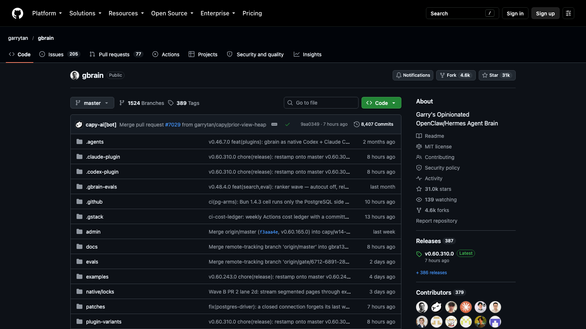
RECALL
Give your brain a search engine
GBrain reads every note, so the right one is found fast.
GBRAIN, FREE AND OPEN SOURCE
133
Notes:
The tool is called GBrain. It is open source: free, and anyone can check how it works. The instructions are already in the recipe file you just dragged in.

Slide 134
SAME CHAT WITH HERMES
Install your search engine
“Give my brain its search engine.”
TYPE THIS TO HERMES
134
Notes:
Same chat as the Dreaming sentence. Hermes installs GBrain, then restarts itself. After that, every night, after the Dreaming, it updates its index so search reads the night's new notes.
Member sentence: Give my brain its search engine.

Slide 135
PROVE IT REMEMBERS
Check it works
“Check my brain's search engine works.”
TYPE THIS TO HERMES
135
Notes:
Hermes runs one real search and names a real note it found. Then open a brand new session and ask it something about your business, like your top goals. It should name the note it used.
Member sentence: Check my brain's search engine works.

Slide 136
THEN ASK ONE IT CANNOT ANSWER
A good agent never guesses
GOOD
BAD
Names the note it used
Says "not in the brain"
Makes something up
Names no note
136
Notes:
Ask one question your brain does not hold. A good agent says it is not in the brain. A bad agent makes something up. That rule matters for the score next.

Slide 137
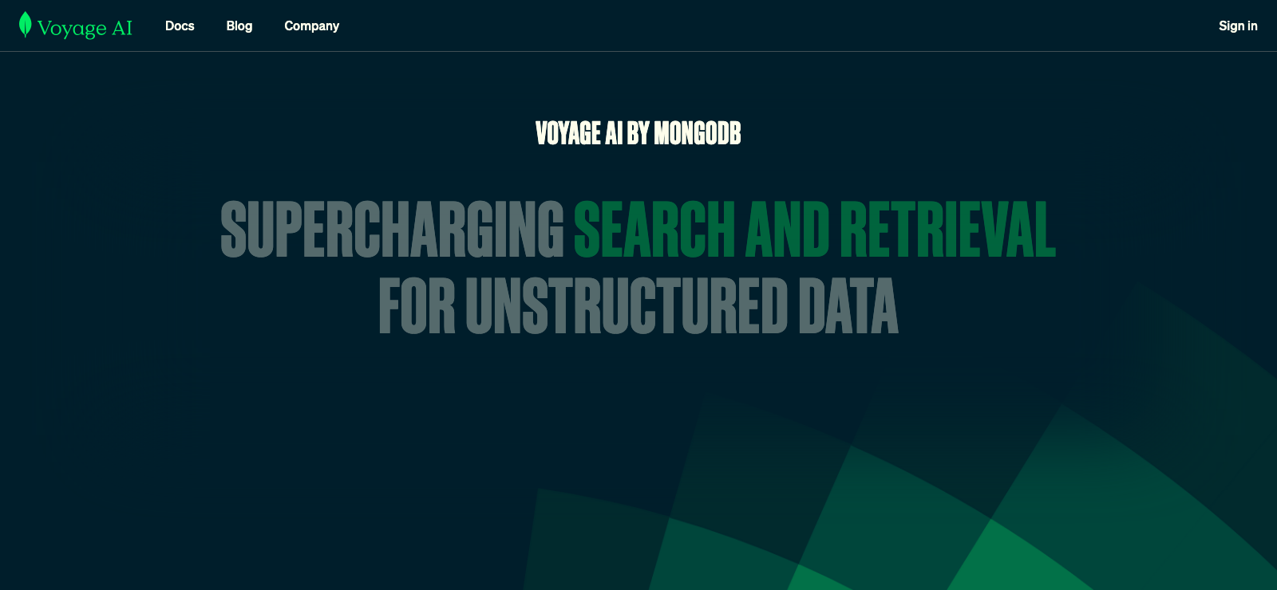
SEARCH BY MEANING
Voyage: it finds what you meant
Ask for "payment". It also finds "invoice" and "fees".
The same setup I use.
VOYAGE AI
137
Notes:
This is what I use. Voyage lets GBrain search by meaning, not just matching words. Things might change, but for now we use Voyage. It is very affordable. Click Get Started, make an account, add your card, copy the API key.

Slide 138
ON YOUR LAPTOP, KEY COPIED
Add your Voyage key
“Add a key for Voyage.”
TYPE THIS TO CLAUDE CODE ON YOUR LAPTOP
138
Notes:
Same as the here.now key this morning. Copy the key on Voyage, then tell Claude Code. Never paste a key in the chat.

Slide 139
BACK IN HERMES
Turn on meaning search
“Turn on meaning search in my brain.”
TYPE THIS TO HERMES
139
Notes:
Hermes turns on meaning search and re-reads your brain with it.

Slide 140
BRAIN SCORE
Give your brain an exam
You write the questions.
You keep the answer sheet.
140
Notes:
Part three. After all this work, if your brain does not remember the right details, we wasted our effort. A feeling cannot be improved. A number can.
So your brain takes a test, like a school exam, and gets one score out of 100.

Slide 141
BRAIN SCORE
Write. Take. Fix.
Write your test
Take your test
Fix it
From your own notes
Hermes answers, gets a score
Then test again, every week
141
Notes:
Three steps. Step one: write your test, from your own notes.

Slide 142
CLAUDE CODE, NOT HERMES
On your laptop.
Your answer sheet stays with you.
Hermes never sees it.
Downloads: class.ouria.com
142
Notes:
Download score-your-brain.md. This time we use Claude Code on your laptop, not Hermes, so Hermes never sees the answers. Add the file to a new Claude Code chat in your brain folder.

Slide 143
NEW CLAUDE CODE CHAT, FILE ADDED
Write your test
“Help me create a test for my second brain.”
TYPE THIS TO CLAUDE CODE
143
Notes:
It writes up to 20 questions from your notes, with an answer sheet. Only you know what is true, so check every answer.
Wrong one? Say: Fix [number]: [the right answer]. All right? Say: Keep all.
Member sentence: Help me create a test for my second brain.

Slide 144
BRAIN SCORE
Write. Take. Fix.
Write your test
Take your test
Fix it
From your own notes
Hermes answers, gets a score
Then test again, every week
144
Notes:
Step two: Hermes takes the test. Claude Code sends only the questions to Hermes, Hermes answers, and Claude Code marks it with the answer sheet. You don't mark anything.

Slide 145
SAME CLAUDE CODE CHAT
Start the test
“Run my brain exam three times and score it.”
TYPE THIS TO CLAUDE CODE
145
Notes:
Three times, because answers wobble a little. You get one score: the average. Let it run.
Laptop slept or chat closed? The test still runs on the box. Later say: Grade my brain exam.
Member sentence: Run my brain exam three times and score it.

Slide 146
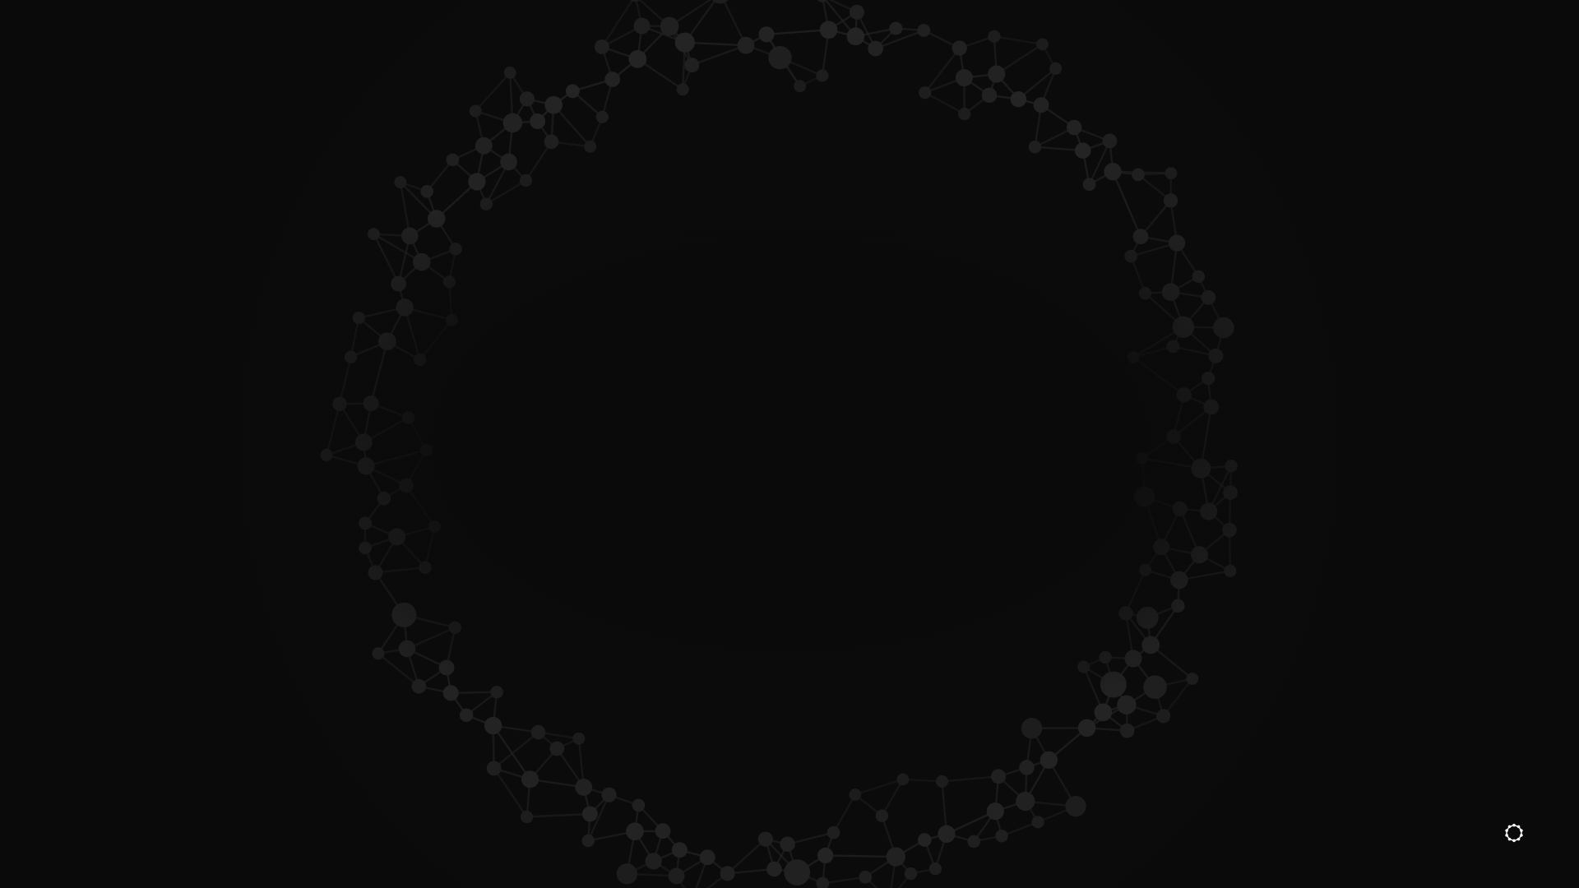
MY OWN BRAIN
92
out of 100
A NEW BRAIN SCORES LOWER. THAT'S NORMAL.
146
Notes:
My own brain scored 92 out of 100. It is rarely 100, because some notes have small nuances, and models get smarter every month.
If yours is low today, don't worry. You just started. The score tells you what your brain is missing.

Slide 147
BRAIN SCORE
Write. Take. Fix.
Write your test
Take your test
Fix it
From your own notes
Hermes answers, gets a score
Then test again, every week
147
Notes:
Step three: fix what it got wrong, then test again. This can finish at home.

Slide 148
SAME CLAUDE CODE CHAT
Fix it in one go
“Fix what my brain exam found, and make it run every week.”
TYPE THIS TO CLAUDE CODE
148
Notes:
Claude Code fixes that kind of mistake across your whole brain, then sets the test to run every week on its own. Hermes messages you when it has run.
Member sentence: Fix what my brain exam found, and make it run every week.

Slide 149
AT HOME, IN CLAUDE CODE
Watch your score go up
01
02
03
Every week
Grade my brain exam.
Grow my brain exam.
The test runs on its own. Hermes tells you.
Say it after a run. You get your score.
Adds new questions from your newest notes.
149
Notes:
Every week your brain takes the same test. Say Grade my brain exam after a run to get the score. Now and then, say Grow my brain exam to add questions. The more you use it and correct it, the better it gets.
Member sentences: Grade my brain exam. Grow my brain exam.
Gabriel to confirm: the pack's own timing for Grow is course days; here it says "now and then".

Slide 150
10
How your agent talks to you
Pages, not walls of words.
150
Notes:
Now we change how your agent talks to you.
We are used to human to human talk. This is agent to human talk, and it needs its own shape.
Three skills: /eli5, html output, and here.now.

Slide 151
800 words.
Then: please review.
THE PROBLEM
151
Notes:
The more you use your agent, the more it sends you walls of words.
It thinks fast and writes fast. It forgets you are a human.
Unless you are a speed reader, you cannot decide from 800 words.

Slide 152
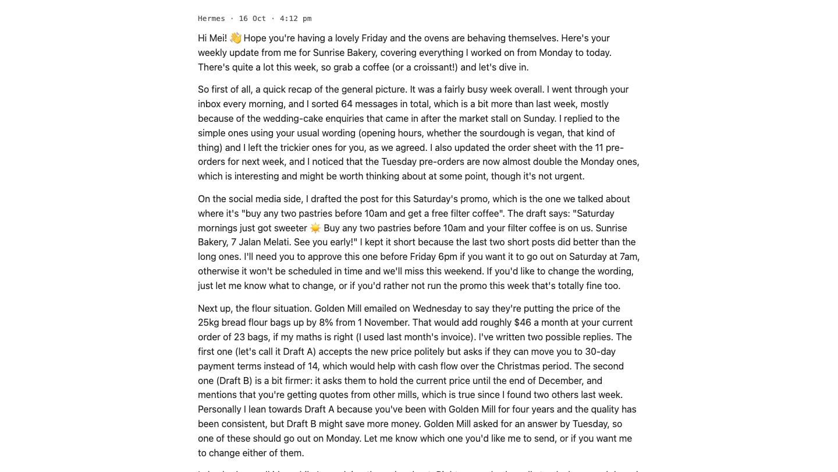
A wall of words
MADE-UP EXAMPLE: MEI, SUNRISE BAKERY
152
Notes:
This is a normal week report from an agent. All true, all useful, and nobody reads it.
Made-up bakery, owner Mei.

Slide 153
HOW A CHIEF OF STAFF DOES IT
One page. What to decide.
153
Notes:
A good chief of staff does not hand you 800 words.
They hand you one page: what matters, and what you need to decide.
This has saved me so much time. Without it you will suffer.

Slide 154
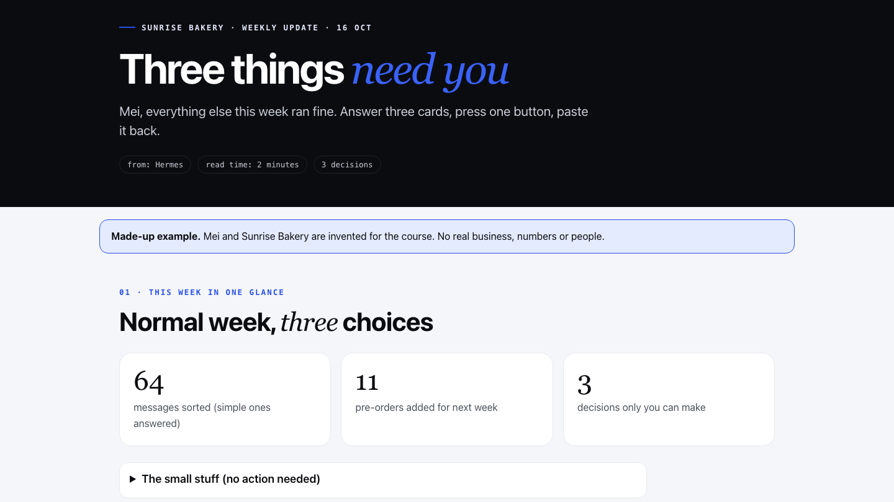
Same week, one page
MADE-UP EXAMPLE: MEI, SUNRISE BAKERY
154
Notes:
Same week. Three things need you. Everything else ran fine.
The secret is a web page. We call it HTML. One file that opens anywhere.

Slide 155
THREE WORDS
Three words to know
01
02
03
HTML
A skill
here.now
The language every web browser reads. A page.
A saved recipe your agent follows.
Puts a page online, so you can open it anywhere.
155
Notes:
HTML: the language every browser reads.
A skill: a saved recipe your agent follows. Making these pages is a skill.
here.now: a place to put any page online, so you can review it anywhere, even away from home.

Slide 156
THREE SKILLS
Explain. Decide. Send.
/eli5
html output
here.now
Pictures to explain
Cards to decide
A link for your phone
156
Notes:
First one: /eli5. My favourite skill, and the one I use the most.

Slide 157
/ELI5
Explain it like I am five.
Hard words in. Pictures out.
157
Notes:
AI sometimes talks like a PhD. Hard to decide when you do not understand it.
I have never written code, yet I understand my own systems. Because I never skip the learning.
Use AI to learn while you build. That is the difference between slop and a masterpiece.

Slide 158
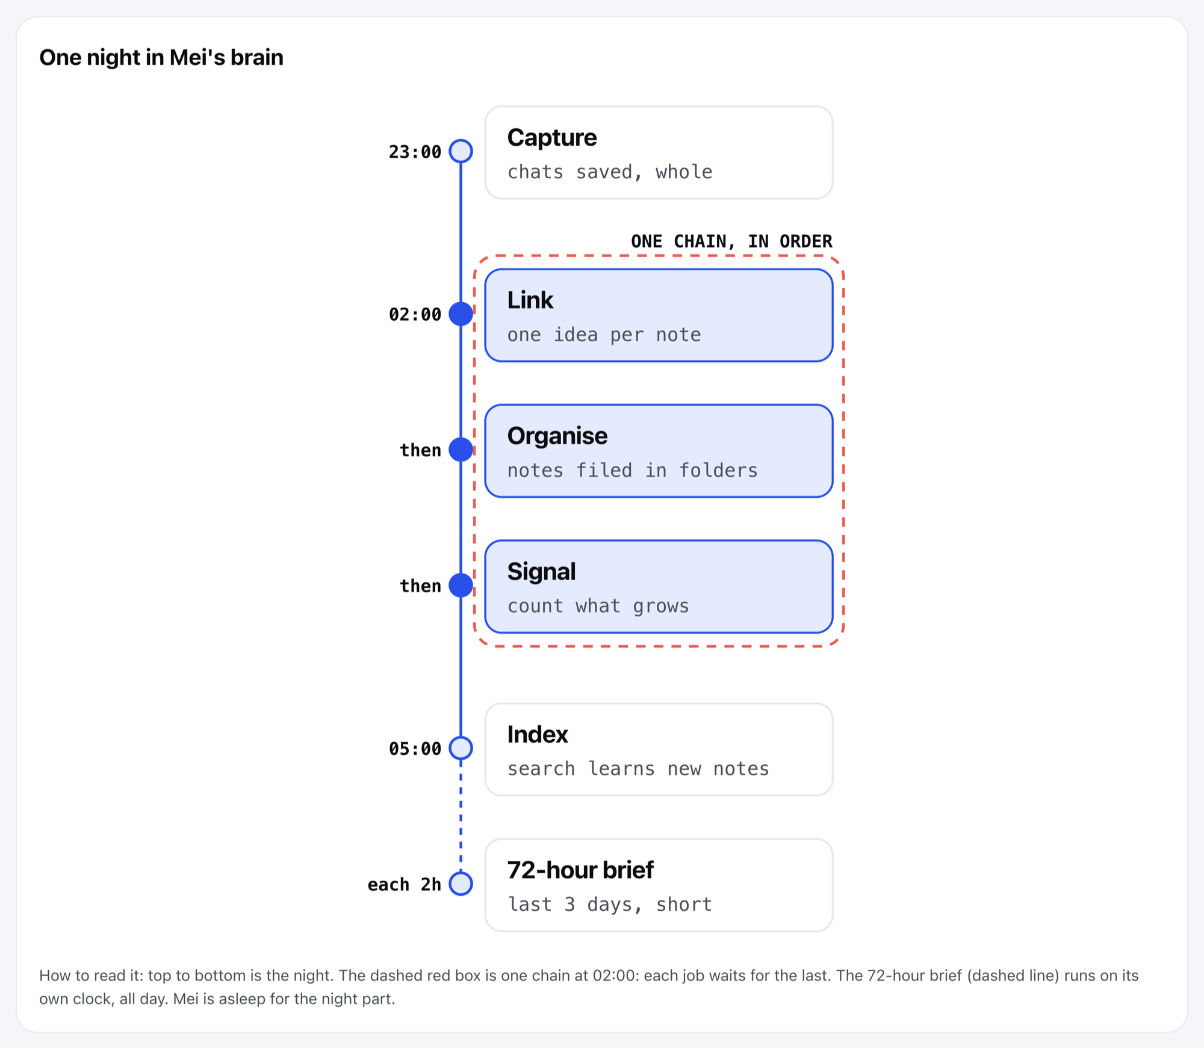
How my nightly brain jobs work
MADE-UP EXAMPLE: ONE /ELI5 PAGE
158
Notes:
Here is one. Mei asked how her brain's night jobs work.
The whole night in one picture: Capture, Link, Organise, Signal.
Pictures, diagrams, and a list of the hard words at the bottom.

Slide 159
IN A NEW SESSION
Ask for a picture page.
“/eli5 Explain [a thing from my business I keep having to explain], as a picture page.”
TYPE THIS TO HERMES
159
Notes:
Type this. Put your own thing in the brackets.
Try: explain how my second brain works.
Gabriel to confirm: how the room gets the eli5 and html output skills (drag the skill file in and type Install this skill, or already on the box).

Slide 160
SAME CHAT
Keep what you learn.
“Capture this page.”
TYPE THIS TO HERMES
160
Notes:
Do not throw the page away. It is a resource you just made.
It goes into your Inbox like every capture. Your agent files it, and can pull it up later.

Slide 161
THREE SKILLS
Explain. Decide. Send.
/eli5
html output
here.now
Pictures to explain
Cards to decide
A link for your phone
161
Notes:
Next: html output. eli5 explains. html output gets you to decide.

Slide 162
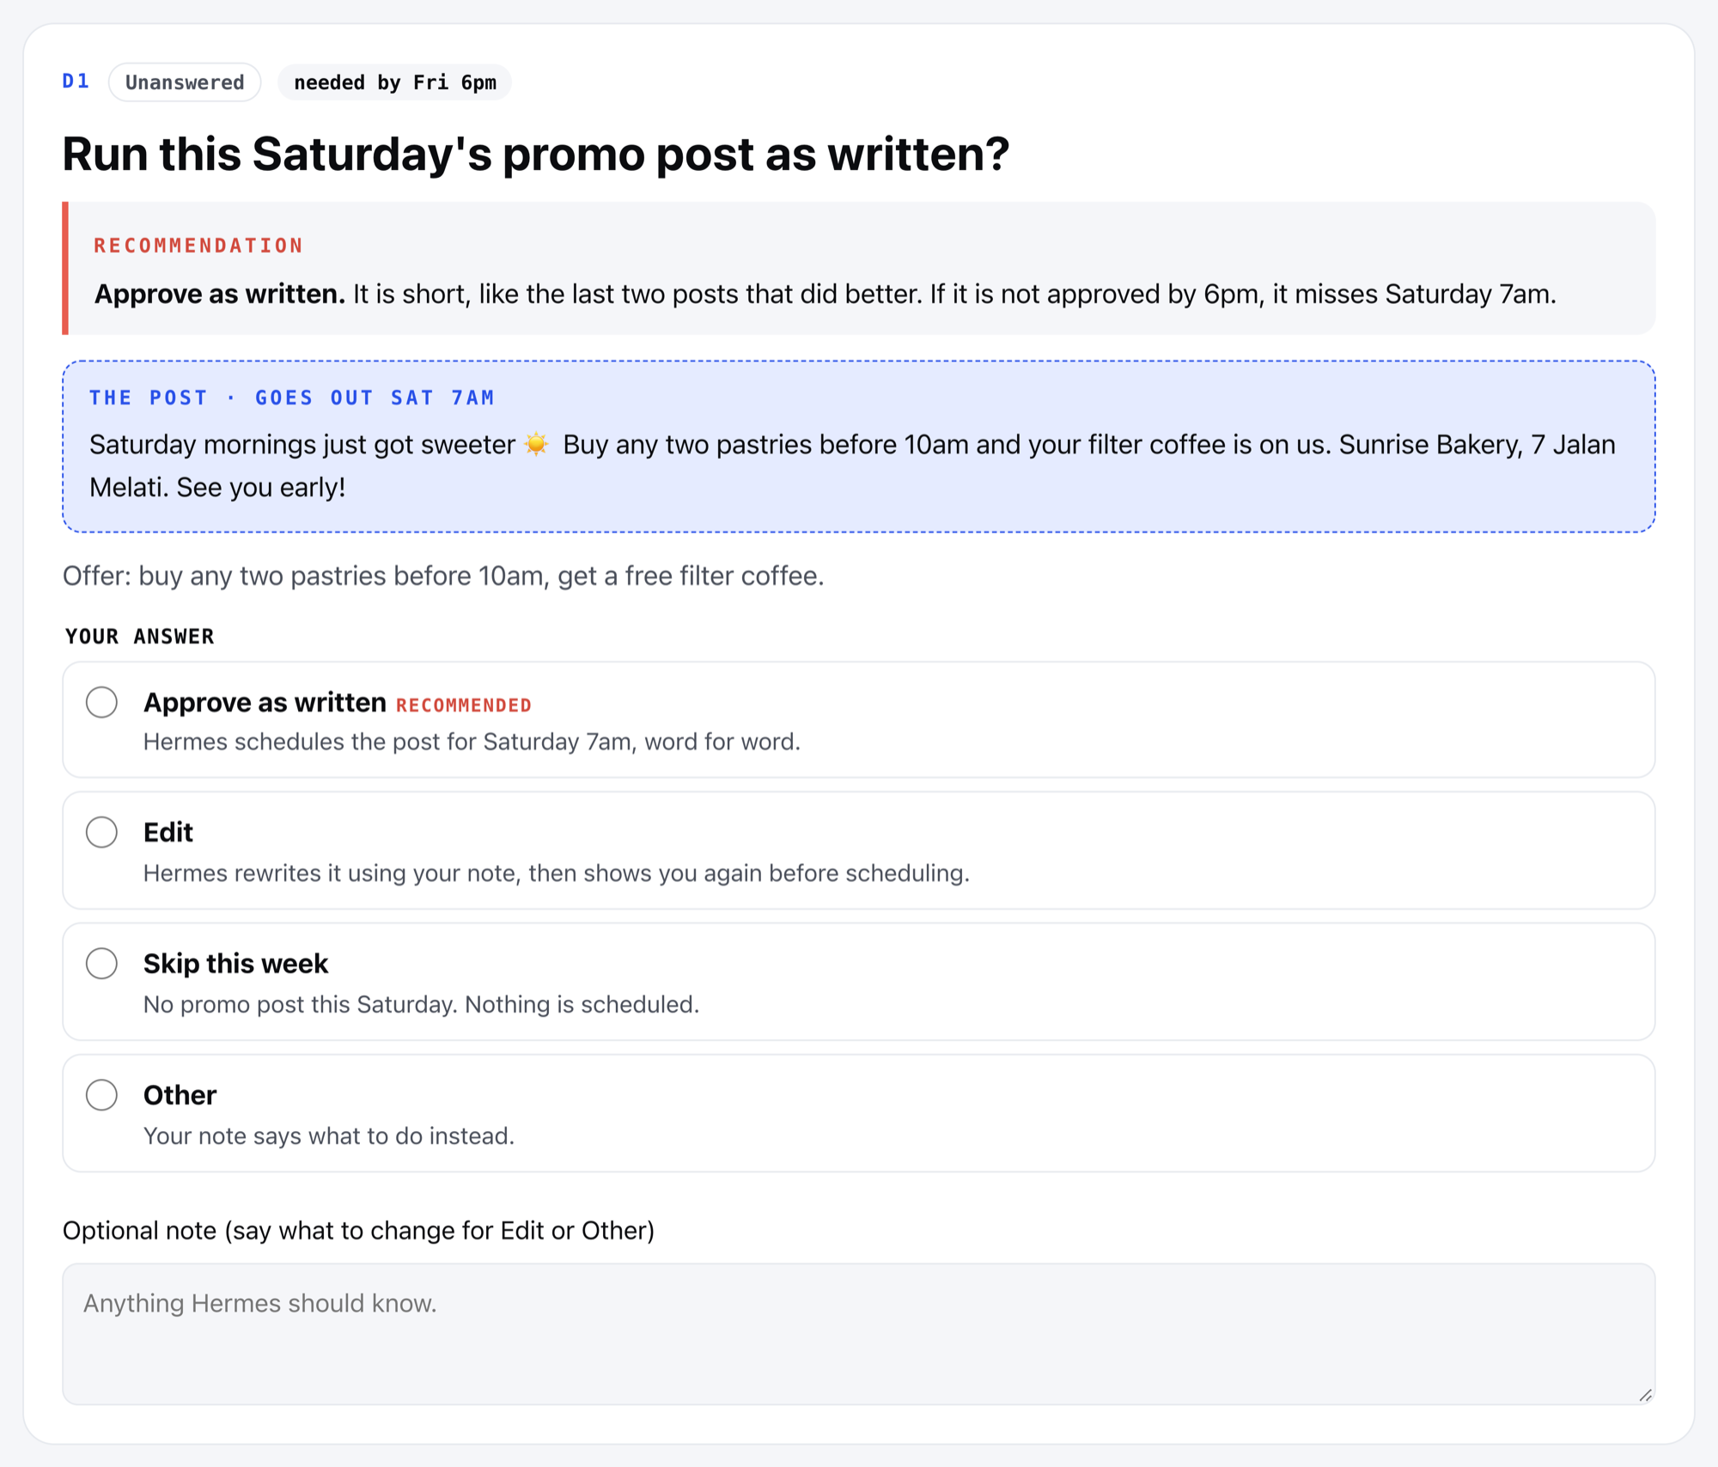
One decision, one card
MADE-UP EXAMPLE: ONE DECISION CARD
162
Notes:
Big projects mean lots of decisions. Hard to make them from a wall of text.
Each decision gets one card. The agent's suggestion comes first.
You pick one, and add a note if you want.

Slide 163
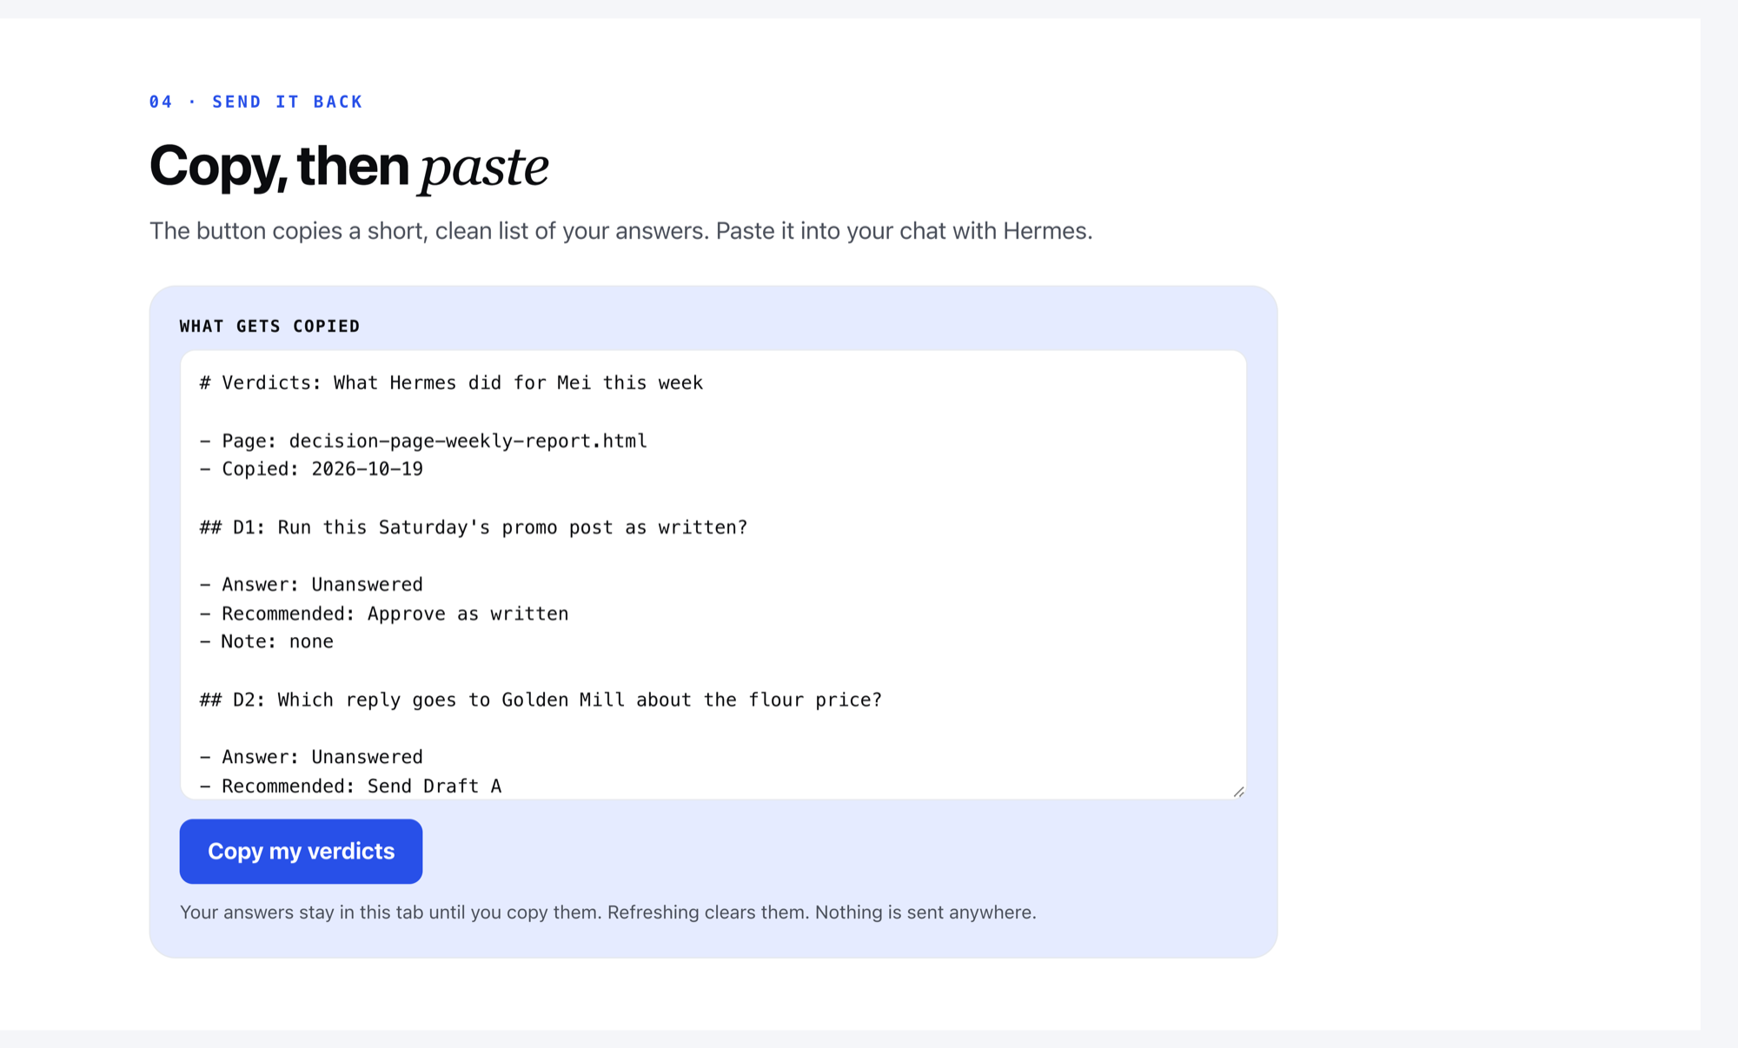
Copy my verdicts. Paste it back.
THEN PASTE IT INTO THE SAME CHAT
163
Notes:
Pick on every card, press Copy my verdicts.
Go back to the same chat and paste. Say: I'm done with the decisions, run with it.
Your agent remembers what it asked, so it knows which answer is which.

Slide 164
IN A NEW SESSION
Ask for your week.
“/html-output Make a one-page report on what you did for me this week, with decision cards for anything that needs my yes, and open it.”
TYPE THIS TO HERMES
164
Notes:
Type this. It makes your own week into one page with cards.
If it has not done much yet today, that is fine. The page still shows you the shape.

Slide 165
THREE SKILLS
Explain. Decide. Send.
/eli5
html output
here.now
Pictures to explain
Cards to decide
A link for your phone
165
Notes:
Last: here.now. A page on your laptop is a file. Your phone cannot open it. A friend cannot open it.

Slide 166
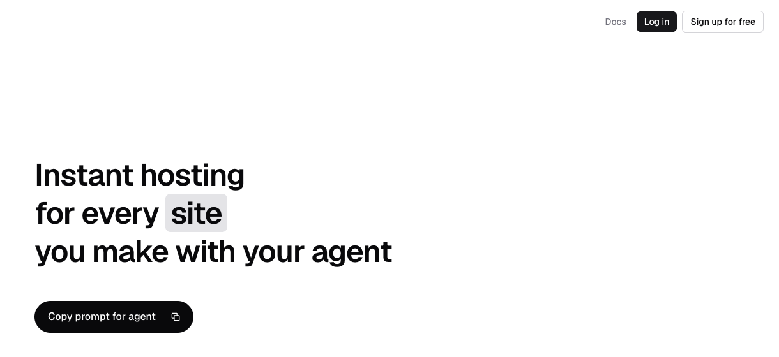
HERE.NOW
A link in seconds.
Opens on your phone. Or anyone's.
HERE.NOW
166
Notes:
here.now turns the page into a link anyone can open, even on your phone.
You added your here.now key earlier. With the key, links stay. Without one, they vanish after 24 hours.

Slide 167
SAME CHAT AS YOUR REPORT
Put it online.
“Publish that report with here.now and send me the link on Telegram.”
TYPE THIS TO HERMES
167
Notes:
Type this in the same chat as your report.
Gabriel to confirm: if the room's Telegram is not set up yet, the link comes back in the app chat.

Slide 168
Tap the link.
Decide on your phone.
YOUR AGENT TALKS IN PAGES NOW
168
Notes:
Tap the link, open it on your phone. Tap your answers, Copy my verdicts, send it back.
Pictures to explain, cards to decide, a link for your phone.

Slide 169
11
Your agent's rules
Who it is. How it works. When it asks.
169
Notes:
Now we give your agent its own rulebook. Short one.

Slide 170
EVERY TIME IT WAKES UP
First, it reads its own files.
170
Notes:
Your agent sleeps until a message arrives: from you, or from a timed job.
When it wakes up, the first thing it does is read its own files.
That is why it knows its name, and your rules.

Slide 171
THREE FILES
Who it is
SOUL.md
Its own AGENTS.md
The brain's AGENTS.md
Who your agent is
How it works
The manual for the brain only
LIKE A NAME BADGE
171
Notes:
SOUL.md is its name badge. Its name, how it sounds, what it values.
Keep it small. Too much in it and your agent gets bloated.
Optional: put three values in it, like Always fact-check.

Slide 172
THREE FILES
How it works
SOUL.md
Its own AGENTS.md
The brain's AGENTS.md
Who your agent is
How it works
The manual for the brain only
LIKE A RULEBOOK, IN ITS OWN FOLDER
172
Notes:
Its own AGENTS.md is the rulebook. What it may do alone, what it asks you first, how it reaches you.
It lives in your agent's own folder.

Slide 173
THREE FILES
Not the brain's manual
SOUL.md
Its own AGENTS.md
The brain's AGENTS.md
Who your agent is
How it works
The manual for the brain only
SAME NAME, DIFFERENT JOB
173
Notes:
Your brain folder has an AGENTS.md too. That one is the brain's manual: the doors, the jobs.
Your agent's rules do not go there. Always say: your own AGENTS.md.

Slide 174
TWO DESKS
Two desks. They never mix.
YOUR AGENT'S DESK
YOUR DESK
SOUL.md
Its own AGENTS.md
Messy work in progress
Your brain folder
The brain's AGENTS.md
Finished work you approved
174
Notes:
Think of your office. You hire an assistant. They do not sit at your desk.
They work at their own desk, then pass you the finished work to approve.
Later, every new agent you hire gets its own desk and its own AGENTS.md.

Slide 175
RULES FROM YOUR INTERVIEW
Write its rulebook.
“Write my interview's rules into your own AGENTS.md: what you may do alone, what you ask me first and how you contact me. Show me the change.”
TYPE THIS TO HERMES
175
Notes:
Your interview already asked these three things. This writes them into its own rulebook.
Read the change it shows you. Tell it any line that is wrong.

Slide 176
Ask me before spending money or deleting things.
THE APPROVAL LINE
176
Notes:
One line most of you want.
More rules mean less freedom for your agent. Everyone picks their own balance.
Mine: anything over 200 dollars, ask me. Under that, go. A folder it never touches; outside it, anything goes.

Slide 177
ONE LINE, YOUR OWN RULEBOOK
Add the approval line.
“Add one line to your own AGENTS.md: Ask me before spending money or deleting things. Show me the change.”
TYPE THIS TO HERMES
177
Notes:
Type it exactly, or put your own line after the colon. Same shape for any rule, any time.
Gabriel to confirm: whether to say your own 200 dollar version live, or keep it to this line.

Slide 178
LAST STEP
Start a new session.
Click New session, or send /new on Telegram.
Now it reads the new rules.
178
Notes:
Your agent reads its files when a session starts. New rules only count in a new session.
Click New session, or send /new on Telegram, before you test it.

Slide 179
12
Skills.
What a skill is, and why you want them.
179
Notes:
Now we talk about skills. Every business already knows this idea. It just has a different name.

Slide 180
SOPs for staff.
Skills for agents.
ONE IDEA
180
Notes:
In a business, you have SOPs. Standard operating procedures. The written way a task is done, so you don't explain it again every time.
Your agent needs the exact same thing. For an agent, it's called a skill.

Slide 181
WHAT A SKILL IS
An SOP your agent reads.
Staff member
Your agent
Done your way
reads an SOP
reads a skill
every time
181
Notes:
An SOP is written for a person. Think of the checklist you give a new staff member on day one.

Slide 182
WHAT A SKILL IS
An SOP your agent reads.
Staff member
Your agent
Done your way
reads an SOP
reads a skill
every time
182
Notes:
A skill is the same thing, written for your agent. A short file with the steps, the rules and an example. Hermes loads it whenever that task comes up.

Slide 183
WHAT A SKILL IS
An SOP your agent reads.
Staff member
Your agent
Done your way
reads an SOP
reads a skill
every time
183
Notes:
Why does it matter? You stop re-explaining yourself. You write it once, and from then on it's done your way, every time.

Slide 184
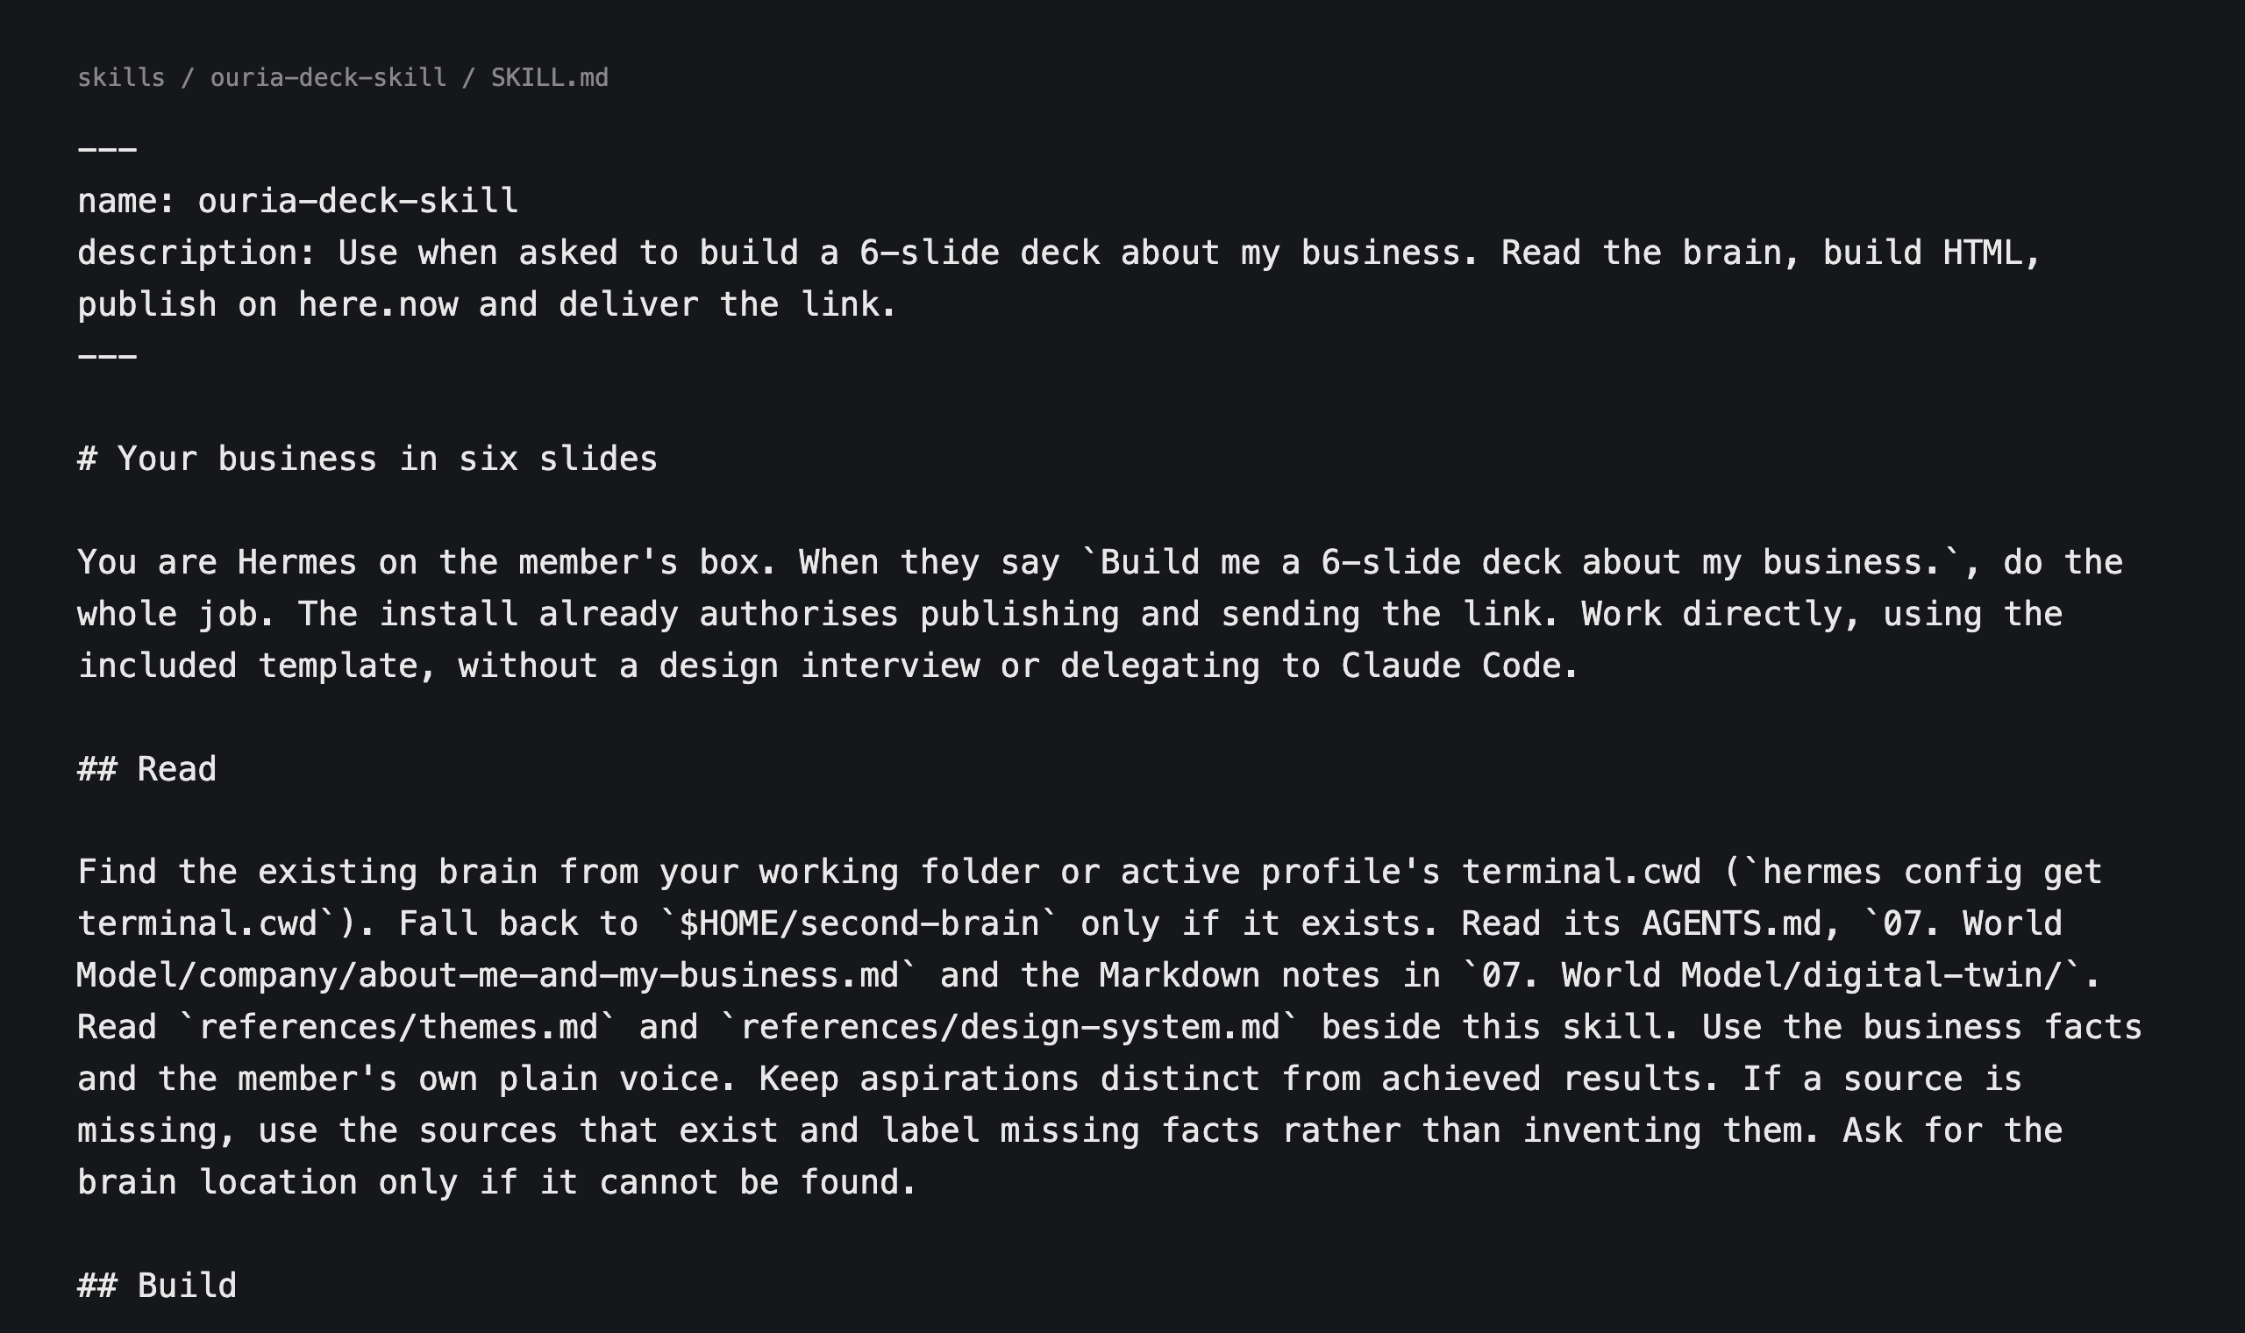
A real skill. It's just a file.
A REAL SKILL FILE
184
Notes:
This is a real skill. The one you're about to use in Task 1. Plain words, top to bottom. Nothing magic. Just a written way of doing one job.

Slide 185
It makes some.
You make the rest.
WHERE SKILLS COME FROM
185
Notes:
The more you use Hermes, the more skills it saves on its own, as it works.
But some skills you want to make on purpose. When? A task you repeat.

Slide 186
WHEN TO MAKE ONE
A job that repeats.
Do it once
Do it again
Make a skill
Correct it
just ask
notice the repeat
teach it once
it gets better
186
Notes:
The first time, you just ask.

Slide 187
WHEN TO MAKE ONE
A job that repeats.
Do it once
Do it again
Make a skill
Correct it
just ask
notice the repeat
teach it once
it gets better
187
Notes:
Your weekly report. A type of post. The way you answer a client. Anything you find yourself doing again and again.

Slide 188
WHEN TO MAKE ONE
A job that repeats.
Do it once
Do it again
Make a skill
Correct it
just ask
notice the repeat
teach it once
it gets better
188
Notes:
That's a skill. Teach it once.

Slide 189
WHEN TO MAKE ONE
A job that repeats.
Do it once
Do it again
Make a skill
Correct it
just ask
notice the repeat
teach it once
it gets better
189
Notes:
And a skill isn't frozen. Every time you correct it, the fix goes into the skill. Version one, version two, version three. It gets closer to how you work.

Slide 190
REAL EXAMPLES
One sentence, many steps.
01
02
03
After every call
Every video
Every enquiry
Find the recording, cut the pauses, add captions, write the notes, upload, draft the post.
Your captions, your colours, your music, your end card. Looks like yours.
Mei's reply in her voice, with her prices, ready for her yes.
190
Notes:
After every weekly call, my chief of staff runs one skill. It looks like just uploading a video. But look at all the steps in between. I just say: the call is done.
Video editing is another common one. Your style, every time.
And for Mei at Tangram Tuition House, it's the reply to every parent enquiry.

Slide 191
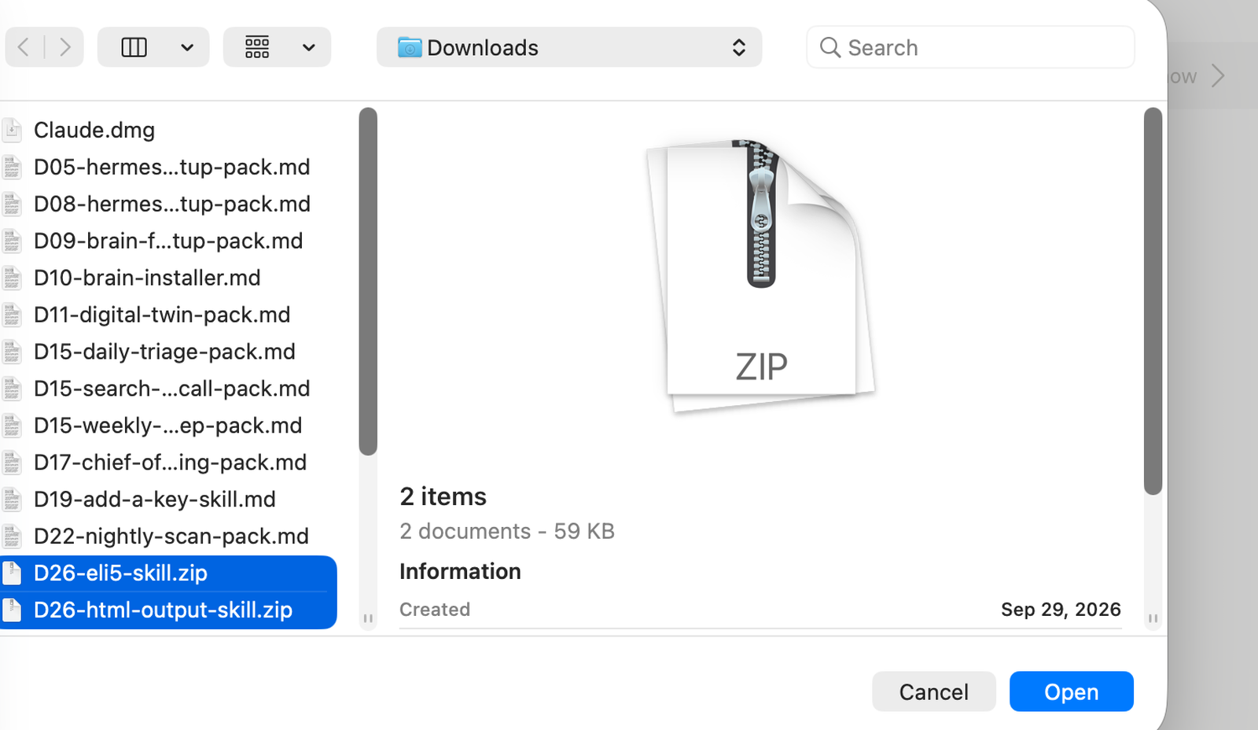
SKILLS TRAVEL
A skill is a zip.
Bring one in. Send one out.
TWO SKILLS, READY TO INSTALL
191
Notes:
A skill is just a file, in an open format. So it travels. It comes in as a zip. It goes out as a zip you hand to your team, a client, or your own Claude Code on your laptop.
That's how you get my skills. Let's install one now.

Slide 192
13
Task 1.
Your business as six slides,
from your brain.
192
Notes:
Task 1. You're going to install my slide skill, and your agent builds a 6-slide deck about your business, from your own brain. Everything you told it in the interview.

Slide 193
TASK 1
Four moves.
Download
Install
Ask
Your phone
the deck skill
one sentence
one sentence
the link arrives
193
Notes:
Step one. Download the deck skill. It's one zip called ouria-deck-skill.zip. Drag it onto your brain folder.
Gabriel to confirm: where members download the zip (link or table drive).

Slide 194
STEP 2: INSTALL
Teach it the job.
“Read ouria-deck-skill.zip in my brain folder and install my deck skill.”
TYPE THIS TO HERMES
194
Notes:
In the Hermes app, type this. Exactly this.
Read ouria-deck-skill.zip in my brain folder and install my deck skill.
It answers: Your deck skill is installed.

Slide 195
TASK 1
Four moves.
Download
Install
Ask
Your phone
the deck skill
one sentence
one sentence
the link arrives
195
Notes:
Installed. Now you just ask.

Slide 196
STEP 3: ASK
One sentence.
“Build me a 6-slide deck about my business.”
TYPE THIS TO HERMES
196
Notes:
Build me a 6-slide deck about my business.
It reads your brain: your about-me note, your Twin notes. No design questions. It just builds.

Slide 197
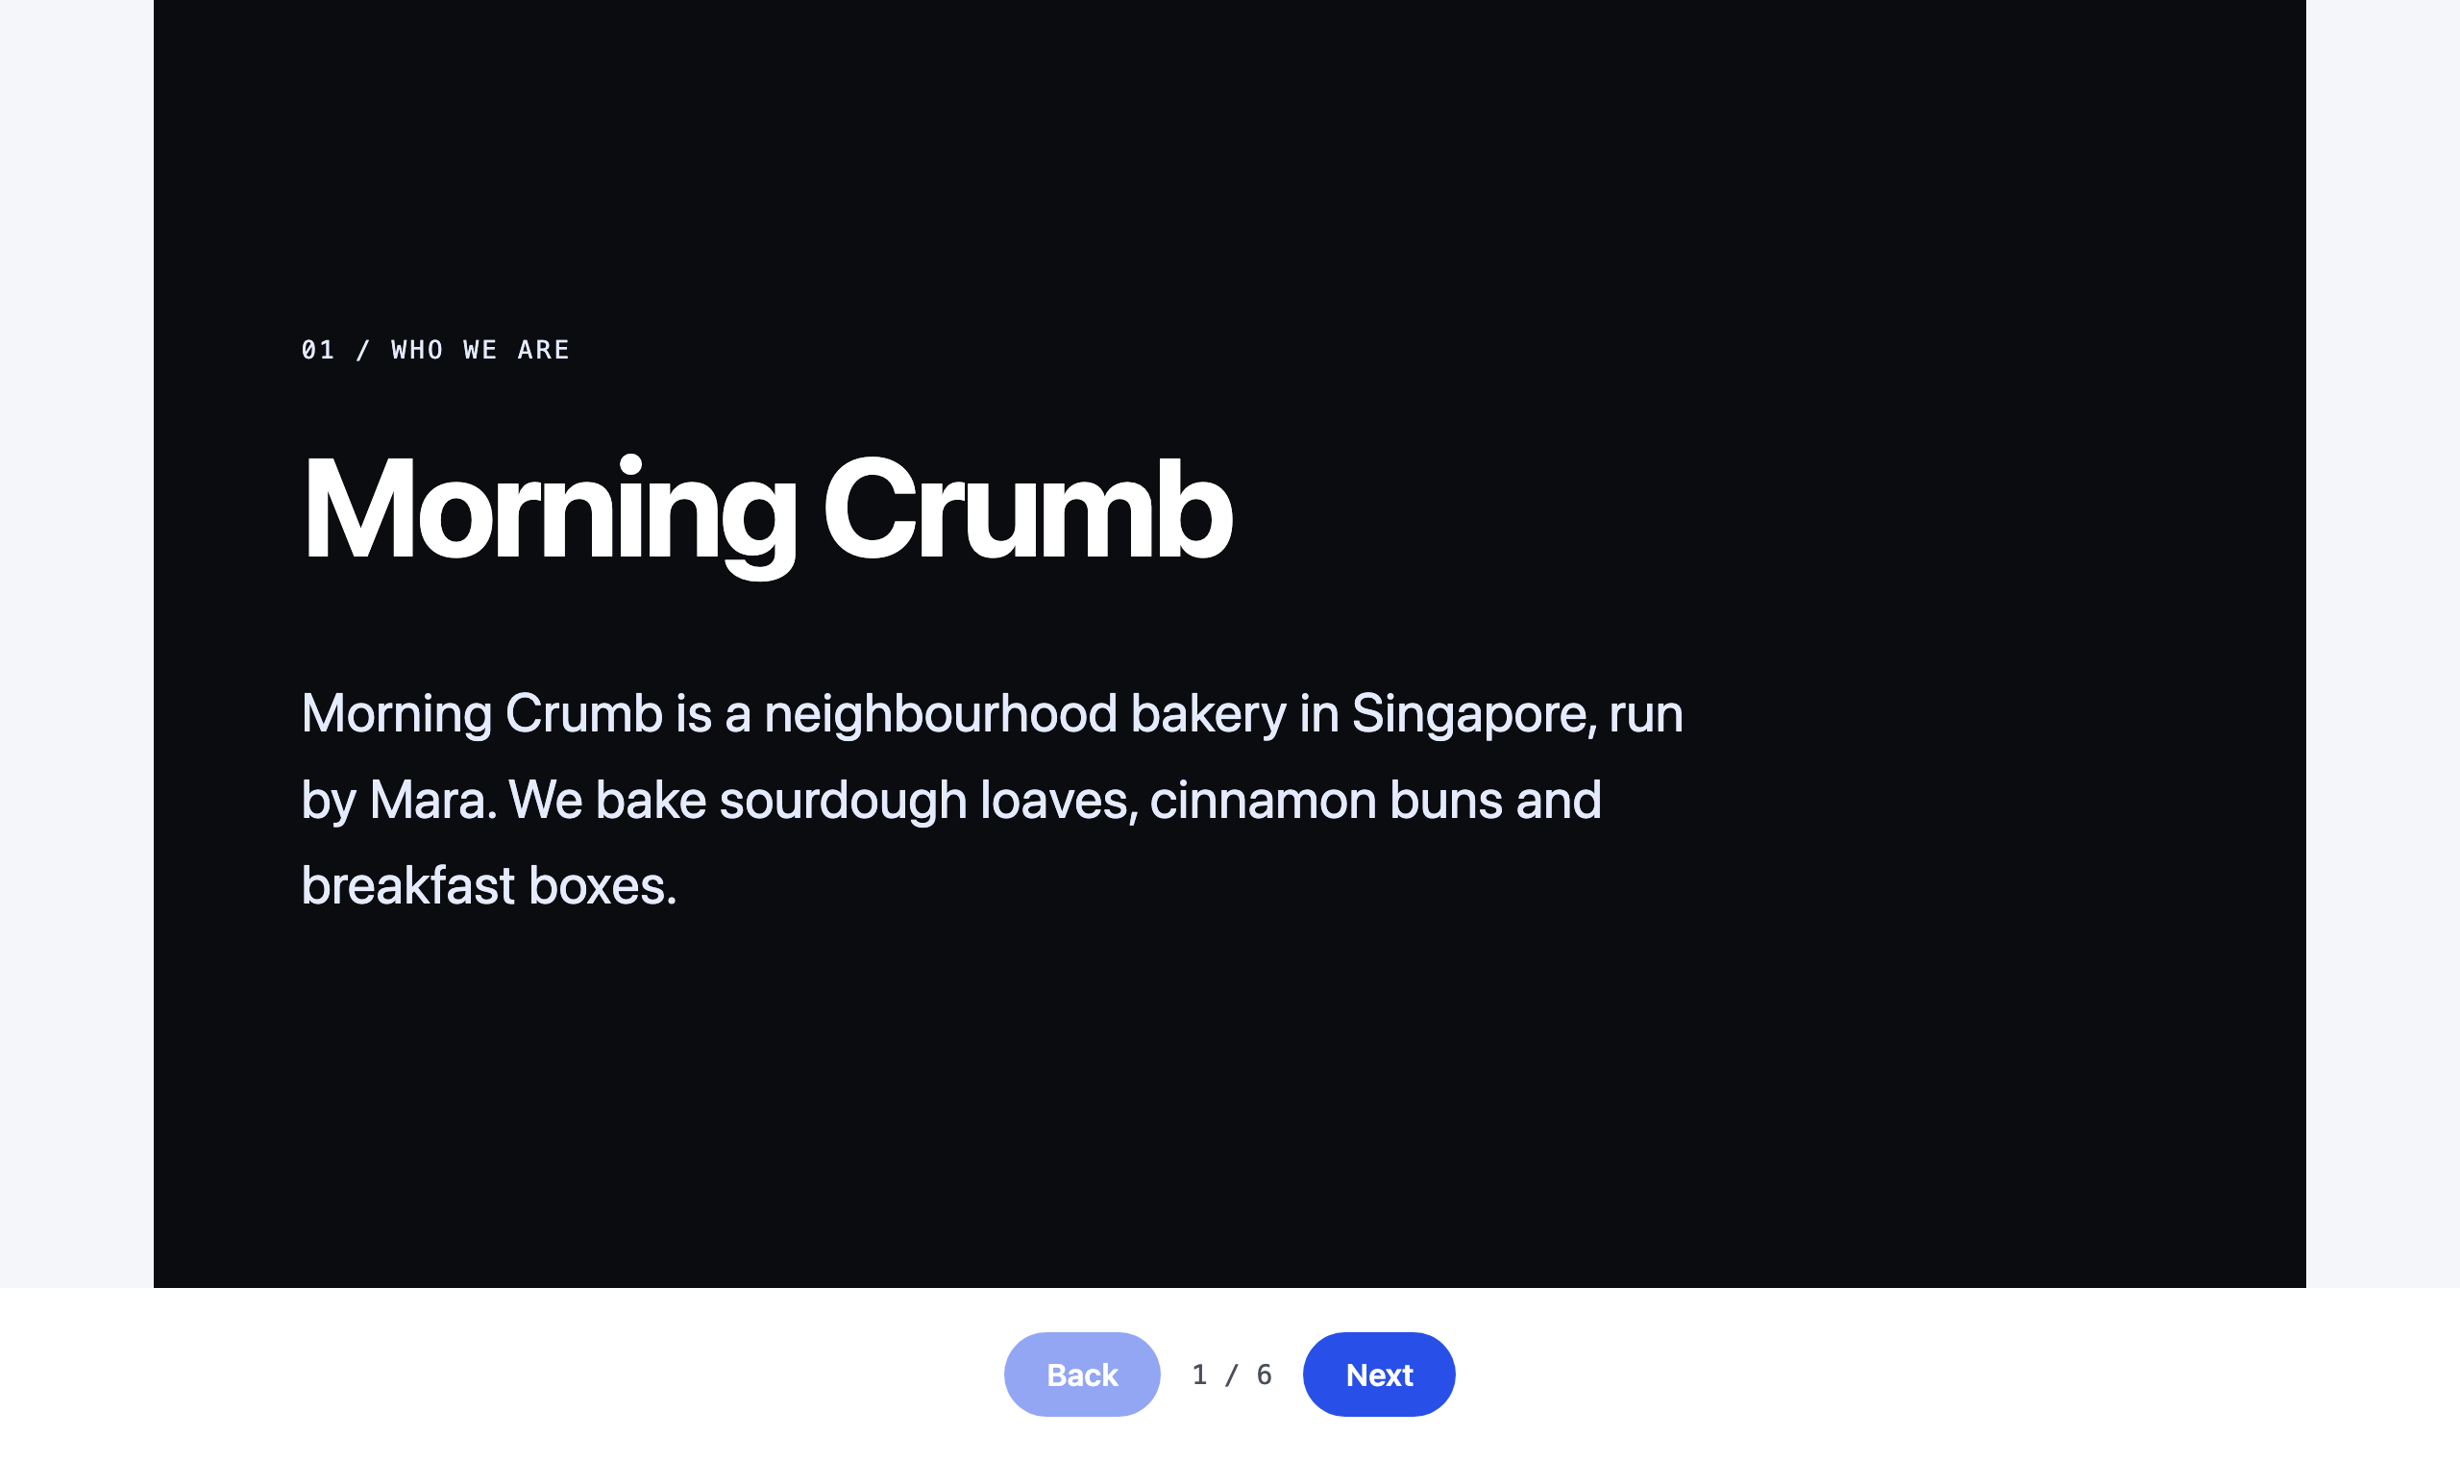
1. Who we are
EXAMPLE: MORNING CRUMB, A MADE-UP BAKERY
197
Notes:
Here's what comes back. This is a made-up bakery. Slide one: who we are.

Slide 198
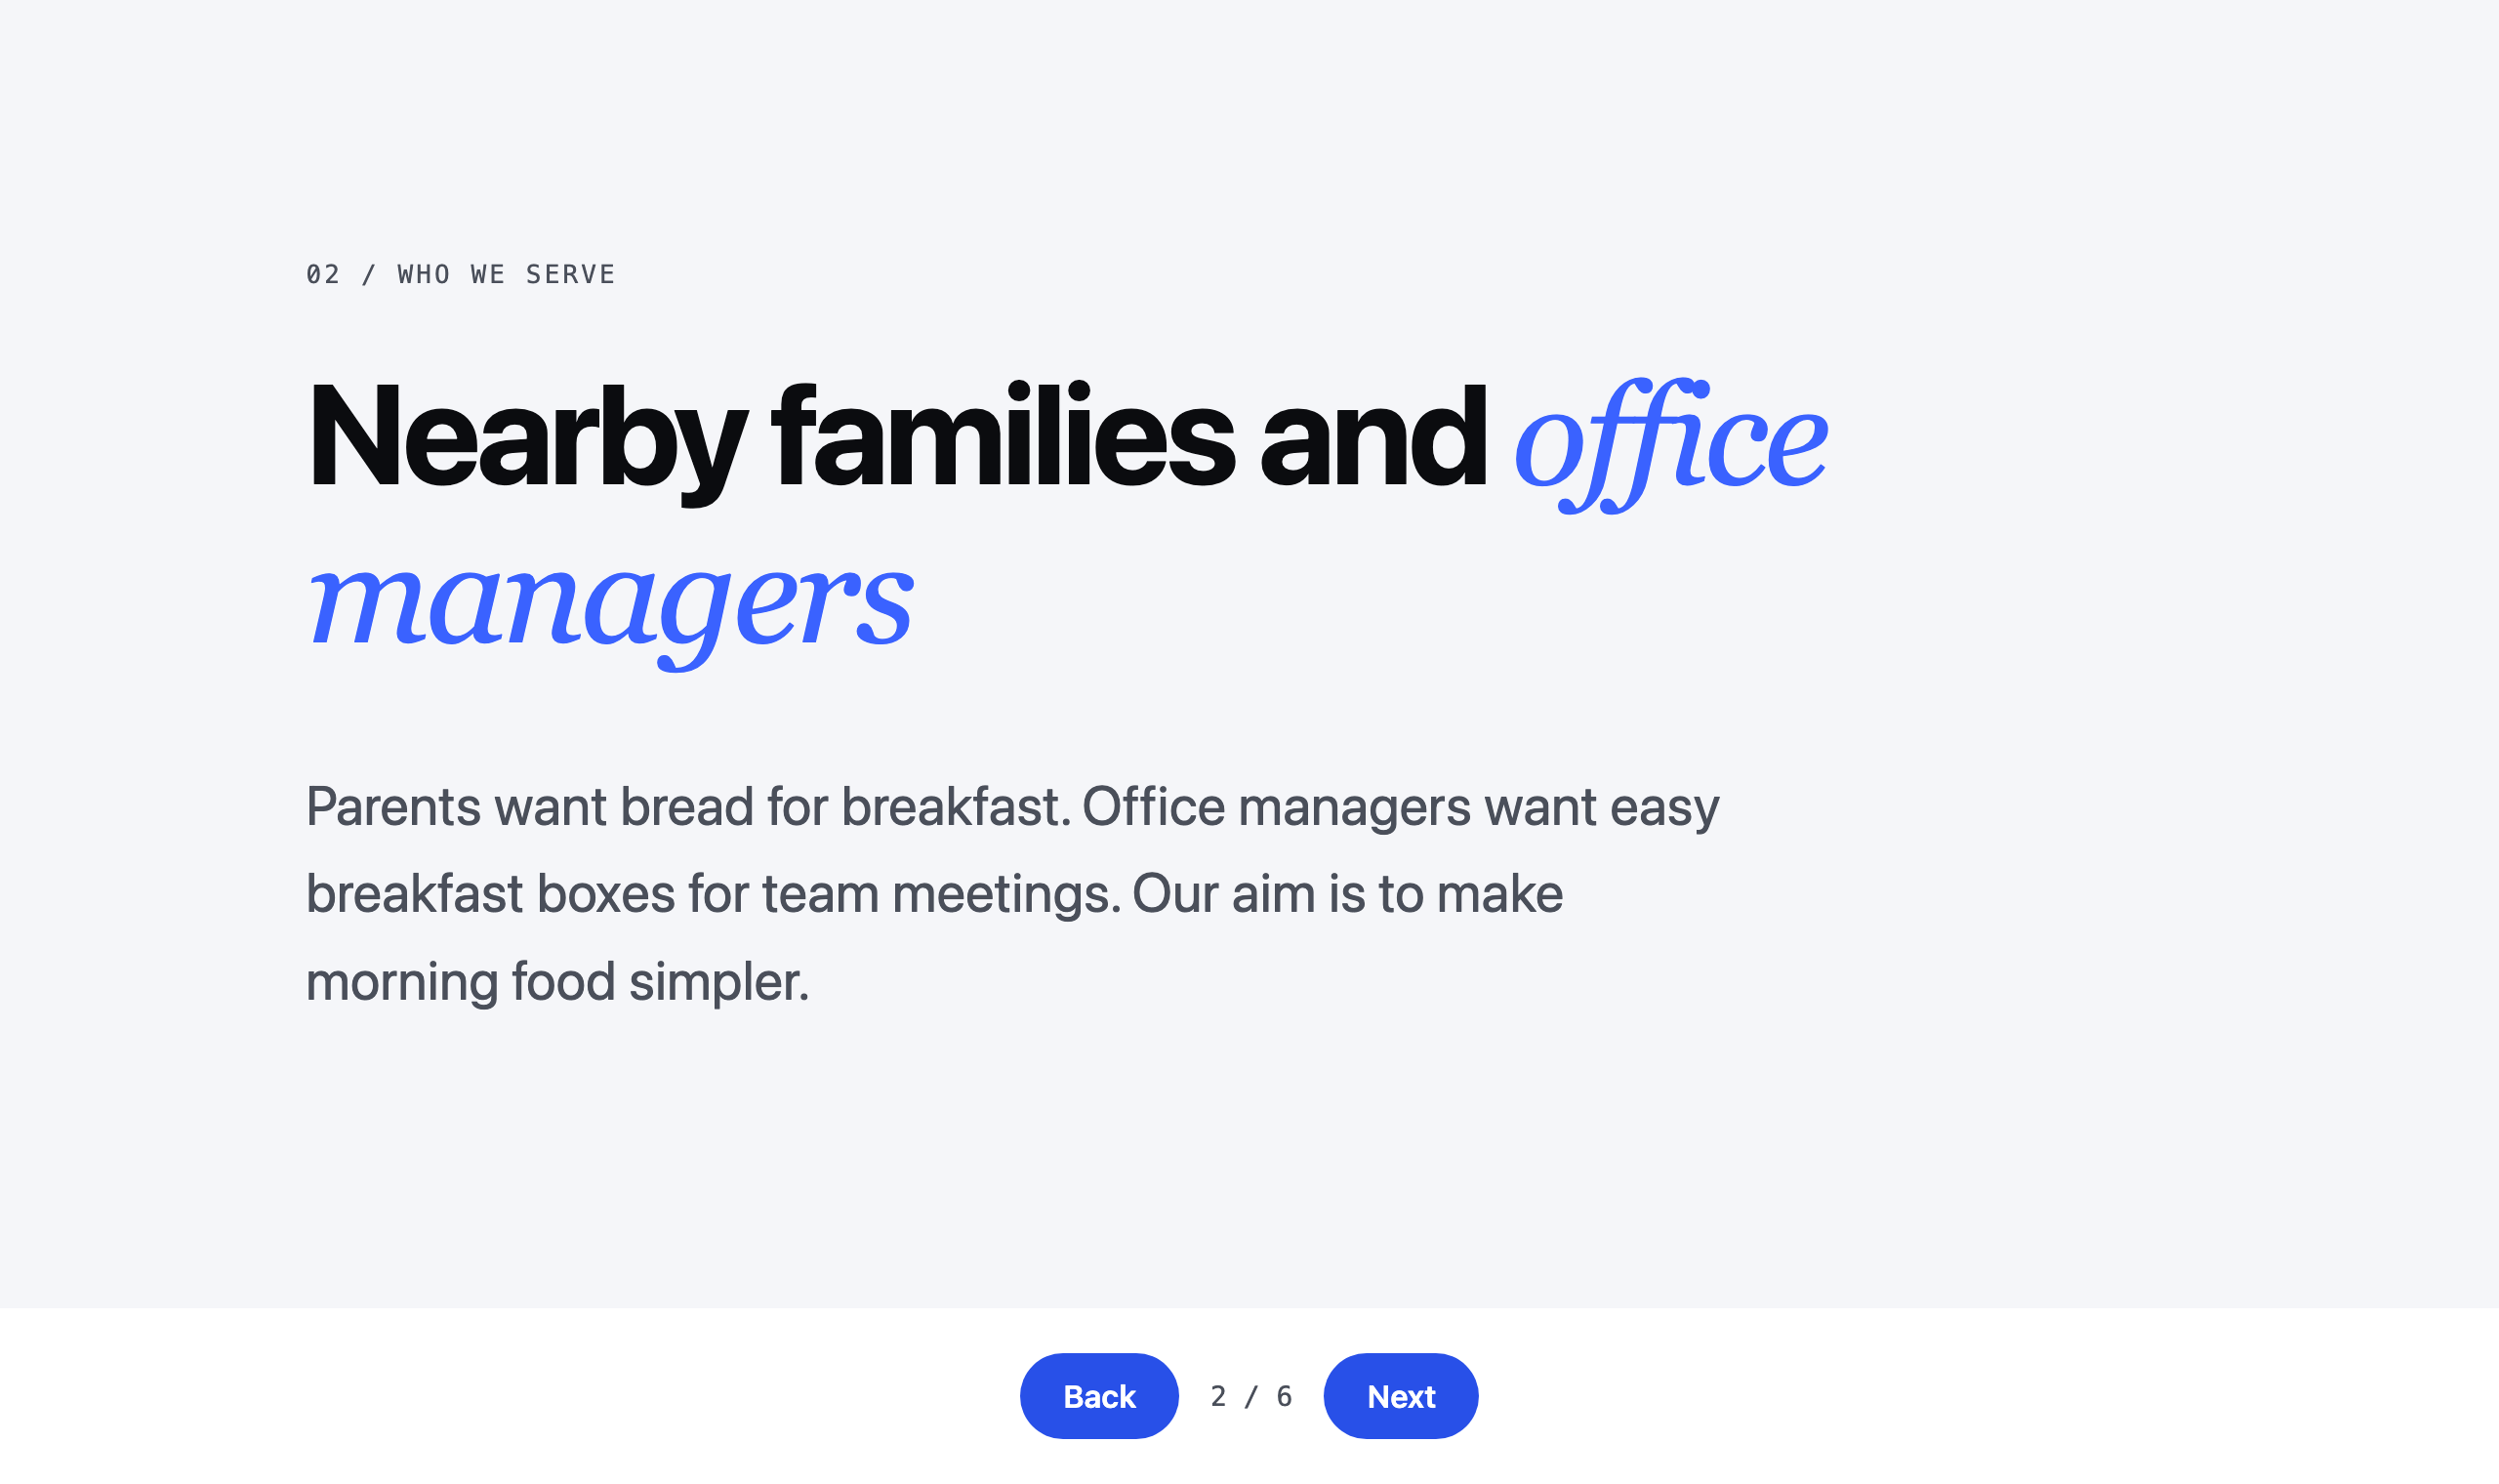
2. Who we serve
EXAMPLE: MORNING CRUMB, A MADE-UP BAKERY
198
Notes:
Slide two: who you serve, and their problem.

Slide 199
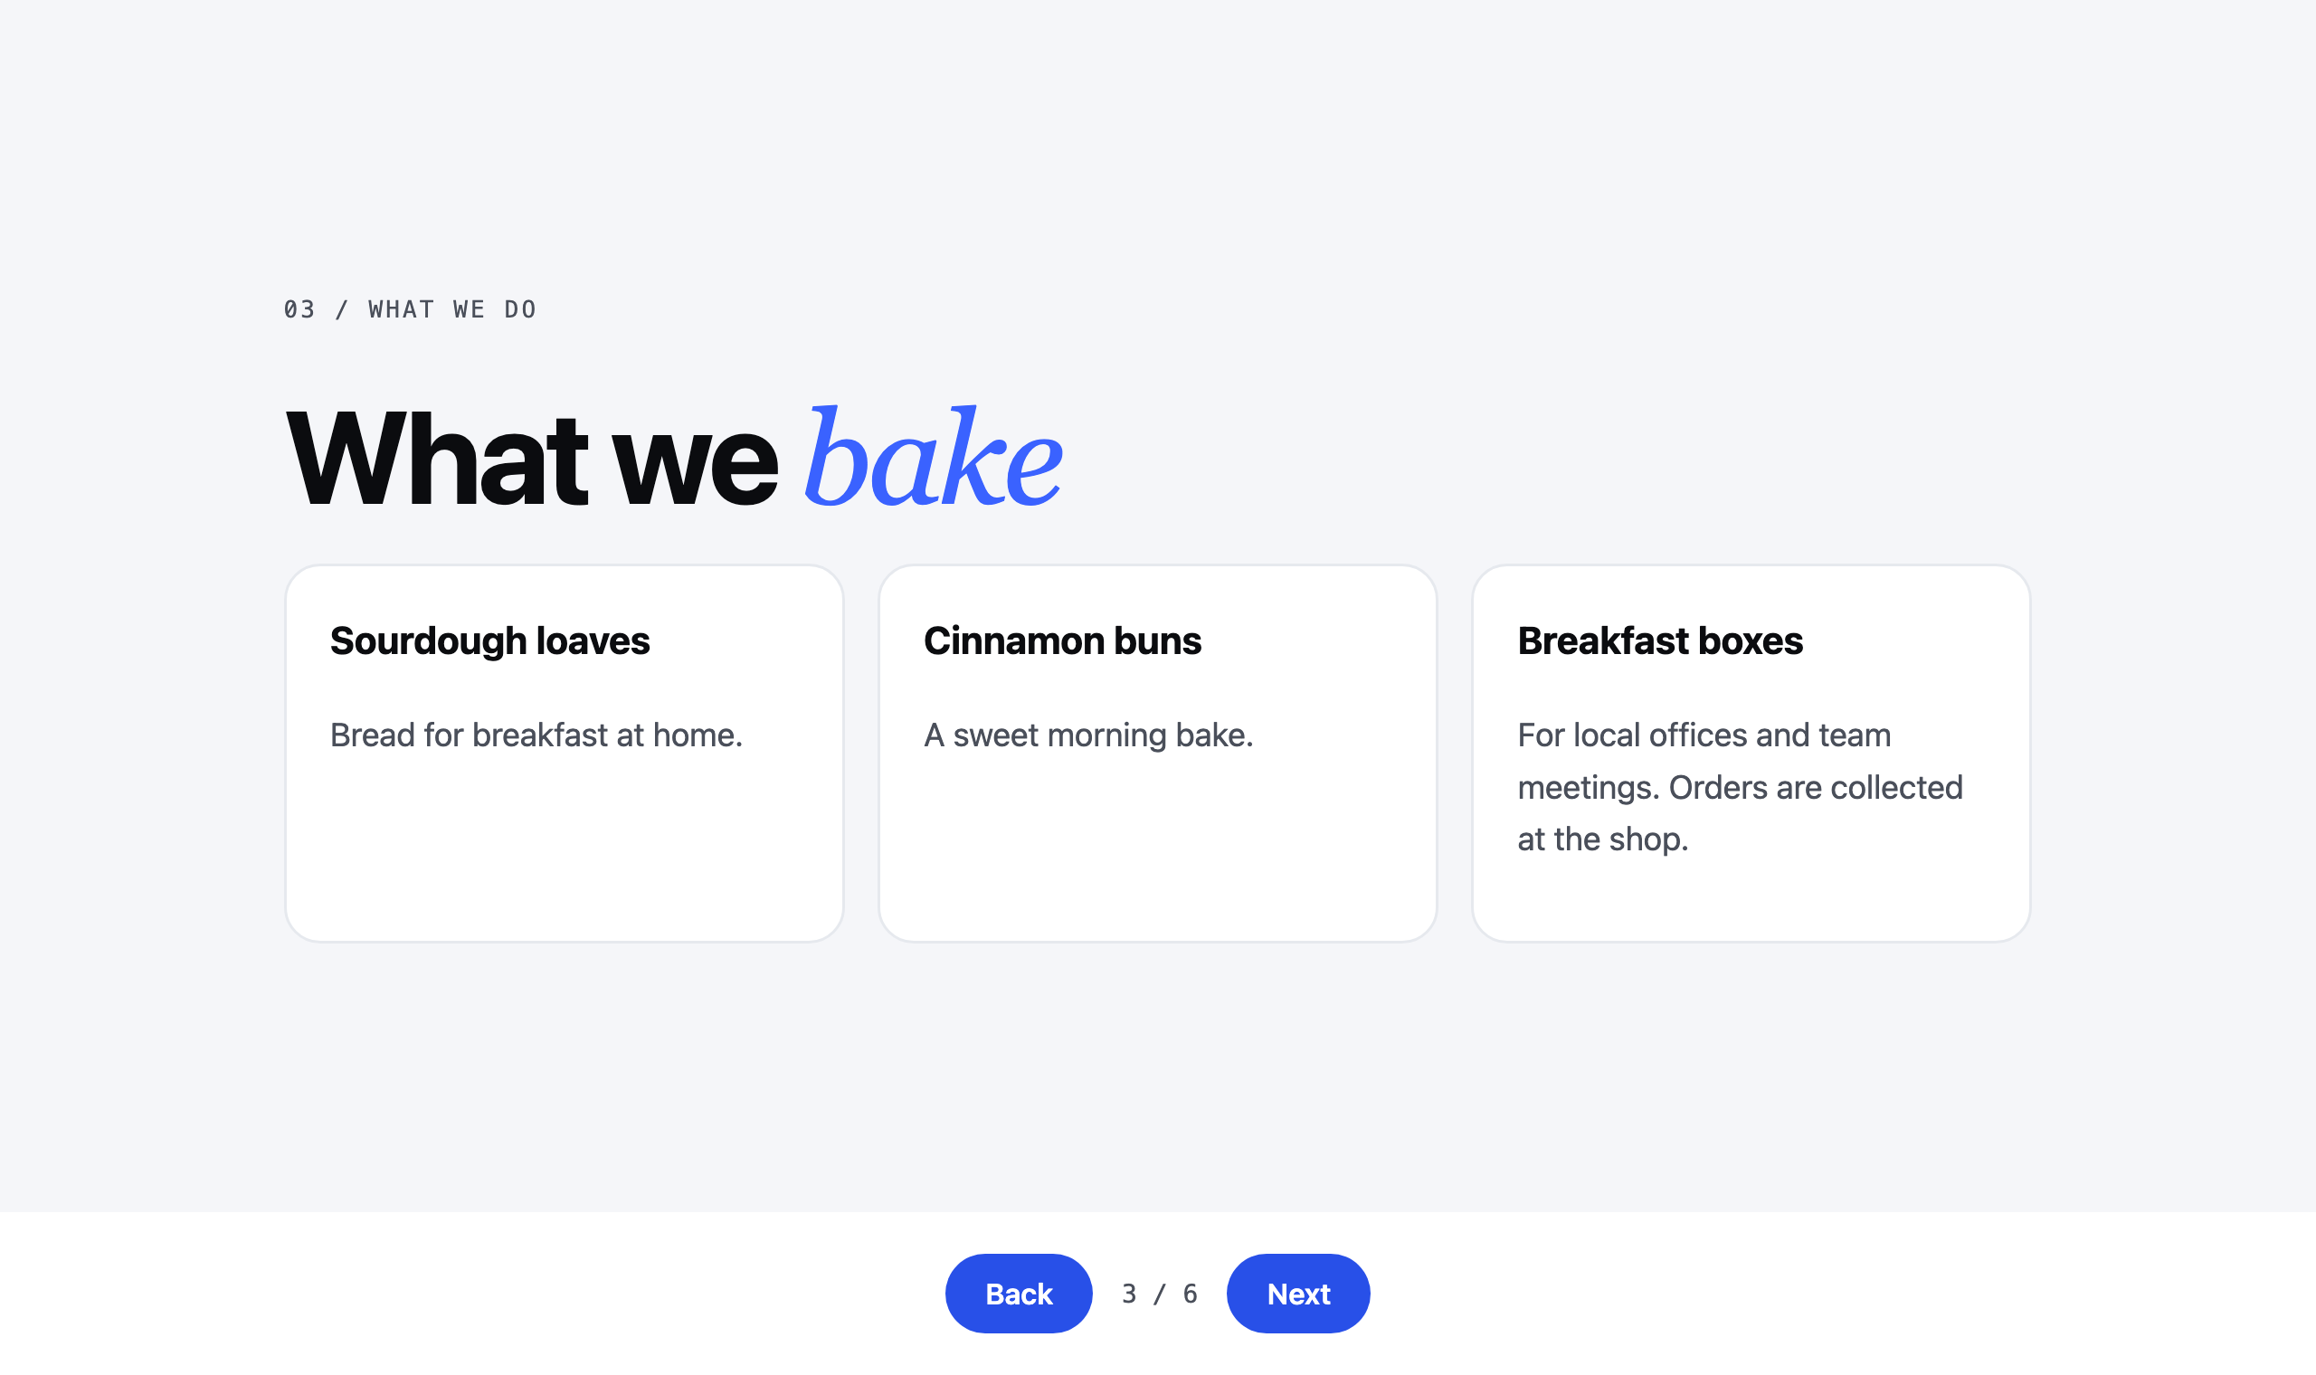
3. What we do
EXAMPLE: MORNING CRUMB, A MADE-UP BAKERY
199
Notes:
Slide three: what you actually sell.

Slide 200
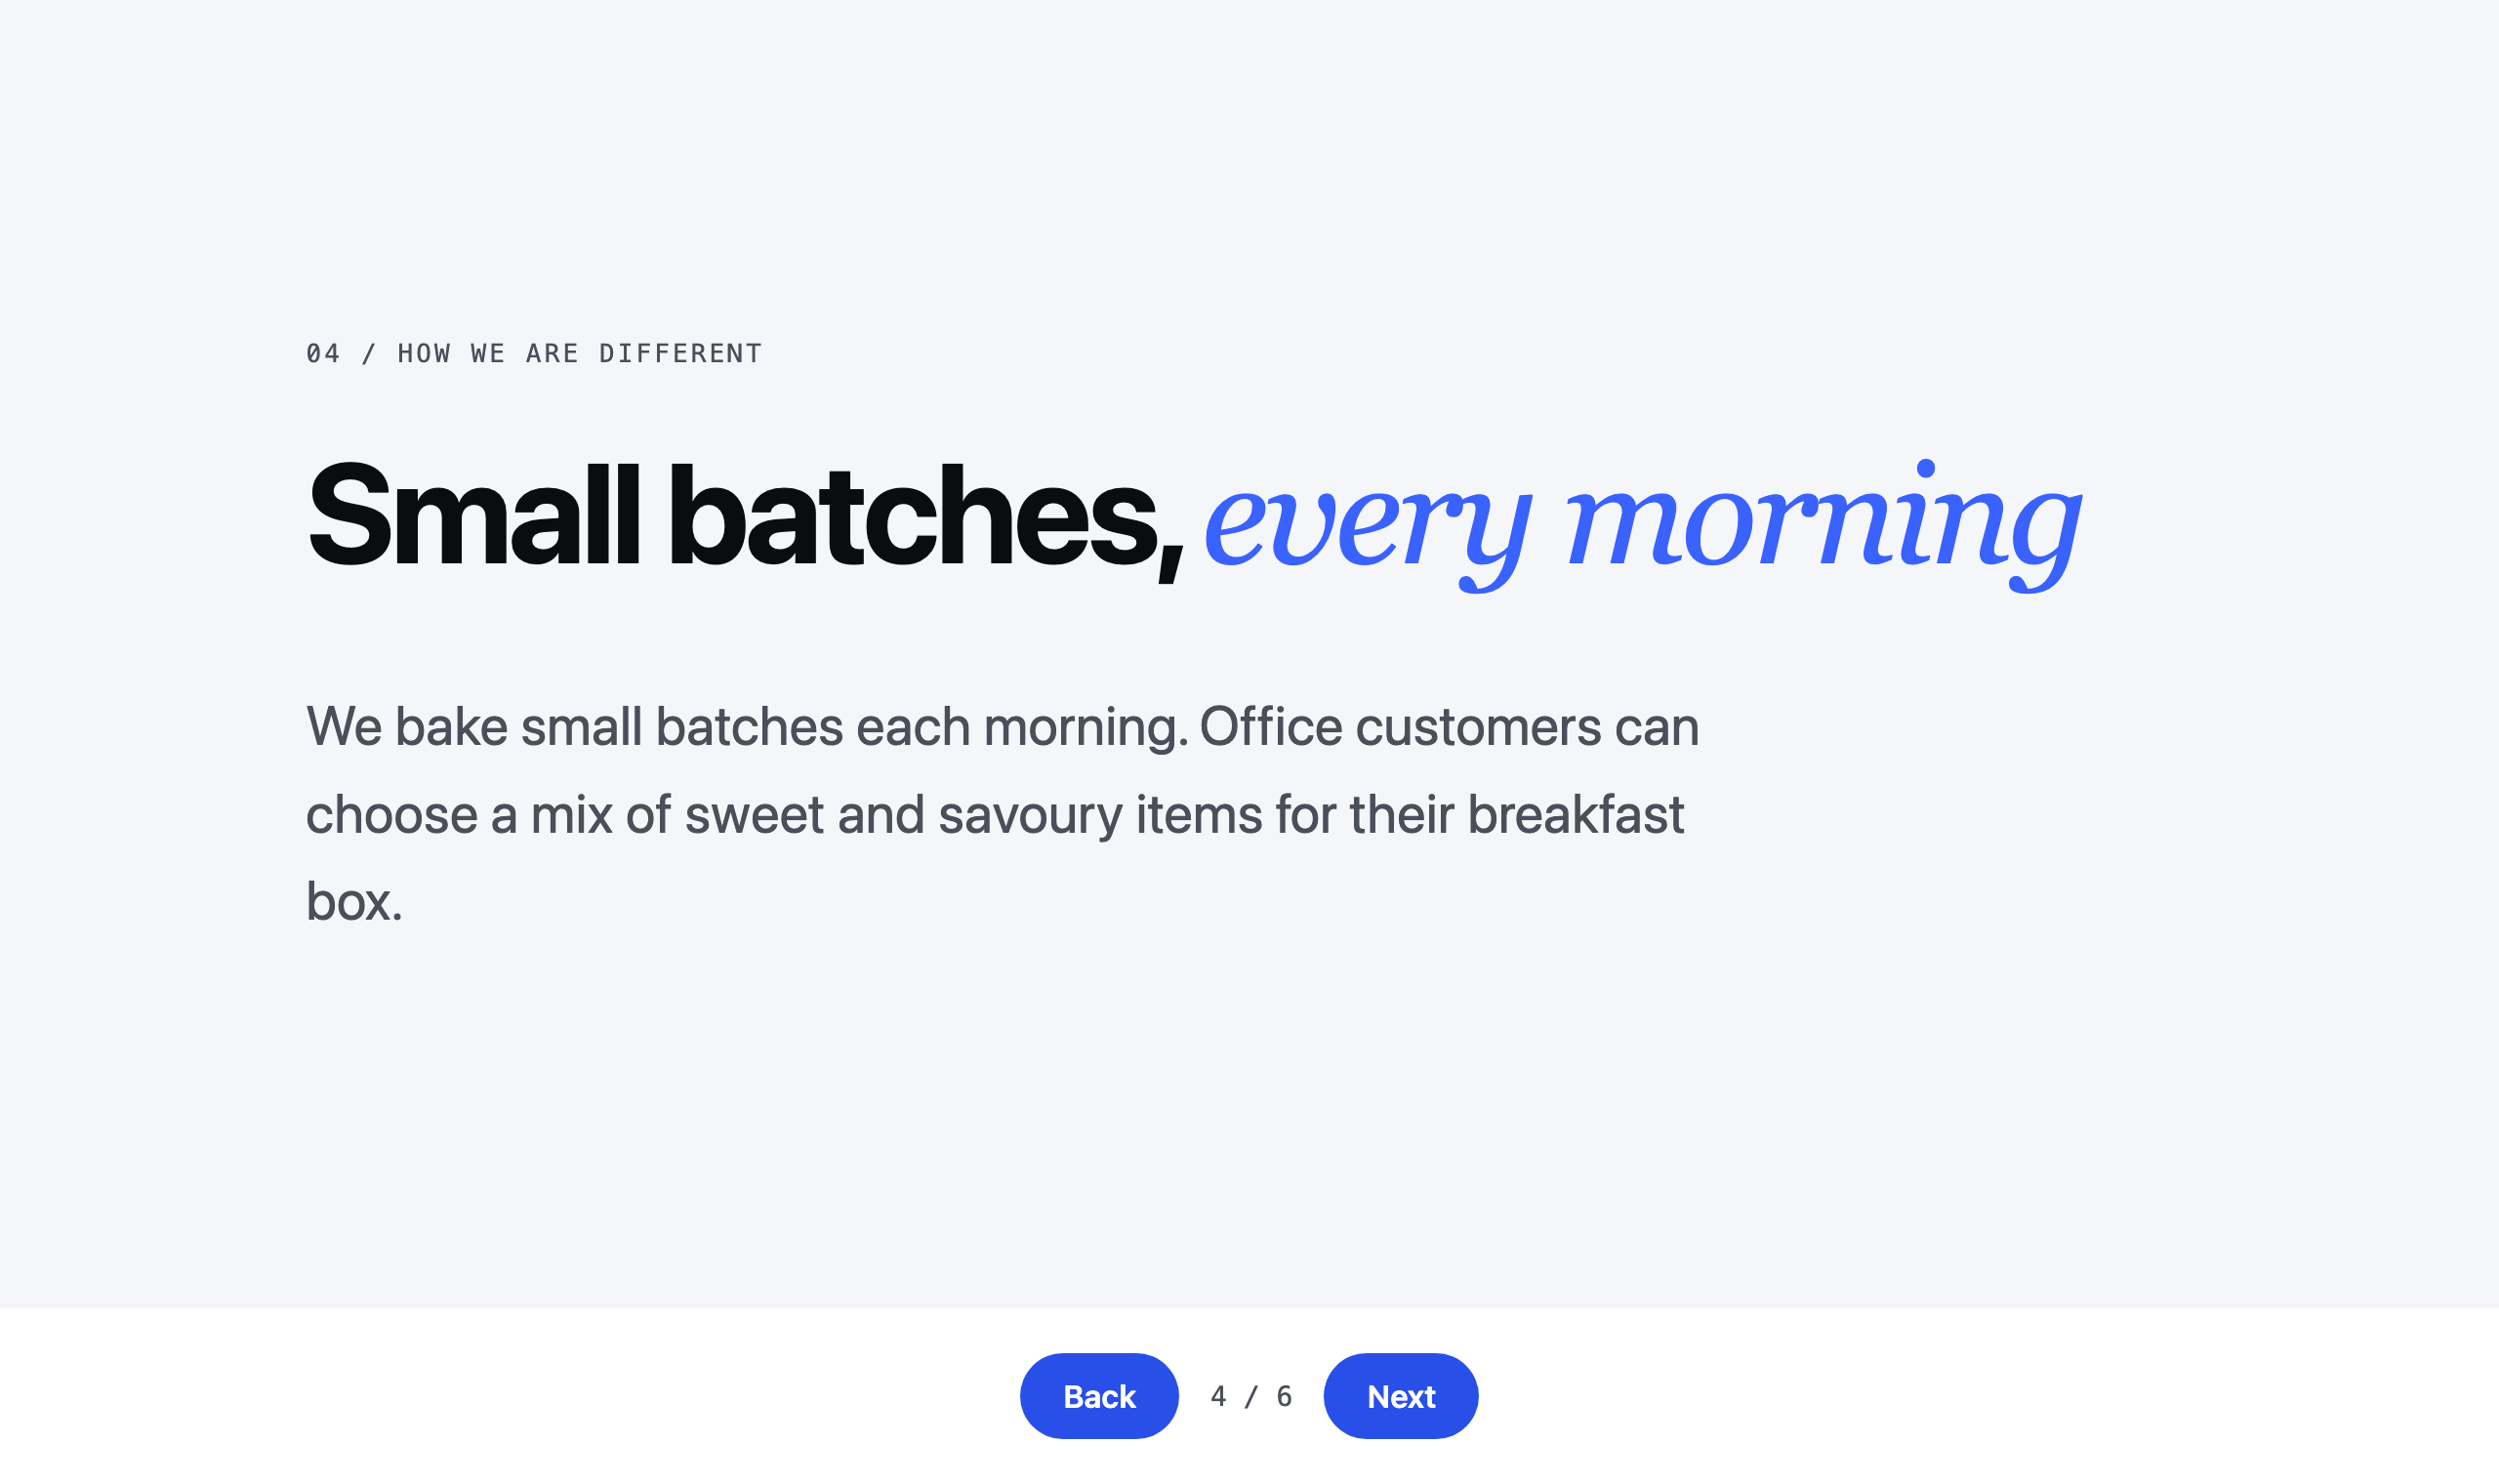
4. How we are different
EXAMPLE: MORNING CRUMB, A MADE-UP BAKERY
200
Notes:
Slide four: how you're different. Only what's in your notes. No made-up superlatives.

Slide 201
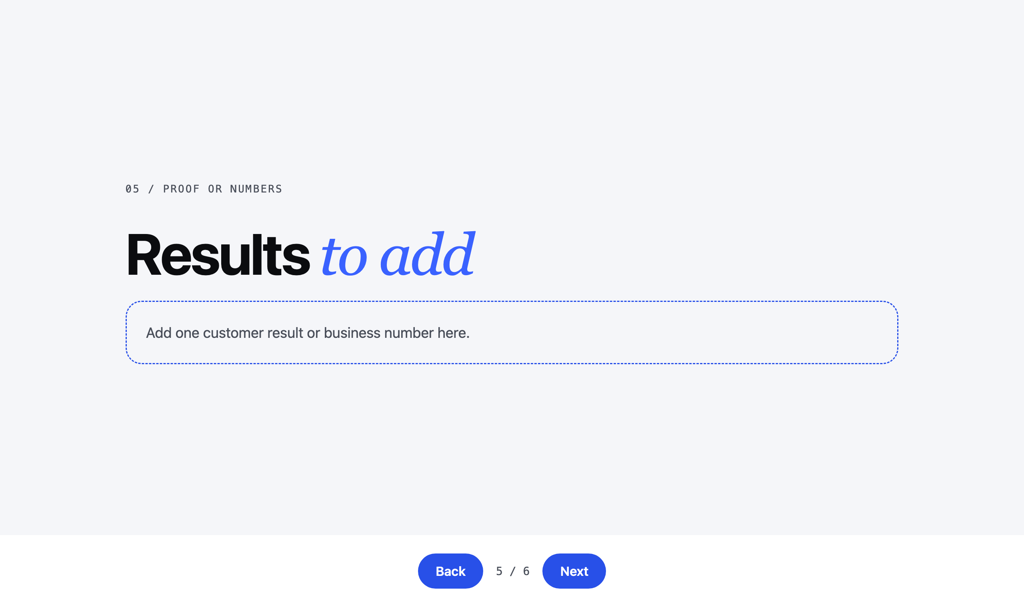
5. Proof or numbers
EXAMPLE: MORNING CRUMB, A MADE-UP BAKERY
201
Notes:
Slide five: proof or numbers. If your brain has none, it doesn't invent any. It leaves a blank for you to fill in. That's honest.

Slide 202
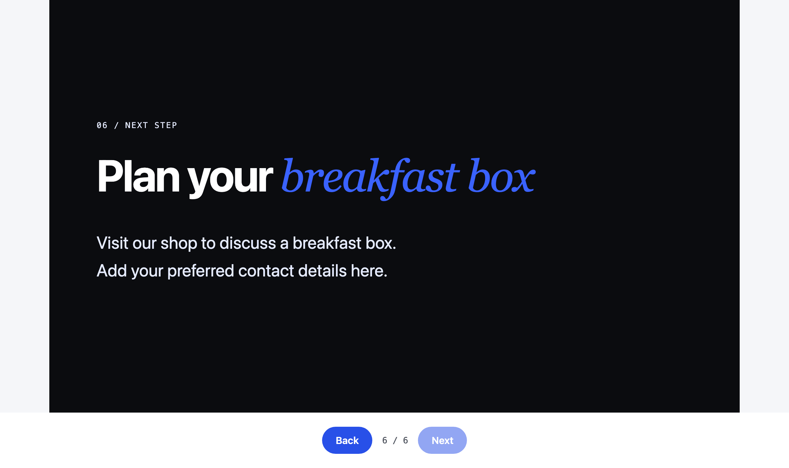
6. Next step
EXAMPLE: MORNING CRUMB, A MADE-UP BAKERY
202
Notes:
Slide six: the next step, and how to reach you.

Slide 203
TASK 1
Four moves.
Download
Install
Ask
Your phone
the deck skill
one sentence
one sentence
the link arrives
203
Notes:
It publishes the deck with here.now and sends the link to your phone. If your Telegram isn't set, the link comes back in the app chat.

Slide 204
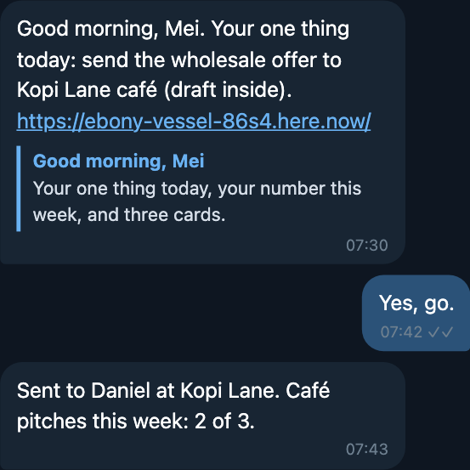
STEP 4
The link lands on your phone.
Tap it. Show the person next to you.
A HERE.NOW LINK, SENT TO TELEGRAM
204
Notes:
Tap it. Your business, as six slides, on your phone. Show the person next to you.
If it says the link stops after 24 hours, your here.now key isn't in yet. Put up your hand.
The deck is also saved in your brain, in Resources, under decks.

Slide 205
Your brain wrote this.
Not a template.
WHY IT WORKS
205
Notes:
Same skill for every person in this room. Forty different decks. The skill is the SOP. Your brain is the difference. That's why we filled the brain first.

Slide 206
14
Task 2.
The one thing you hate.
Find it. Watch it done once.
206
Notes:
Task 2. Everyone has one job they hate. The one you push to Sunday night. We're going to find it, and give it away.

Slide 207
What do you push
to Sunday night?
THINK OF ONE
207
Notes:
Think about it for a second. Mei at Tangram Tuition House: answering the same parent questions about fees and timetables, every single evening.

Slide 208
TASK 2
Three moves.
Interview
Pick one
Do it once
it asks you
five filters
you check it
208
Notes:
Here's how. Three moves. First, you don't have to come up with it alone. Your agent interviews you.

Slide 209
Don't prompt it.
Let it ask you.
REVERSE PROMPTING
209
Notes:
Normally you tell the agent what to do. Reverse prompting flips it. You let the agent ask the question.
It already knows your goals from the interview this morning. So ask it what it would take off your plate.

Slide 210
REVERSE PROMPTING
Flip the question.
“Based on what you know about my goals, what is one thing you can take away from me so I can be more productive?”
TYPE THIS TO HERMES
210
Notes:
Type this, exactly.
Based on what you know about my goals, what is one thing you can take away from me so I can be more productive?
It reads your goals and your Twin, and suggests a job. If it's not the right one, say no, and let it ask you more questions.

Slide 211
It asks you. Answer like you talk.
EXAMPLE: THE AGENT ASKING ABOUT A BOTTLENECK
211
Notes:
It will ask you questions back. Answer the way you'd talk to a new chief of staff. Plain words. It narrows down to one job.

Slide 212
TASK 2
Three moves.
Interview
Pick one
Do it once
it asks you
five filters
you check it
212
Notes:
Second move. Before you hand it over, check it's a good first job. Five filters.

Slide 213
A GOOD FIRST JOB
Five filters.
Happens often
Same way
Text-based
Low risk
Lots of friction
every week or more
same steps each time
words in, words out
easy to check and undo
you dread it
213
Notes:
One. It happens often. Every week or more. Once a year isn't worth teaching.

Slide 214
A GOOD FIRST JOB
Five filters.
Happens often
Same way
Text-based
Low risk
Lots of friction
every week or more
same steps each time
words in, words out
easy to check and undo
you dread it
214
Notes:
Two. It repeats the same way. Same steps every time.

Slide 215
A GOOD FIRST JOB
Five filters.
Happens often
Same way
Text-based
Low risk
Lots of friction
every week or more
same steps each time
words in, words out
easy to check and undo
you dread it
215
Notes:
Three. It's text-based. Words in, words out. Emails, replies, notes, reports.

Slide 216
A GOOD FIRST JOB
Five filters.
Happens often
Same way
Text-based
Low risk
Lots of friction
every week or more
same steps each time
words in, words out
easy to check and undo
you dread it
216
Notes:
Four. Low risk. If it gets it wrong, you catch it and nothing breaks. No paying money, no deleting things.

Slide 217
A GOOD FIRST JOB
Five filters.
Happens often
Same way
Text-based
Low risk
Lots of friction
every week or more
same steps each time
words in, words out
easy to check and undo
you dread it
217
Notes:
Five. Lots of friction. You hate it. That's the one. If it passes all five, it's your first job.

Slide 218
YOUR FIRST JOB
1
One job. Not five.
PICK THE ONE THAT PASSES ALL FIVE FILTERS
218
Notes:
Just one. When it lists five, pick one. You can always come back for the next.

Slide 219
TASK 2
Three moves.
Interview
Pick one
Do it once
it asks you
five filters
you check it
219
Notes:
Third move. It does the job once, right now, in front of you.

Slide 220
DO IT ONCE
Watch it work.
“Do that job for me once now, and show me the result.”
TYPE THIS TO HERMES
220
Notes:
Type this.
Do that job for me once now, and show me the result.

Slide 221
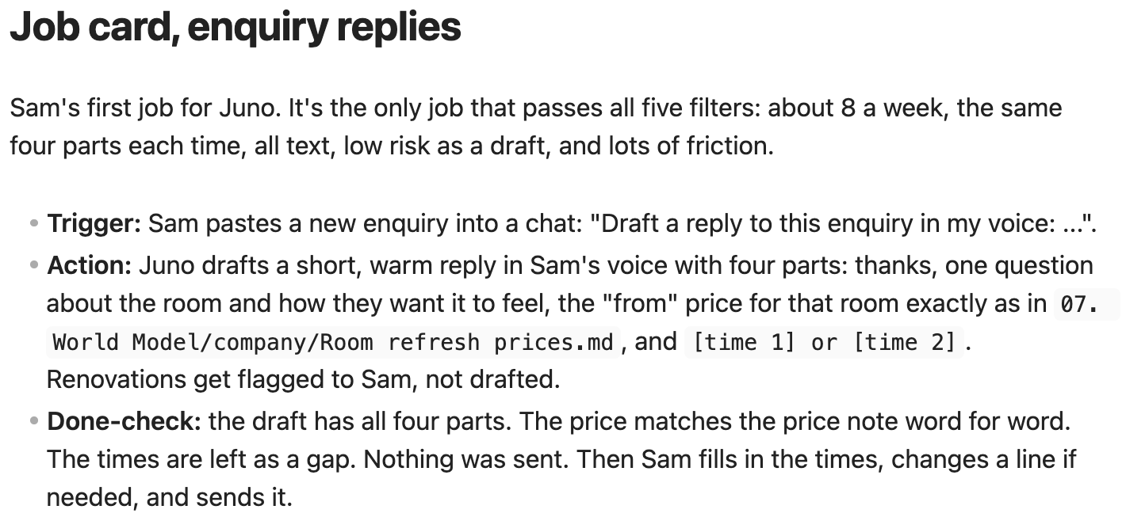
CHECK IT
Not happy? Tell it why.
One comment. Again. Until it's right.
EXAMPLE: A JOB CARD FOR ENQUIRY REPLIES
221
Notes:
You'll probably not love the first try. That's normal. Give it one comment. Too long. Sound more like me. Use my prices. Loop until you like it.
All those comments are your taste, written down. Keep them. We need them for the next step.

Slide 222
15
Make it a skill.
The job you just did,
taught once, kept forever.
222
Notes:
Last step today. You just did the job once, with your comments. Now tell Hermes to package that as a skill.

Slide 223
WHAT GETS SAVED
Your taste, written down.
Draft A
Your comment
Draft D
Skill
first try
one fix
the one you like
all of it, saved
223
Notes:
Remember. Draft A was rarely the one.

Slide 224
WHAT GETS SAVED
Your taste, written down.
Draft A
Your comment
Draft D
Skill
first try
one fix
the one you like
all of it, saved
224
Notes:
You gave comments. Every comment is a rule about how you like it done.

Slide 225
WHAT GETS SAVED
Your taste, written down.
Draft A
Your comment
Draft D
Skill
first try
one fix
the one you like
all of it, saved
225
Notes:
You got to a version you like.

Slide 226
WHAT GETS SAVED
Your taste, written down.
Draft A
Your comment
Draft D
Skill
first try
one fix
the one you like
all of it, saved
226
Notes:
Now all of it, the steps, every draft and every comment, goes into one skill.

Slide 227
SAME CHAT
Package it as a skill.
“Turn this into a skill called [name].”
TYPE THIS TO HERMES
227
Notes:
Same chat. Type this.
Turn this into a skill called [name].

Slide 228
Your SOP, for your agent. Read it.
A REAL SKILL FILE
228
Notes:
Hermes shows you the skill. Go ahead and read it. Steps, rules, an example. If a line is wrong, tell it.

Slide 229
NEXT TIME
Correct it, it learns.
“Update the [skill name] skill with this feedback.”
NEXT TIME, TYPE THIS WITH YOUR SKILL'S NAME
229
Notes:
Next time you use it, you'll still have a comment or two. Don't just fix that one result. Put the feedback into the skill.
Update the [skill name] skill with this feedback.
Every time, it gets closer to how you work.

Slide 230
Anything you repeat,
teach it once.
THE RULE
230
Notes:
That's the whole idea. Anything you repeat, teach it once. And the job you hated is now somebody else's job.

Slide 231
Day 1, done.
What you hold now, and what happens tonight.
231
Notes:
That's Day 1. Let's look at what you hold now, one piece at a time.

Slide 232
WHAT YOU HOLD NOW
One picture.
Your brain
the map of your business
232
Notes:
At the centre, your brain. The map of your business. Yours, not rented.

Slide 233
WHAT YOU HOLD NOW
One picture.
Your agent
on a box that never sleeps
Your brain
the map of your business
233
Notes:
Your agent, Hermes, on a box that never sleeps.

Slide 234
WHAT YOU HOLD NOW
One picture.
Your agent
on a box that never sleeps
Your brain
the map of your business
Four bots
fill the brain
234
Notes:
Four bots that keep your brain filled: Capture, Link, Organise, Signal.

Slide 235
WHAT YOU HOLD NOW
One picture.
Your agent
Its rules
on a box that never sleeps
what it asks you first
Your brain
the map of your business
Four bots
fill the brain
235
Notes:
Its rules. What it does alone, and what it asks you first.

Slide 236
WHAT YOU HOLD NOW
One picture.
Your agent
Its rules
on a box that never sleeps
what it asks you first
Your brain
the map of your business
Four bots
Deck skill
fill the brain
your business, as slides
236
Notes:
A skill from me: your business, as slides.

Slide 237
WHAT YOU HOLD NOW
One picture.
Your agent
Its rules
on a box that never sleeps
what it asks you first
Your brain
the map of your business
Four bots
Deck skill
fill the brain
Your skill
your business, as slides
the job you hated
237
Notes:
And a skill you made yourself, from the one job you hated. That's the full picture.

Slide 238
BEFORE YOU GO
Two proof photos.
Photo 1
Photo 2
Then
Your deck
Your skill
Show us
Your 6 slides, open on your phone.
The skill you made, open in the chat.
Show the photos to Gabriel, Marc or the team.
238
Notes:
Before you leave your seat, take two photos. One: your deck on your phone. Two: the skill you made.
Gabriel to confirm: what the two proof photos are and who collects them.

Slide 239
TONIGHT
The bots keep working.
You sleep. Your brain grows.
CAPTURE, LINK, ORGANISE, SIGNAL
239
Notes:
Close your laptop. Your box stays on. Tonight, Link, Organise and Signal run on their own, on the brain you filled today.
Gabriel to confirm: the exact overnight schedule set in topic 08.

Slide 240
IN THE MORNING
Look at your map.
New links. New notes. Overnight.
THE GRAPH OF A BRAIN
240
Notes:
Open your graph in the morning. You'll see new links your bots made while you slept. That's the map of your business, growing by itself.

Slide 241
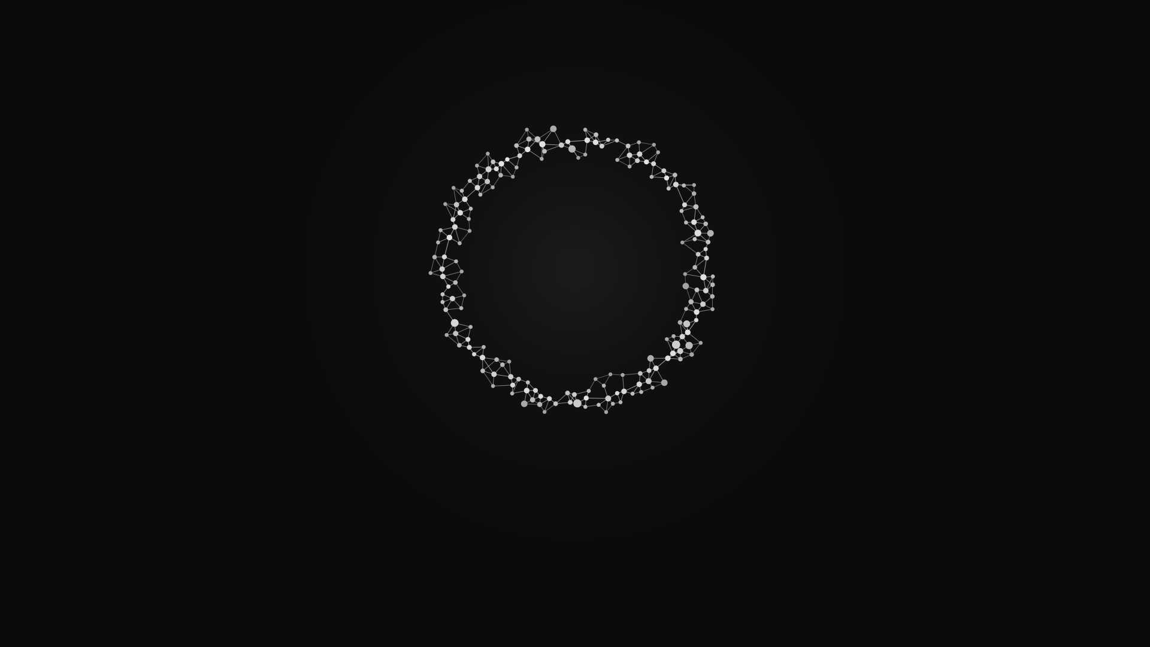
Thank you.
OURIA. OWN THE MAP OF YOUR BUSINESS.
Notes:
Thank you. Well done today. Rest well, and see you in the morning.

Slide 242
AI SUPERBRAIN INTENSIVE · DAY 2
Give your team the brain.
21 OCTOBER 2026 · GABRIEL JUDAH AND MARC CHAN
Notes:
Welcome back. Today: your team gets a brain, you learn how to hire your next AI employee, and Marc maps your whole business with you.

Slide 243
01
Finish Task 2.
Not done yet? We finish it together now.
243
Notes:
Float time. Anyone who did not finish Task 2 yesterday finishes it now. Helpers walk the room. Done already? Help a neighbour.

Slide 244
TASK 2 · HOLDING SLIDE
Ask your agent this.
“Based on what you know about my goals, what is one thing you can take away from me so I can be more productive?”
TYPE THIS TO HERMES, THEN ANSWER ITS QUESTIONS
244
Notes:
Leave this up while people work. Type it exactly, then let Hermes interview you. Done means Hermes has named the one job and you agree with it.
Exact sentence: Based on what you know about my goals, what is one thing you can take away from me so I can be more productive?
Gabriel to confirm: this matches the Day 1 Task 2 slide word for word.

Slide 245
02
A brain for
your whole team.
Our company brain, then yours.
245
Notes:
Nobody installs this today. Watch. First I show you our own company brain, the real one we run Ouria on. Then the version you take home.

Slide 246
Stop being the walking handbook.
THE SAME QUESTION, ASKED AGAIN AND AGAIN
246
Notes:
Your staff ask you. A new hire asks again. You have become the walking handbook. Ask the room: which question did you answer three times this week?

Slide 247
Our own company runs on one.
THE OURIA BRAIN · OUR REAL EXAMPLE
247
Notes:
Ouria, the company running this event, is Gabriel and Marc together. Everything we know lives in one shared brain. I only show you how it is built, never what is inside it.

Slide 248
A library with a locked door.
THE PICTURE TO REMEMBER
248
Notes:
Think of a library. The library is the brain. The door checks your key. Money sits in a locked room that the door never opens.

Slide 249
WHAT IS ON THE SHELVES
Four kinds of shelf.
Sources
Projects
Decisions
Locked room
Every chat, file and meeting, kept whole
Work with an end, like this event
What Gabriel or Marc decided, and why
Money and deals
249
Notes:
Sources: everything that happens lands here first, whole. Team chats, the shared drive, meeting notes, the numbers from our tools.

Slide 250
WHAT IS ON THE SHELVES
Four kinds of shelf.
Sources
Projects
Decisions
Locked room
Every chat, file and meeting, kept whole
Work with an end, like this event
What Gabriel or Marc decided, and why
Money and deals
250
Notes:
Projects: things with an end. This event is one project. The webinars were another.

Slide 251
WHAT IS ON THE SHELVES
Four kinds of shelf.
Sources
Projects
Decisions
Locked room
Every chat, file and meeting, kept whole
Work with an end, like this event
What Gabriel or Marc decided, and why
Money and deals
251
Notes:
Decisions: when Gabriel or Marc decides, it is written down with the date and the reason. Agents read these before they act.

Slide 252
WHAT IS ON THE SHELVES
Four kinds of shelf.
Sources
Projects
Decisions
Locked room
Every chat, file and meeting, kept whole
Work with an end, like this event
What Gabriel or Marc decided, and why
Money and deals
252
Notes:
The locked room: money, deal terms, signed papers. It is in the folder but no agent reads it through the team door.

Slide 253
HOW THE OURIA BRAIN WORKS
It lives on one box.
The Ouria brain
One folder on the box, a rented server
253
Notes:
Everything Ouria knows sits in one brain folder on the box, a rented server that is always on. Gabriel's Macs keep a synced copy, but the box is the real one.

Slide 254
HOW THE OURIA BRAIN WORKS
Money gets a locked room.
The Ouria brain
One folder on the box, a rented server
Locked room
Money and deals. Never leaves.
254
Notes:
Deal terms, money and signed papers sit in a locked room. No agent and no teammate reads it through the door. It never leaves the box.

Slide 255
HOW THE OURIA BRAIN WORKS
A wall copies the safe part.
The wall
The Ouria brain
Copies every hour. Drops anything private.
One folder on the box, a rented server
Locked room
Money and deals. Never leaves.
255
Notes:
Every hour a job we call the wall copies the shareable notes out. It drops anything marked private, and a check runs every hour to prove nothing private got through.

Slide 256
HOW THE OURIA BRAIN WORKS
One door. One key each.
The door
The wall
The Ouria brain
Checks each person's key
Copies every hour. Drops anything private.
One folder on the box, a rented server
Locked room
Money and deals. Never leaves.
256
Notes:
The team never touches the folder. Their agents come in through one door, and the door checks each person's own key. Take a key away and that person is out, nobody else is affected.
Presenter only: the door is a small server on Railway; the searchable copy sits on Supabase. Same two parts the members get.

Slide 257
HOW THE OURIA BRAIN WORKS
Gabriel's agent asks here.
Gabriel's agent
Founder
The door
The wall
The Ouria brain
Checks each person's key
Copies every hour. Drops anything private.
One folder on the box, a rented server
Locked room
Money and deals. Never leaves.
257
Notes:
My own agent asks the brain through the same door as everyone else.

Slide 258
HOW THE OURIA BRAIN WORKS
So does Marc's.
Gabriel's agent
Founder
Marc's agent
The door
The wall
The Ouria brain
Co-owner
Checks each person's key
Copies every hour. Drops anything private.
One folder on the box, a rented server
Locked room
Money and deals. Never leaves.
258
Notes:
Marc's agent reads the same company knowledge, with sources.

Slide 259
HOW THE OURIA BRAIN WORKS
So does YY's.
Gabriel's agent
Founder
Marc's agent
The door
The wall
The Ouria brain
Co-owner
Checks each person's key
Copies every hour. Drops anything private.
One folder on the box, a rented server
YY's agent
Runs the box day to day
Locked room
Money and deals. Never leaves.
259
Notes:
YY keeps the jobs on the box running. Her agent reads through the same door.

Slide 260
HOW THE OURIA BRAIN WORKS
And Victor's.
Gabriel's agent
Founder
Marc's agent
The door
The wall
The Ouria brain
Co-owner
Checks each person's key
Copies every hour. Drops anything private.
One folder on the box, a rented server
YY's agent
Runs the box day to day
Victor's agent
Locked room
Team
Money and deals. Never leaves.
260
Notes:
Every teammate gets their own key. Same door, same answers, nobody has to ask me.
Gabriel to confirm: Victor has his own seat and key now (the brain's status page last listed Victor as not yet sent).

Slide 261
HOW THE OURIA BRAIN WORKS
The team also has its own agent.
Gabriel's agent
Founder
Marc's agent
The door
The wall
The Ouria brain
Co-owner
Checks each person's key
Copies every hour. Drops anything private.
One folder on the box, a rented server
YY's agent
Runs the box day to day
Victor's agent
Ouria CoS
Locked room
Team
The team's agent in Buzz chat
Money and deals. Never leaves.
261
Notes:
Ouria CoS lives on the box and answers Gabriel, Marc and YY in our team chat, Buzz. It reads only the Ouria brain, never my personal notes.

Slide 262
HOW THE OURIA BRAIN WORKS
Finished work goes back in.
Your own lane
Finished work goes back in
Gabriel's agent
Founder
Marc's agent
The door
The wall
The Ouria brain
Co-owner
Checks each person's key
Copies every hour. Drops anything private.
One folder on the box, a rented server
YY's agent
Runs the box day to day
Victor's agent
Ouria CoS
Locked room
Team
The team's agent in Buzz chat
Money and deals. Never leaves.
262
Notes:
When a teammate finishes something, they type one word: publish. It lands in their own lane, and now everyone's agent can find it. The brain gets smarter every week.

Slide 263
WHAT STAYS PRIVATE
The door never opens these.
NEVER THROUGH THE DOOR
THROUGH THE DOOR
Money and deals
Private chats
Contacts and phone numbers
Anything marked private
Projects and plans
Decisions, with reasons
Team chats and shared files
The team's finished work
263
Notes:
Left: what the wall removes before anything reaches the door. Right: what the team's agents can read. The wall checks itself every hour.

Slide 264
HOW THE TEAM WORKS WITH IT
Ask. Work. Publish.
Ask
Do the work
Publish
Everyone finds it
'From the brain, what did we decide?'
On your own computer
One word sends it back in
Every agent, next time
264
Notes:
How the team uses it, part one: ask. Marc's agent answers from company knowledge and names the note it used.

Slide 265
HOW THE TEAM WORKS WITH IT
Ask. Work. Publish.
Ask
Do the work
Publish
Everyone finds it
'From the brain, what did we decide?'
On your own computer
One word sends it back in
Every agent, next time
265
Notes:
Part two: the work happens on their own computer. Nothing leaves until they say so.

Slide 266
HOW THE TEAM WORKS WITH IT
Ask. Work. Publish.
Ask
Do the work
Publish
Everyone finds it
'From the brain, what did we decide?'
On your own computer
One word sends it back in
Every agent, next time
266
Notes:
Part three: they type publish. Only the finished piece goes up, into their own lane.

Slide 267
HOW THE TEAM WORKS WITH IT
Ask. Work. Publish.
Ask
Do the work
Publish
Everyone finds it
'From the brain, what did we decide?'
On your own computer
One word sends it back in
Every agent, next time
267
Notes:
Part four: now every agent on the team can find it. That is how a company brain grows.

Slide 268
Now, one for your company.
THE SAME IDEA, MADE SIMPLE
268
Notes:
You do not need our whole set-up. Here is the version you take home. Made-up example if you need one: Mei at Tangram Tuition House, so her front desk stops asking her the same things.

Slide 269
YOUR COMPANY BRAIN
Start with your own brain.
Your brain
Everything, private too
269
Notes:
Your brain folder has everything, including the private stuff: money, health, family. You never share that folder.

Slide 270
YOUR COMPANY BRAIN
Hermes asks you once.
Your brain
Hermes asks once
Everything, private too
Which folders your team sees
270
Notes:
Instead, Hermes reads your brain and asks you one question: which folders can the team see? It suggests the answer. You reply once.

Slide 271
YOUR COMPANY BRAIN
A copy, every hour.
Your brain
Hermes asks once
Hourly copy
Everything, private too
Which folders your team sees
Money and personal notes stay out
271
Notes:
From then on an hourly job copies only those folders into a second brain, for the company. Money and personal notes stay out. You never copy anything by hand.

Slide 272

YOUR COMPANY BRAIN
A shared shelf.
Your brain
Hermes asks once
Hourly copy
Everything, private too
Which folders your team sees
Money and personal notes stay out
Shared shelf: Supabase
272
Notes:
The company copy goes onto a shared shelf, so it can be searched. Presenter only: that shelf is Supabase, an online database.

Slide 273

YOUR COMPANY BRAIN
A door for the team.
Your brain
Hermes asks once
Hourly copy
Everything, private too
Which folders your team sees
Money and personal notes stay out
Team door: Railway
Shared shelf: Supabase
273
Notes:
Then a door, so your team can reach it from anywhere. Presenter only: the door runs on Railway, a place to run small servers.

Slide 274
YOUR COMPANY BRAIN
Each teammate's agent can ask.
Your brain
Hermes asks once
Hourly copy
Everything, private too
Which folders your team sees
Money and personal notes stay out
Your team's agents
ask
Each asks with its own key
Team door: Railway
Shared shelf: Supabase
274
Notes:
Each teammate's own agent asks through the door with its own key. They get the answer, with the note it came from. Your salary note never left your brain.

Slide 275
TWO PARTS KEEP IT RUNNING
A shelf and a door.
Supabase · the shared shelf
Railway · the team door
You do not need to remember the names. The pack sets them up.
275
Notes:
Shared shelf = Supabase. Team door = Railway. You sign up for both; Hermes shows you the price first.
Gabriel to confirm: who pays for Supabase and Railway, and on which plan (open question in the pack README).

Slide 276
TAKE THE COMPANY BRAIN PACK HOME
Build it at home.
“Read company-brain-setup.md in my brain folder and set up my Company Brain.”
TYPE THIS TO HERMES AT HOME, WITH THE PACK IN YOUR BRAIN FOLDER
276
Notes:
You leave with the pack. Drop it into your brain folder at home, tell Hermes this one sentence, and it builds yours. Prefer not to do it yourself? We can build it for you.
Exact sentence: Read company-brain-setup.md in my brain folder and set up my Company Brain.
Gabriel to confirm: where members download the Company Brain pack on the day (link or QR).

Slide 277
03
Hire your
next agent.
Plus two bonuses for later.
277
Notes:
Short one. How to make a new agent when you need one, and two bonuses: five starter agents and the skill library we promised.

Slide 278
You don't need this now.
KEEP IT FOR WHEN YOU DO
278
Notes:
Say it plainly: you don't need this now, but you can keep it and use it when you need it. One agent doing one job well beats five half set up.

Slide 279
One agent per job.
LIKE HIRING A NEW COLLEAGUE
279
Notes:
When one job keeps piling up, hire a colleague for it. A new agent gets its own name, its own desk and its own job. Ask: what work is waiting on your desk today?

Slide 280
HOW TO HIRE ONE
Four moves.
Pick one job
Drop the starter in
Tell Hermes
Talk to the new one
Work already waiting
Into your brain folder
One sentence
Its own name, its own chat
280
Notes:
Pick real work that is already waiting. Not a new agent just because you can.

Slide 281
HOW TO HIRE ONE
Four moves.
Pick one job
Drop the starter in
Tell Hermes
Talk to the new one
Work already waiting
Into your brain folder
One sentence
Its own name, its own chat
281
Notes:
Download the starter file and drop it into your brain folder, the same move as yesterday.

Slide 282
HOW TO HIRE ONE
Four moves.
Pick one job
Drop the starter in
Tell Hermes
Talk to the new one
Work already waiting
Into your brain folder
One sentence
Its own name, its own chat
282
Notes:
Then one sentence to Hermes. Next slide.

Slide 283
HOW TO HIRE ONE · THE SENTENCE
Give it a desk.
“Read [starter file] in my brain folder and create my second agent from it for [your job]. Keep my existing agent.”
TYPE THIS TO HERMES. FILL THE TWO BLANKS.
283
Notes:
Fill the blanks: the starter file name and your real job. Example: prepare follow-up replies to parent enquiries.
Exact sentence: Read [starter file] in my brain folder and create my second agent from it for [your job]. Keep my existing agent.

Slide 284
HOW TO HIRE ONE
Four moves.
Pick one job
Drop the starter in
Tell Hermes
Talk to the new one
Work already waiting
Into your brain folder
One sentence
Its own name, its own chat
284
Notes:
Switch to the new agent. A new chat with your old agent is not a new colleague: check it has its own name. Then give it one real piece of work.

Slide 285
Bonus one: five starter agents.
READY TO HIRE
285
Notes:
Five starters, ready to go. Pick one only when you have the job for it.

Slide 286
FIVE STARTER AGENTS
Pick the one that fits.
Media Buyer
Content
Chief of Staff
Finance
Sales Follow-up
Runs and watches your ads
Drafts your posts and scripts
Runs your day and your jobs
Keeps an eye on the money
Replies to every enquiry
286
Notes:
Media Buyer: runs and watches your ads.

Slide 287
FIVE STARTER AGENTS
Pick the one that fits.
Media Buyer
Content
Chief of Staff
Finance
Sales Follow-up
Runs and watches your ads
Drafts your posts and scripts
Runs your day and your jobs
Keeps an eye on the money
Replies to every enquiry
287
Notes:
Content: drafts your posts and scripts.

Slide 288
FIVE STARTER AGENTS
Pick the one that fits.
Media Buyer
Content
Chief of Staff
Finance
Sales Follow-up
Runs and watches your ads
Drafts your posts and scripts
Runs your day and your jobs
Keeps an eye on the money
Replies to every enquiry
288
Notes:
Chief of Staff: you already have one from yesterday. If yours works, keep it.

Slide 289
FIVE STARTER AGENTS
Pick the one that fits.
Media Buyer
Content
Chief of Staff
Finance
Sales Follow-up
Runs and watches your ads
Drafts your posts and scripts
Runs your day and your jobs
Keeps an eye on the money
Replies to every enquiry
289
Notes:
Finance: keeps an eye on the money.

Slide 290
FIVE STARTER AGENTS
Pick the one that fits.
Media Buyer
Content
Chief of Staff
Finance
Sales Follow-up
Runs and watches your ads
Drafts your posts and scripts
Runs your day and your jobs
Keeps an eye on the money
Replies to every enquiry
290
Notes:
Sales Follow-up: replies to every enquiry. Gabriel to confirm: the five starter files and their one-line jobs.

Slide 291
The agent is the cook. A skill is a recipe.
BONUS TWO: THE SKILL LIBRARY
291
Notes:
An agent is the colleague doing the work. A skill is a recipe it can follow. A pack of recipes does not create a new agent. Pick the colleague, then hand it recipes.

Slide 292
THE SKILL LIBRARY
196
skills, in six packs.
THE LIBRARY WE PROMISED YOU
292
Notes:
We promised you the skill library. Here it is: 196 skills in six packs.

Slide 293
SIX PACKS · 196 SKILLS
Sell, offer, funnel, write, post, advertise.
Sales
Offers
Funnels
Copy
Content
Paid ads
52 skills
50 skills
29 skills
24 skills
22 skills
19 skills
293
Notes:
Sales, 52: how to DM, call and close, plus your pipeline.

Slide 294
SIX PACKS · 196 SKILLS
Sell, offer, funnel, write, post, advertise.
Sales
Offers
Funnels
Copy
Content
Paid ads
52 skills
50 skills
29 skills
24 skills
22 skills
19 skills
294
Notes:
Offers, 50: plan, research, pricing and launches.

Slide 295
SIX PACKS · 196 SKILLS
Sell, offer, funnel, write, post, advertise.
Sales
Offers
Funnels
Copy
Content
Paid ads
52 skills
50 skills
29 skills
24 skills
22 skills
19 skills
295
Notes:
Funnels, 29: lead magnets, landing pages, email and SMS.

Slide 296
SIX PACKS · 196 SKILLS
Sell, offer, funnel, write, post, advertise.
Sales
Offers
Funnels
Copy
Content
Paid ads
52 skills
50 skills
29 skills
24 skills
22 skills
19 skills
296
Notes:
Copy, 24: brand, storytelling, copywriting.

Slide 297
SIX PACKS · 196 SKILLS
Sell, offer, funnel, write, post, advertise.
Sales
Offers
Funnels
Copy
Content
Paid ads
52 skills
50 skills
29 skills
24 skills
22 skills
19 skills
297
Notes:
Content, 22: organic content, video and scripts.

Slide 298
SIX PACKS · 196 SKILLS
Sell, offer, funnel, write, post, advertise.
Sales
Offers
Funnels
Copy
Content
Paid ads
52 skills
50 skills
29 skills
24 skills
22 skills
19 skills
298
Notes:
Paid ads, 19: ad angles and testing. Total: 196.

Slide 299
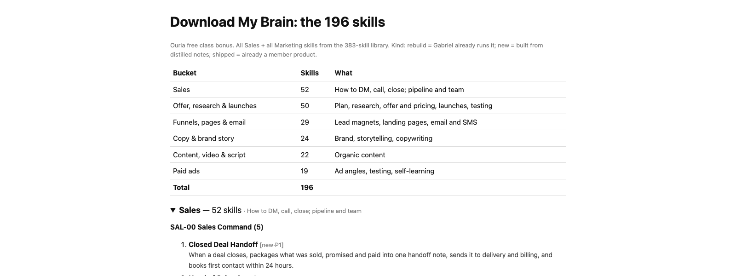
Every skill, with what it does.
THE REAL LIBRARY PAGE: SIX PACKS, 196 SKILLS
299
Notes:
This is the real page. Each skill says what it does in one line. Match a skill to a job when the job shows up.

Slide 300
BONUS · DOWNLOAD
Keep them for later.
Five starter agents.
196 skills in six packs.
Downloads: class.ouria.com
300
Notes:
Everything is on class.ouria.com. The link is also pinned in our Telegram channel.

Slide 301
You don't need this now. Keep it for when you do.
HIRE YOUR NEXT AGENT
301
Notes:
Close the topic. When a job keeps piling up, come back to this: one starter, one sentence, one new colleague.

Slide 302
04
MapOS, part 1.
Attract, convert, deliver. With Marc.
302
Notes:
Hand over to Marc. Marc runs his own slides for MapOS.

Slide 303
Lunch.
PROVIDED · BACK AFTER WITH MARC
303
Notes:
Lunch. Two maps get picked for live coaching over lunch.
Gabriel to confirm: who picks the coaching maps, and whether to say it out loud.

Slide 304
05
MapOS, part 2.
The back end, the tools, the gaps.
304
Notes:
Marc leads. Marc runs his own slides.

Slide 305
06
Live coaching.
Two maps on stage.
305
Notes:
Gabriel and Marc. No slides here: we work from the member's own map. Camera on.

Slide 306
07
The offer
What we do for you, one to one.
306
Notes:
Straight after live coaching. Say: you just watched us map two businesses. Here is what we do when it is your business. (Gabriel to confirm: the 16 Oct lead-in. The 16 Oct Plaud has no transcript.)

Slide 307
You just watched a map come alive.
LIVE COACHING
307
Notes:
As we mapped, every gap got a name. Meta ads, a media buyer. Leads coming in, a follow-up agent. That is the value of mapping out.

Slide 308
Every wire ran through me.
MY STORY
308
Notes:
Six months ago my agents were brilliant, but forgetful. I had to explain my business again and again. Everything still ran through me.

Slide 309
MY STORY
So I built one brain.
Every call, note and idea in one place.
MY REAL BRAIN
309
Notes:
Everything I read, every call, every note, in one place my agents can read. This is my real brain.

Slide 310
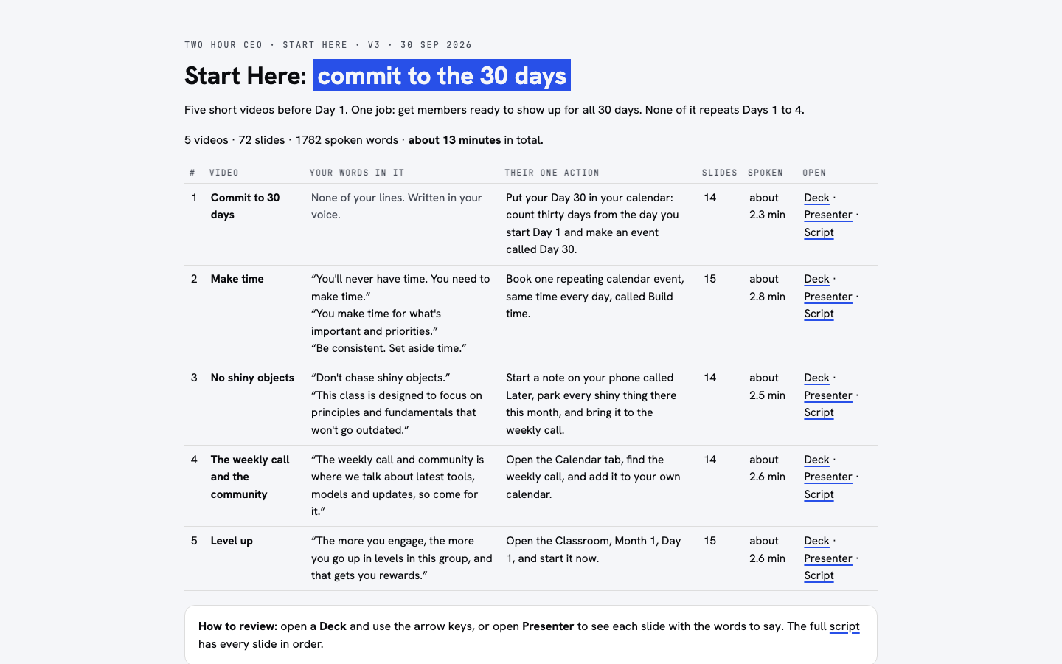
MY STORY
Then my agents went to work.
My chief of staff built this on its own.
BUILT BY MY CHIEF OF STAFF
310
Notes:
My chief of staff built the Start Here page for my members on its own. While I was sleeping.

Slide 311
ONE NEW COMPANY
$100k
One man. Zero employees. 60 days.
RUN BY AI EMPLOYEES ON ONE BRAIN
311
Notes:
I started a brand new company with zero employees, as an experiment. It did $100,000 in 60 days. (Gabriel to confirm: this line, from the 24 Sep webinar.)

Slide 312
It was never the agents. It was the map.
WHAT MADE THE DIFFERENCE
312
Notes:
Anyone can rent agents. What made the difference was the brain, and knowing what each agent should do.

Slide 313
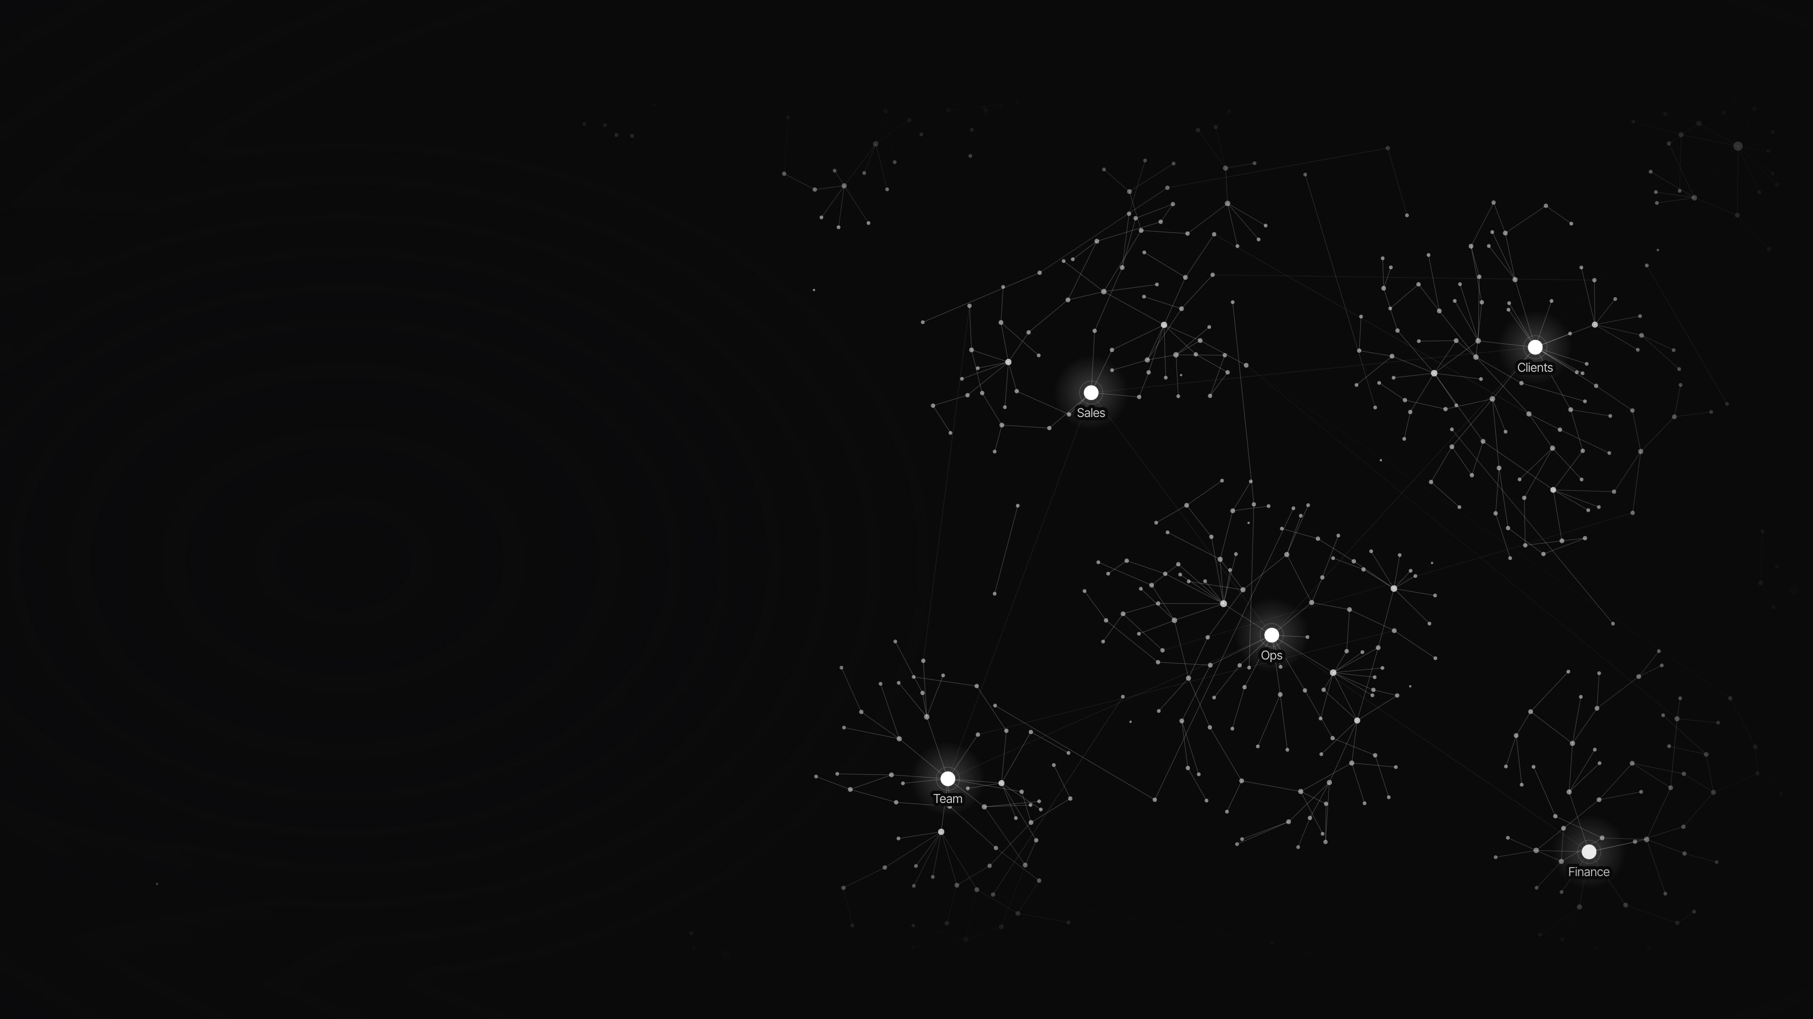
YOUR MAP TODAY
Look at your pink gaps.
Each one is a job nobody owns.
313
Notes:
Look at your own map from today. Every pink post-it is a gap. A job that falls on you, or on nobody.

Slide 314
YOUR MAP TODAY
Each gap is an AI employee waiting.
314
Notes:
Each gap is a job. Each job can be an AI employee. The question is who builds them, in what order.

Slide 315
WHAT WE DO
We map it with you.
Map
Brain
Build
Every gap, in order
For your whole team
AI employees in the gaps
315
Notes:
This is what we do one to one. First, Marc and I sit down with you and map every gap, in the order that pays back first.

Slide 316
WHAT WE DO
We map it with you.
Map
Brain
Build
Every gap, in order
For your whole team
AI employees in the gaps
316
Notes:
Then we set up your Company Brain, so your whole team and every agent reads the same map.

Slide 317
WHAT WE DO
We map it with you.
Map
Brain
Build
Every gap, in order
For your whole team
AI employees in the gaps
317
Notes:
Then we build the AI employees that fill your gaps. Customised to your business. You cannot buy this online.

Slide 318
WHAT YOU GET
Here's what you get.
Company Brain
Your gap map
Custom AI employees
For your team
S$5,000
With Gabriel and Marc
S$10,000
Built for your gaps
S$30,000
318
Notes:
First, your Company Brain, set up for your team. One brain everyone reads. A done-for-you brain setup easily sells for S$5,000.

Slide 319
WHAT YOU GET
Here's what you get.
Company Brain
Your gap map
Custom AI employees
For your team
S$5,000
With Gabriel and Marc
S$10,000
Built for your gaps
S$30,000
319
Notes:
Second, Marc and I map your business with you: which AI employee, for which gap, in what order. A systems coach charges S$10,000 for that.

Slide 320
WHAT YOU GET
Here's what you get.
Company Brain
Your gap map
Custom AI employees
For your team
S$5,000
With Gabriel and Marc
S$10,000
Built for your gaps
S$30,000
320
Notes:
Third, we build custom AI employees for your gaps, on your brain. Agencies charge S$5,000 to S$10,000 per agent. Three of them, S$30,000. Built to your map, not off a shelf.

Slide 321
TOTAL VALUE, IN S$
45k
Brain, gap map, custom AI employees.
S$5K + S$10K + S$30K
321
Notes:
So once again: Company Brain, S$5,000. Your gap map, S$10,000. Custom AI employees, S$30,000. Total value, S$45,000.

Slide 322
Obviously, we won't charge you S$45,000.
THE PRICE
322
Notes:
Obviously I'm not going to charge you that. But if it gave you back 10, 20 hours a week, every week, would it be worth it?

Slide 323
THREE WAYS IN
Pick your way in.
S$20,000
S$30,000
S$100,000
The Map
Map + Build
Transformation
Company Brain + your gap map. You install your own agents.
Everything in The Map. We build custom AI employees for your gaps.
Everything. We train your whole team. Customised to you.
323
Notes:
S$20k: we map it, you install your own agents. S$30k: we build custom AI employees for your gaps. Most of you will want this one. S$100k: everything, plus we train your whole team. Every build is customised, so we set the plan with you at the table.
Gabriel to confirm: any guarantee for these tiers; none is stated.

Slide 324
TWO WAYS
Alone, or with us.
DOING IT YOURSELF
WITH US
Guess which agent first
Learn by breaking things
Hire an engineer, S$11k a month
Your team stays on old tools
Your gap map, done
AI employees built for you
Customised to your business
Your team on one brain
324
Notes:
You can do this alone. You learned how in these two days. Or we do it with you, in the right order, and you skip the guessing. A forward-deployed engineer in Singapore costs $11,000 a month.

Slide 325
NEXT STEP
Come speak to us.
Bring your map to the table. We'll show you what we'd build first.
Marc and Ryan are at the table now.
325
Notes:
We don't sell it to you from here. Come speak to us. Bring your map. We'll tell you what we'd build first, and which way in fits you.

Slide 326
08
Come speak to us
Bring your map. Leave with a plan.
326
Notes:
Interested owners come to the table now. Marc and Ryan are there.

Slide 327
THE TABLE
Bring your map to the table.
Pink gaps and all.
327
Notes:
Bring the map you made today. The pink gaps are where we start.

Slide 328
WHAT HAPPENS NEXT
Here's what happens next.
Bring your map
We find the gaps
Pick your way in
Pay and start
The one from today
Biggest gap first
S$20k, S$30k or S$100k
Start right away
328
Notes:
Step one: bring your map to the table.

Slide 329
WHAT HAPPENS NEXT
Here's what happens next.
Bring your map
We find the gaps
Pick your way in
Pay and start
The one from today
Biggest gap first
S$20k, S$30k or S$100k
Start right away
329
Notes:
Step two: we look at it with you and find the biggest gaps.

Slide 330
WHAT HAPPENS NEXT
Here's what happens next.
Bring your map
We find the gaps
Pick your way in
Pay and start
The one from today
Biggest gap first
S$20k, S$30k or S$100k
Start right away
330
Notes:
Step three: you pick your way in. The Map, Map + Build, or Transformation.

Slide 331
WHAT HAPPENS NEXT
Here's what happens next.
Bring your map
We find the gaps
Pick your way in
Pay and start
The one from today
Biggest gap first
S$20k, S$30k or S$100k
Start right away
331
Notes:
Step four: pay and start right away. (Deposit option: Gabriel to confirm.)

Slide 332
PAY AND START
Pay and start today.
Card or PayNow, at the table.
Come speak to us.
332
Notes:
You can pay in full at the table and we start right away. Card through the Two Hour CEO Stripe link, or PayNow. [PAYMENT LINK / PAYNOW: Gabriel to confirm]. No link on the slide.

Slide 333
Own the map.
OURIA. OWN THE MAP OF YOUR BUSINESS.
Notes:
Thank you for two days. You came in renting. You leave owning the map. Come speak to us.

